Slide 1
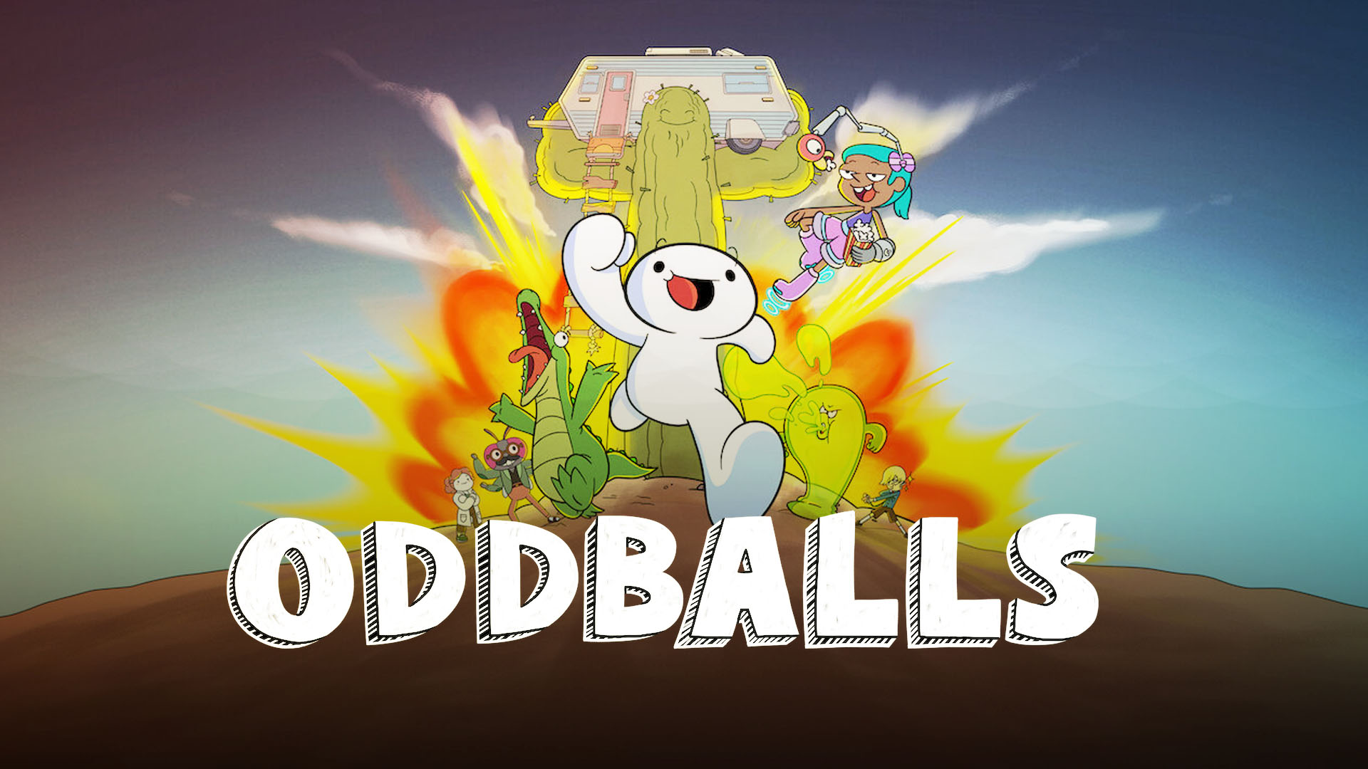
Oddballs
BY MUHANAD

Slide 2
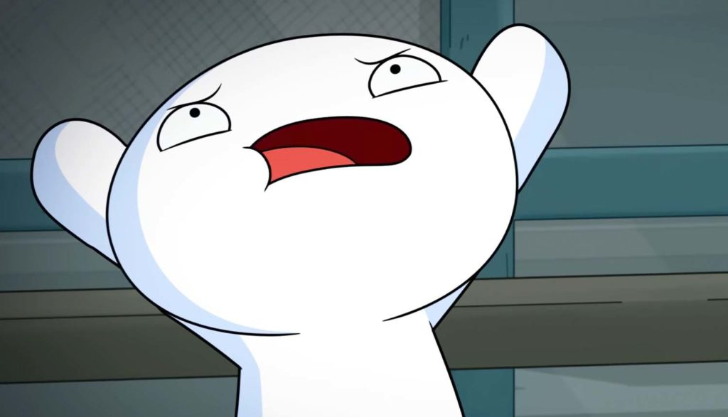
About it
Oddballs will tell the story of James, a bubble-shaped boy, who goes on comedic rants regarding minute and everyday annoyances, often elevating them to extreme levels, He is joined by his crocodile friend Max and a girl who claims to be plucked from the future, Echo.

Slide 3
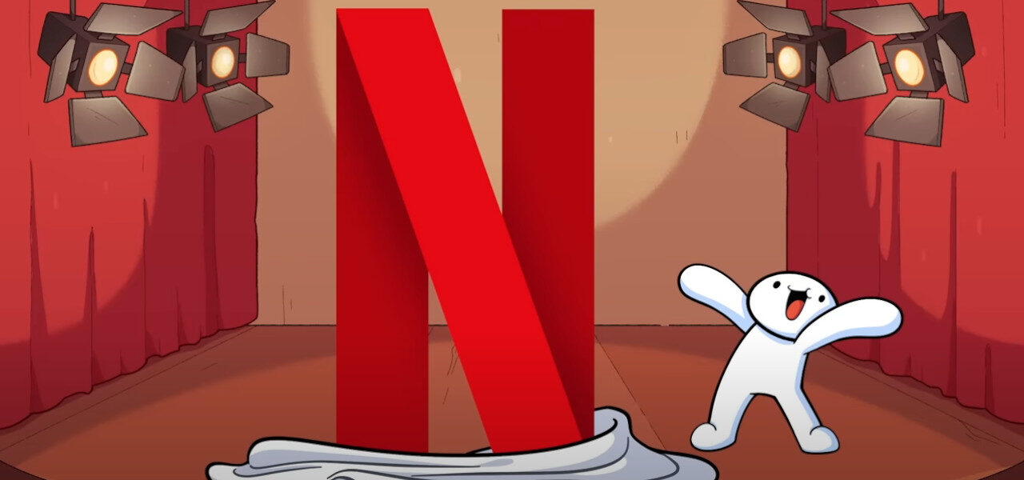
James
He is a bubble-shaped teenage boy who enjoys insane adventures and frequently goes on rants about anything, including subjects like toasters, trophies and line cutting.

Slide 4
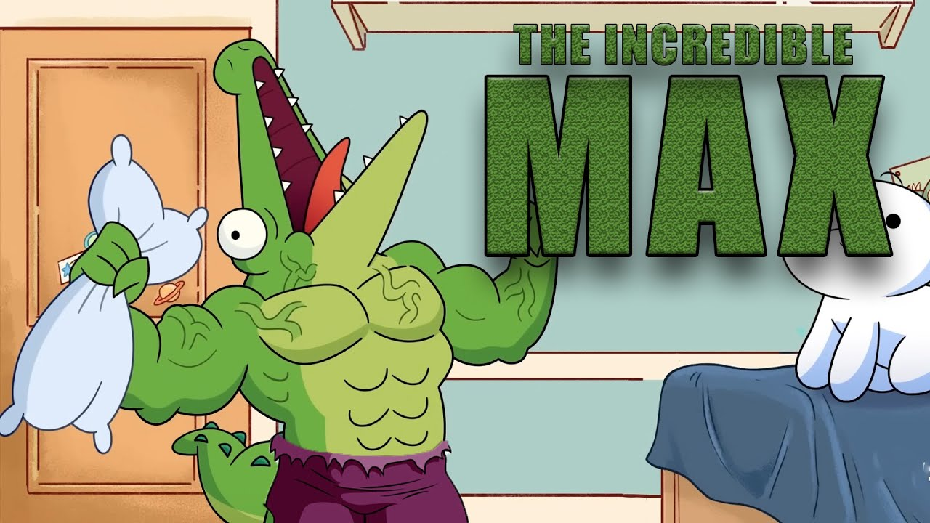
Max
He is a failed genetic experiment gifted with human intelligence and a voice.

Slide 5
Echo
She is from a time and place where processed food doesn't exist.

Slide 6
Thank you

