Slide 1
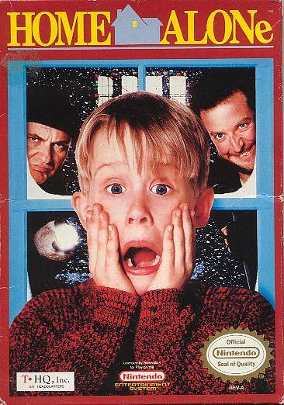
Home Alone
By Salma Nabulsi6D

Slide 2
The Plot of Home Alone
When bratty 8-year-old Kevin McCallister acts out the night before a family trip to Paris, his mother makes him sleep in the attic. After the McCallisters mistakenly leave for the airport without Kevin, he wakes up to an empty house and assumes his wish to have no family has come true. But his excitement fades when he realizes that two robbers Harry and Marv plan to rob the McCallister house, and that he alone must protect the family home, by pulling pranks and tricks on them.

Slide 3
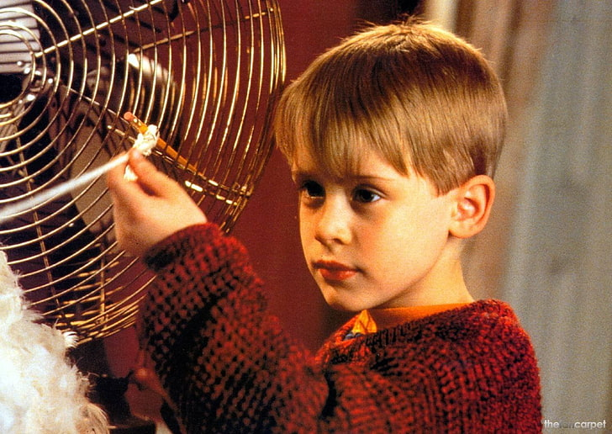
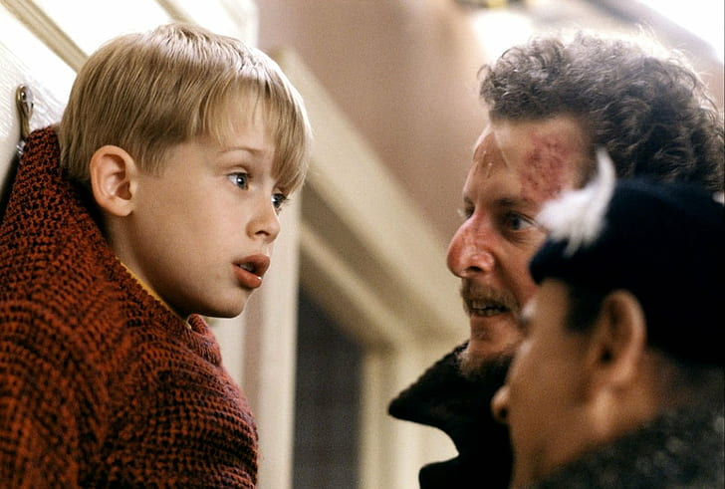
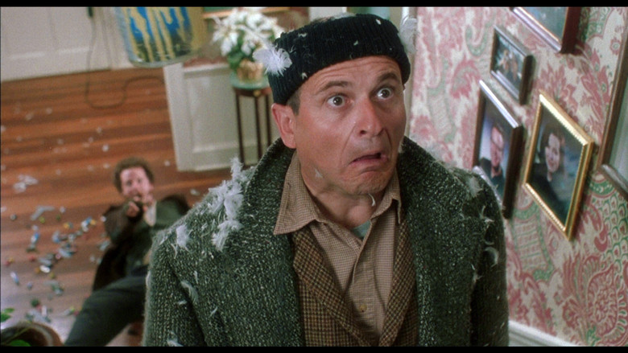
The pranks Kevin did
1. Chicken Suit
2. Paint Cans
3. Red-Hot Doorknob
4. Icy Steps
5. Tarantula

Slide 4
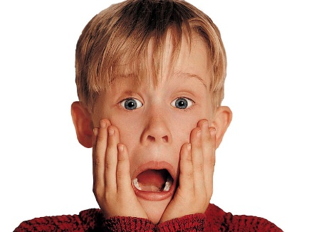
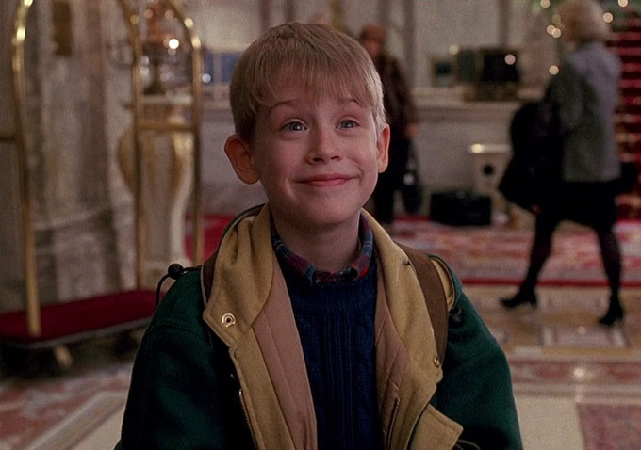
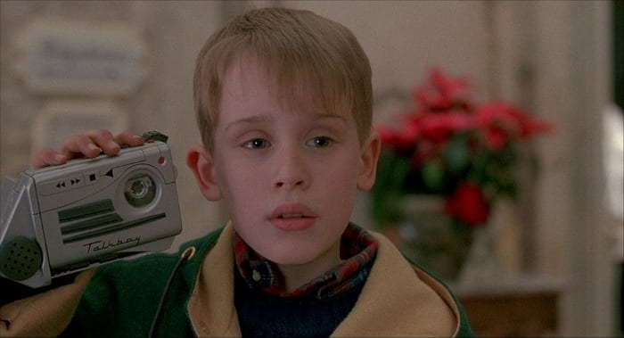
Kevin McCallister
Kevin is a mischievous, stubborn, yet good hearted young boy, he is often bullied by his older siblings, and his mom often blames him for something he didn’t do.

Slide 5
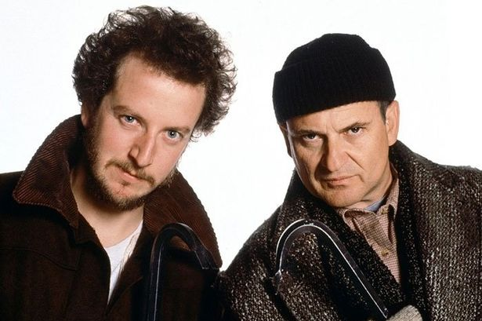
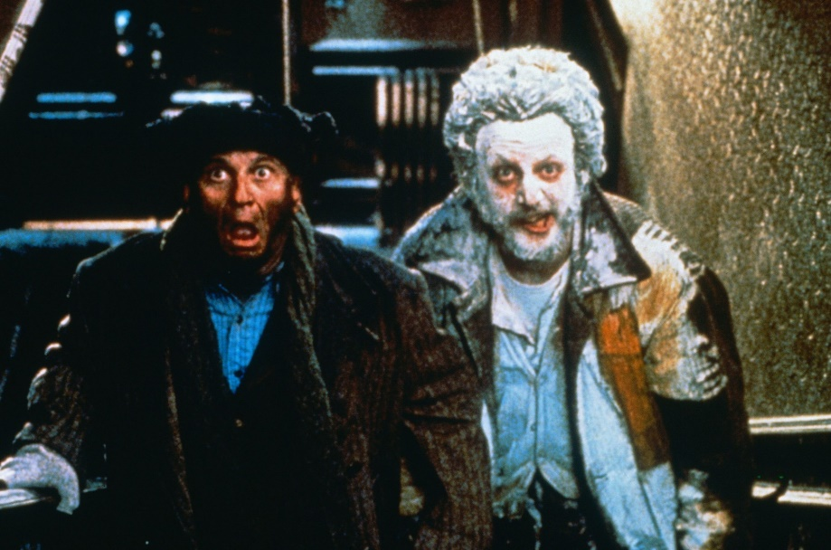
Harry & Marv
Harry and Marv are a team, they are robbers, thieves and decided to rob the McCallisters house, they could be for prison for 3 years if they got caught.

Slide 6
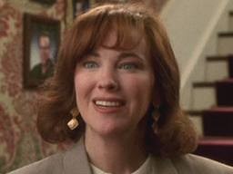
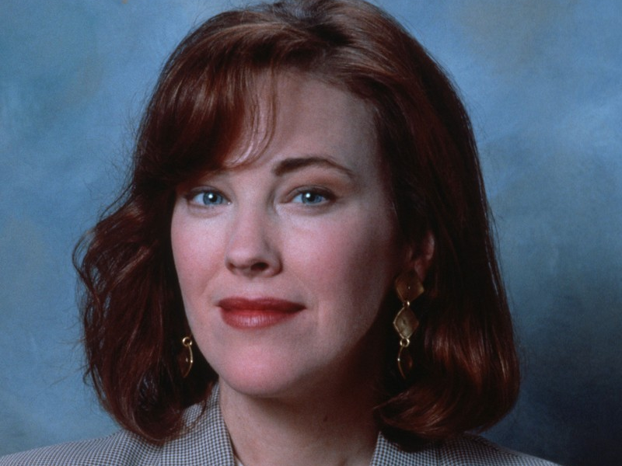
Kate McCallister (Kevins mom)
Kate is a strict mom, humble, protective, supportive and intelligent, when she remembered she forgot Kevin she tried everyway to go back home

Slide 7
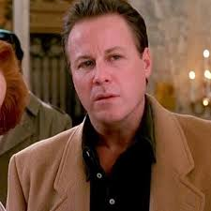
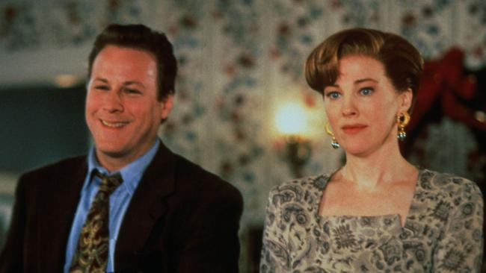
Peter McCallister (Kevins dad)
Peter works as a a businessman and is a loyal family man, Peter's practical nature and strong sense of duty make him a good father and husband, and he reassures his wife that everything's going to be okay, even though he's kind of wrong about that.

Slide 8
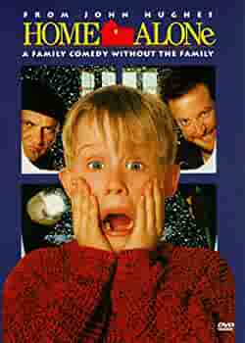
The End
Thank you

