Slide 1
Home Alone
1990 flim!
Taleen Ammari
6B
Fact about Home Alone:it’s a comedy/family movie!

Slide 2
What does Home Alone Movie Talk About?
Is the story of 8-year-old Kevin (Macaulay Culkin), a mischievous kid who feels largely ignored by his large extended family. While everyone is preparing for a Christmas vacation in Paris, Kevin gets in trouble, is banished to the attic overnight, and wishes his family would just disappear. He gets his wish the next morning when they mistakenly leave him behind. At first Kevin is elated -- but pretty soon he realizes that being home alone isn't all it's cracked up to be. He misses his mom ,and even his brother, who bullies him. With all of the block's other families also away. Meanwhile, a pair of bumbling burglars played by Joe Pesci and Daniel Stern take advantage of the situation by pillaging the neighborhood. It's up to Kevin to defend his home, using every prank in his well-stocked arsenal.

Slide 3
Characters
Joe Pesci: (Harry Lime)
Daniel Stern (Marv Murchains)
Macaulay Culkin (Kevin McCallister)
Buzz McCallister (Devin Ratray)
Fuller McCallister (Kieran Culkin)
Kate McCallister (Catherine O'Hara)
Peter McCallister (John Heard)
Uncle Frank (Gerry Bamman)
Linnie McCallister (Angela Goethals)
Marley (Robert Blossom)
(The real characters name )
(the character name)
Main Characters

Slide 4
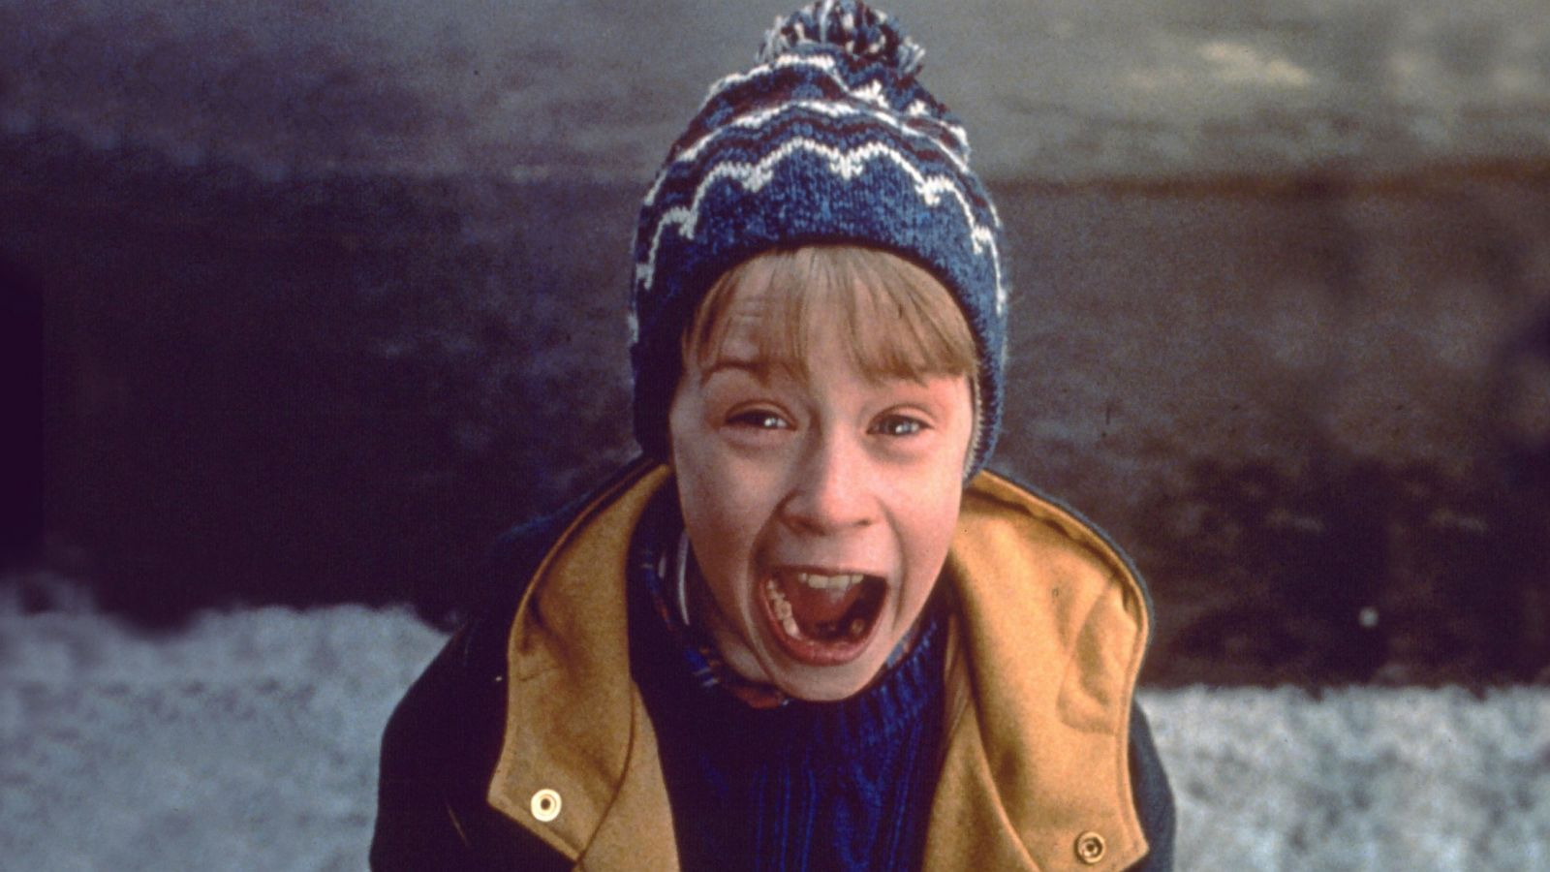
My Favortie Character
Kevin Mccallister
He is very confident, brave ,intelligent, amazing ,powerful young boy to get rid of those creeps that tried to break in to their house. And I love how he does pranks everytime when they try to break into their house. I believe that no one could do that when they are home alone like kevin.

Slide 5
Clot and Solution
Problem: An eight-year-old troublemaker must protect his house from a pair of burglars when he is accidentally left home alone by his family during Christmas vacation.
Solution: the burglars got arrested. And his family were on the way to come back for Kevin.
(The The film takes place in the fictional town of Shermer, Illinois.) Sweet Home Chicago

Slide 6
Facts
Release date: November 16, 1990 (Canada)
Director: Chris Columbus
Box office: $476.7 million
Art director: Dan Webster

Slide 7
Thank you so much!
Favorite Movie
(Third Month Assessment English Project)

