Slide 1
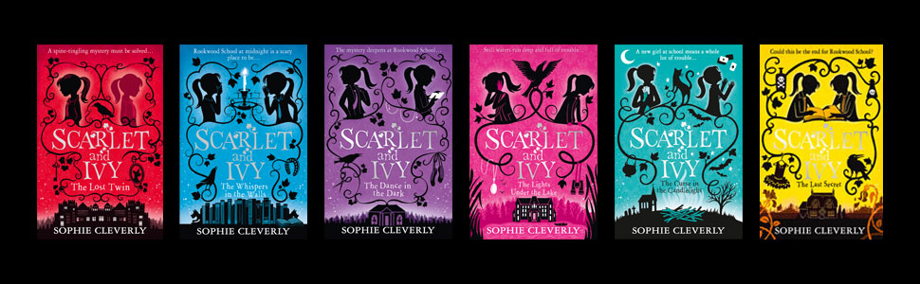
Scarlet And Ivy
By Sophie Cleverly
Made by Elisa 6B

Slide 2
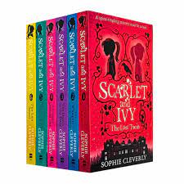
About this story
This story is by sophie cleverly its called scarlet and ivy it has 6 series which are the lost twin, the whispers in the wall, the dance in the dark, the lights under the lake, the curse in the candle light and the last secret.
This story has a rating on amazon of 4.7 out of 5
Theme: suspense

Slide 3
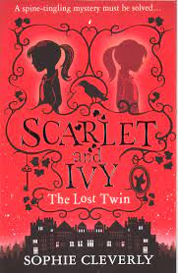
The lost twin
This lost twin is about a two twins who were identical one twin was sent to school while the other one stayed at her aunt because her family didn’t want her though later than she received a letter from her sisters school mentioning that she has to take her place in this weird school as her sister who she was told was dead as well as a weird headmistress.
Peoples reviews
‘’This is one of the best books I have ever read.it was exciting, funny, warm and mysterious’’. Lily age 9.

Slide 4
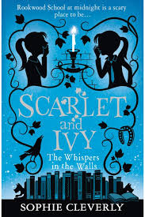
The whispers in the wall
New weird headmaster legend says he drowned a child worse than before the twins are in danger again while the cold wind and snow outside bullies everywhere secret passages whispers heard in the walls just want to be let out scary news letters
Peoples reviews
‘’The whole book was brilliant… after the first paragraph it was as if ivy was my best friend’’. Ciara, aged 10

Slide 5
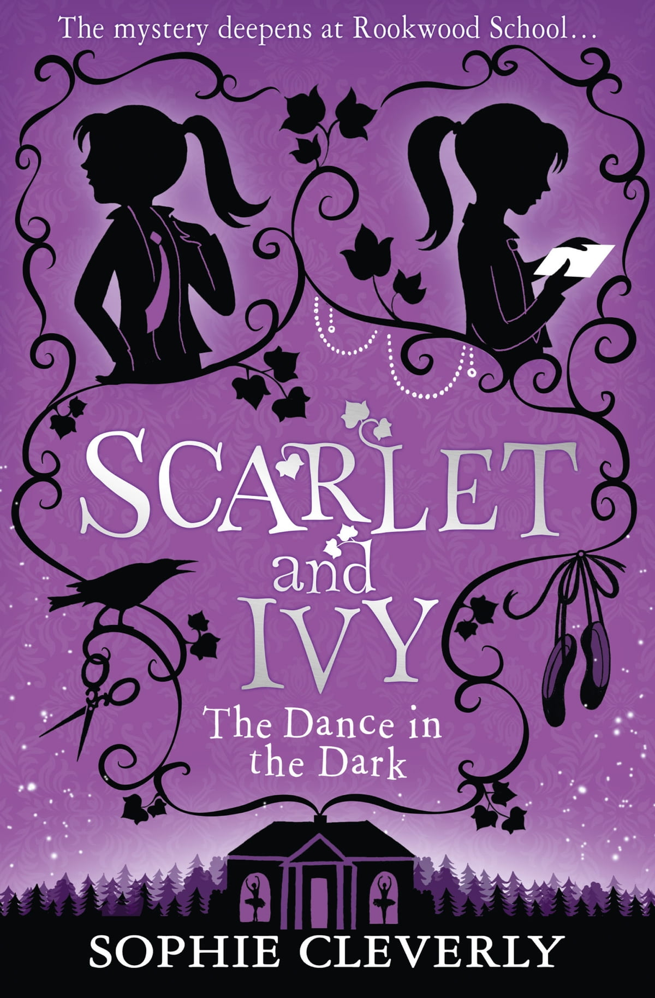
The dance in the dark
Mysterious notes. Frightening dreams. Rumors spreading. As both evil headmasters are out of the picture the girls thought it was going to be ok well that was wrong. Teachers missing, suspicious replacements. Strange accidents. What's happening!?!
Peoples reviews.
“This book is full of excitement and adventure a masterpiece!” Sidney, aged 11

Slide 6
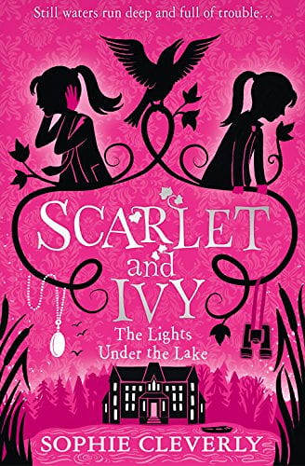
The light Under the lake
The students at Rookwood have a field trip. The students signed up to get away from lessons for a few days but find a man named Bob Owens who's stories change your perspective about this lakeside hotel and make them look evil. Creepy screams at night, horrifying books and sentimental ideas
Peoples reviews
“this is a page-turning mystery adventure with puzzles that keep you guessing.” Felicity, aged 8

Slide 7
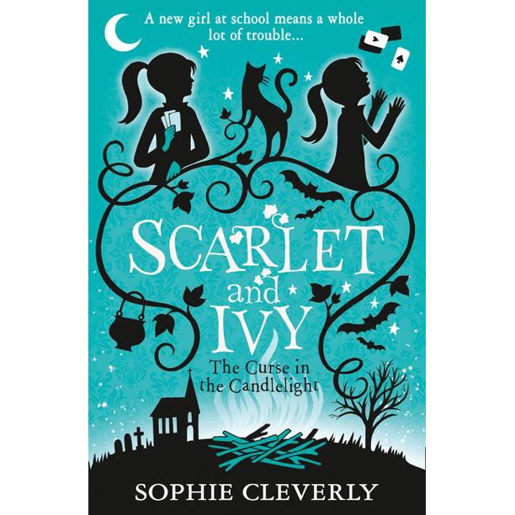
The curse in the candlelight
A new girl is a at school she's as enchanting as she is mysterious. At first everyone is spellbound by her. But, when a curse threatens a student, things really start to become dangerous. And all hallows’ eve is on the way.
Peoples reviews
“A brilliant and exciting book”. Evie, aged 8

Slide 8
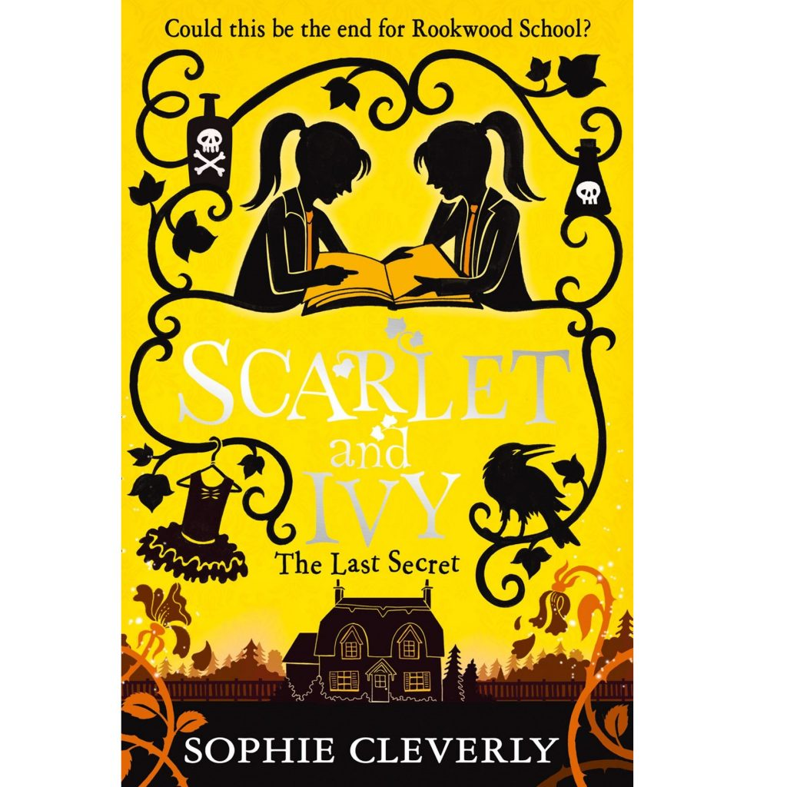
The last secret
When the twins return to school after the holidays, they quickly realize that the school is in danger. The twins will need to confront enemies from their past and present if they are to have any chance of it surviving. Could the last secret at Rookwood be the one that brings it down?
Peoples reviews
“the story shone with excitement secrets and bonds of friendship… if I had to mark this book out of the I would give it 11!” Sidney, aged 11

Slide 9
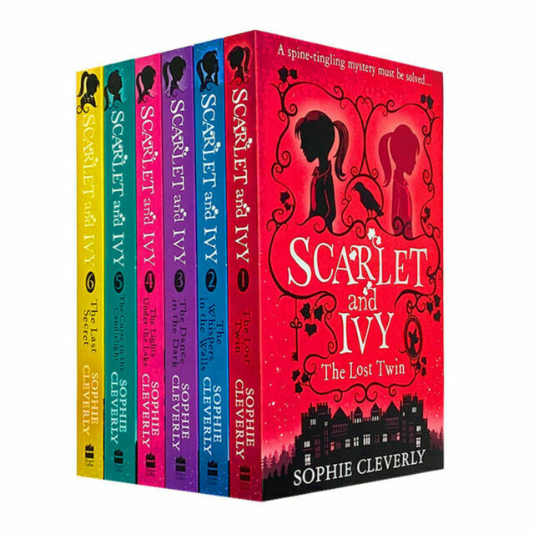
My opinion
The book is full of excitement perfect for everyone many pages to keep you guessing it’s an amazing book totally recommend after the first book you wont be able to let go.
I really like the book

