Slide 1
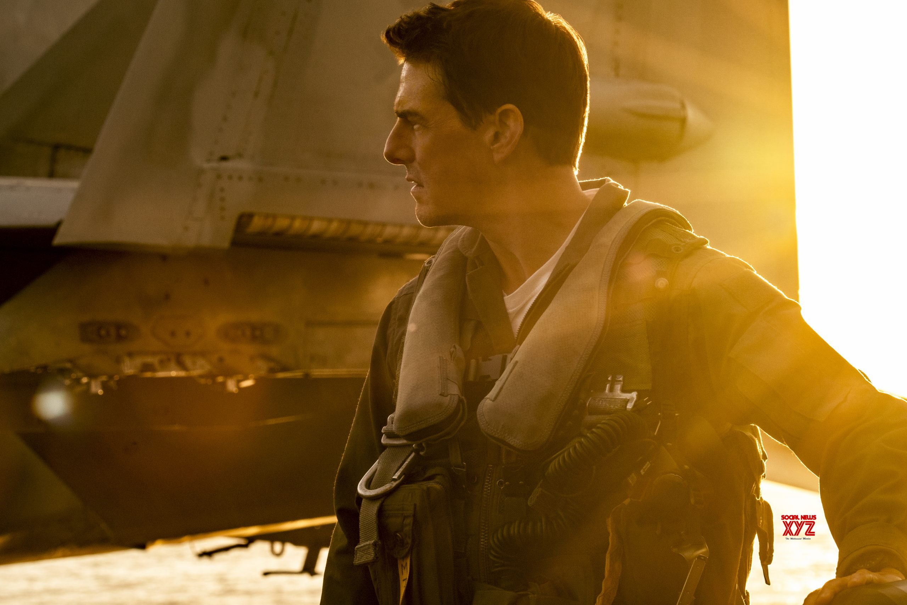
MAVERICK
TOP GUN
By
Sanad Samawi
6th GRADE D

Slide 2
TOP GUN Maverick
Since I am a big fan of action movies, I recently watched the movie TOP GUN.
TOP GUN Maverick is a 2022 American action film directed by Joseph Kosinski.
and due to the hardness level of this mission,
he did it himself along with his students, and finally the mission was accomplished in partnership between Pete and one of his good students.
Tom Cruise really did fly the planes he used in the film.
Over More this movie is the sequel to the 1986 film TOP GUN and the second installment in the Top Gun film series.

Slide 3
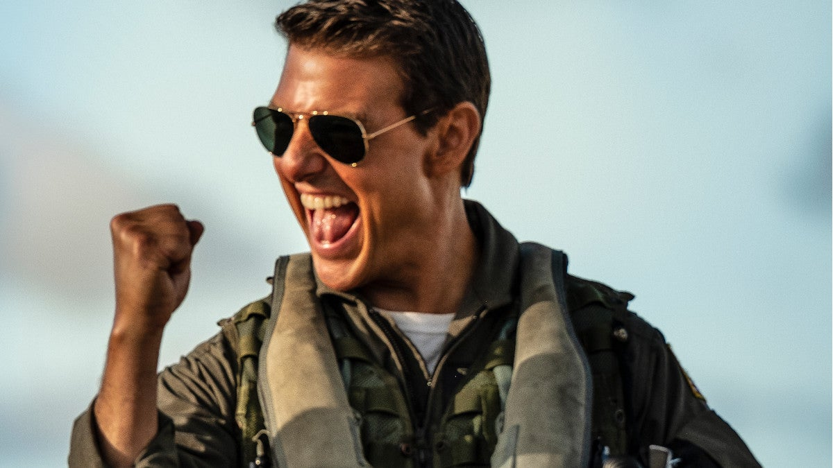
Tom cruise
Tom cruise is the starring actor in the
TOP GUN maverick and played Captain Pete
"Maverick" Mitchell in the movie,
Tom Cruise is a professional Pilot who was
asked to train some pilots for a special mession,

Slide 4
Miles Teller
Miles teller acted in the movie TOP GUN maverick he played as Bradley Rooster in the movie, he did not matched the required qualification for such a mission in the trainings but he managed to do it at the field

