Slide 1
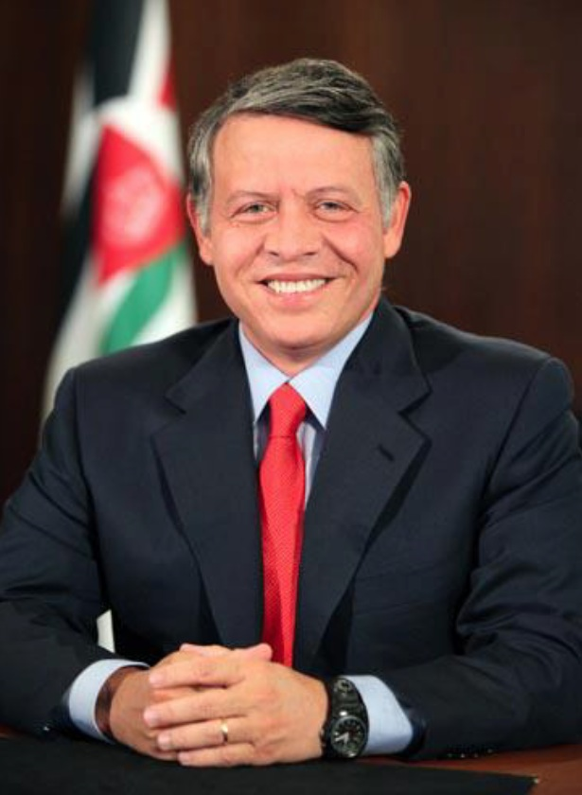
Abdullah the Second
By: Jena Halteh / 5E
Subject: Social Studies

Slide 2
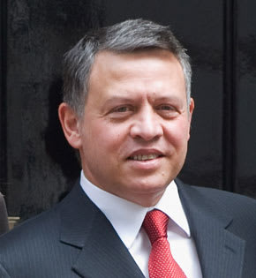
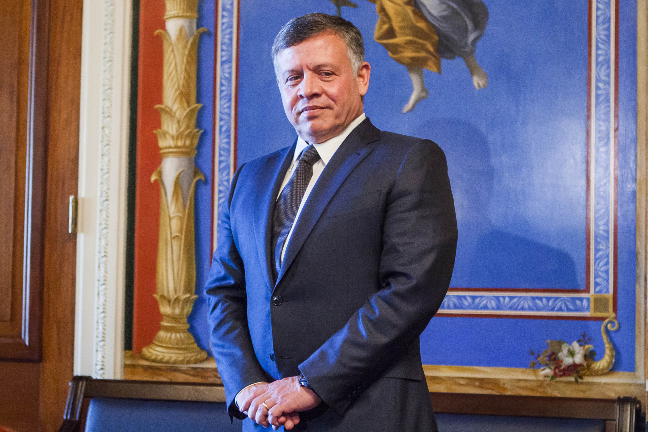
Who is Abdullah the Second?
Abdullah the second is currently the king of Jordan, born on the 30th of January 1962 reigning from the 7th of February 1999, and is a member of the Hashimite dynasty, the royal family in Jordan since 1921, and is considered a 41st generation direct descendant of Prophet Muhammad.

Slide 3
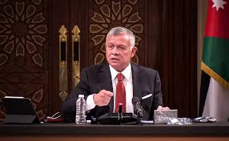
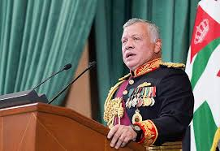
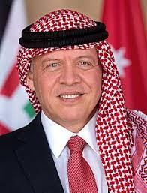
What did he do?
Since ascending the Throne in 1999, King Abdullah II has been focused on economic development. Through His Majesty’s efforts, many programs have borne fruit and enhanced Jordanians’ living conditions.
The King has identified several pillars to fulfil this vision, including liberalizing and modernizing the economy, improving the living standards of all Jordanians, reducing debt, narrowing the budget deficit, joining the global economy, enhancing economic ties with Arab states and other major global markets as well as combating poverty and unemployment.
Jordan has developed a successful partnership with the World Economic Forum (WEF) — thanks to economic, political and social reforms led by His Majesty — turning the Kingdom into a forward-looking model in the region.
The King’s keenness to ensure Jordan participates in the WEF has enabled the country to assume an advanced status within the Forum’s circles, paving the way for a strong partnership that has turned Jordan into a second home for this international platform. King Abdullah II sees this gathering as the right venue to address political, economic and intellectual leaders, along with the millions of people they serve around the world.
His Majesty has also issued directives to prepare programs to enhance the living conditions of citizens with limited incomes by providing a social security safety net, building housing units for targeted social segments, implementing empowerment programs through training and qualifying people in poverty pockets as well as supporting underprivileged families through the Jordan Hashemite Charity Organization distribution of food and aid parcels.

Slide 4
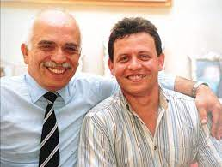
Family
King Abdullah II is the eldest son of His Majesty the late King Al Hussein Bin Talal and Her Royal Highness Princess Muna Al Hussein. His Majesty has four brothers and six sisters.
His Majesty is married to Her Majesty Queen Rania Al Abdullah. They have four children—two sons, Their Royal Highnesses Crown Prince Al Hussein and Prince Hashem, and two daughters, Their Royal Highnesses Princess Iman and Princess Salma.

