Slide 1
Sonic movie

Slide 2
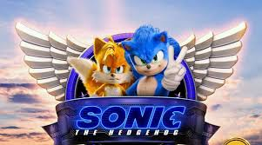
About this movie
Action – adventure comedy film based on the video game series of the same name published by Sega

Slide 3
After discovering a small, blue, fast hedgehog, a small-town police officer must help him defeat an evil genius who wants to do experiments on him.

Slide 4
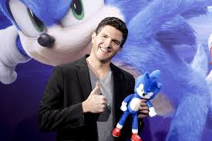
Based on the global blockbuster videogame franchise from Sega, SONIC THE HEDGEHOG tells the story of the world's speediest hedgehog as he embraces his new home on Earth

Slide 5
What is sonic real power
Sonic's greatest ability is his running speed, and he is known as the world's fastest hedgehog. Using the power of the seven Chaos Emeralds, he becomes Super Sonic and can achieve even greater speeds.

Slide 6
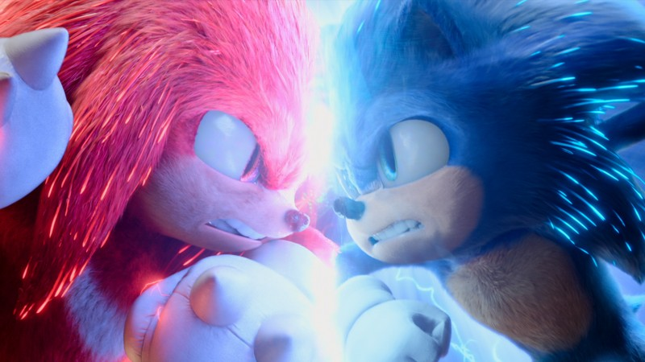
Plot Summary
A blue hedgehog with supersonic speed must rescue animals from being turned into robots by a mad scientist. Doctor Robotnik is an evil and mad scientist who only had one destiny, taking over the whole world and to do this he needs to collect all six chaos emeralds which are located on the South Island

Slide 7
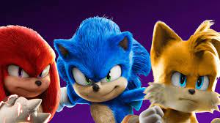
I recommend you to watch this move
Thank you
Zaid Hieshan
Grade 6 “E”

