Slide 1
jumanji
By Faisal Al-Ayyoub
Came out in the year 2017

Slide 2
The four main characters
Dwayne Johnson is Spencer
Karen Gilan is Ruby
Kevin hart is Franklin
Jack black is Bethany

Slide 3
The story
Four high school kids discover an old game console and decided to play it, they all choose their characters and got sucked in the world of Jumanji ,Spenser becomes a muscular man, his friend Fridge becomes Franklin an expert zoologist is upset about his avatar because he is a foot shorter, Martha becomes Ruby, and Bethany is now Dr. Shelly a cartographer which she mistook for a woman because of her description curvy genius each one of them has three lines on their hand, if they die they lose one line, fleeing from a stamped of hippos, the group encounters Nigel, they realize that Nigel is a NPC who gave them a letter explaining that Nigel was a part of a expedition by Van to get the legendary gem the jaguars eye on the jaguar statue, to win the game they have to put back the gem a call out Jumanji.

Slide 4
continuation
When they are done talking they get dropped of onto the forest then they get attacked by Van’s men but Ruby gets shot and disappears only to fall out of the sky, the fifth playable character introduces himself as pilot Jefferson his real name is Alex, and he mentions he has been stuck in the game for months but Spenser and fridge know that he stuck here for twenty years , then they all go on a plane to go put the gem back where it belongs but unluckily Fridge drops the gem on a bunch of rhorns, Fridge sacrifices himself to get it back ,they make a plan to put the gem back and it is Ruby takes Van out while the other three provide a distraction leaving Spenser to put the gem back, Martha retrieves the gem from a pit of snakes and Spenser places the gem and calls Jumanji.

Slide 5
Why I liked this movie
Fun to watch.
Entertaining fights.
It is a funny movie.

Slide 6
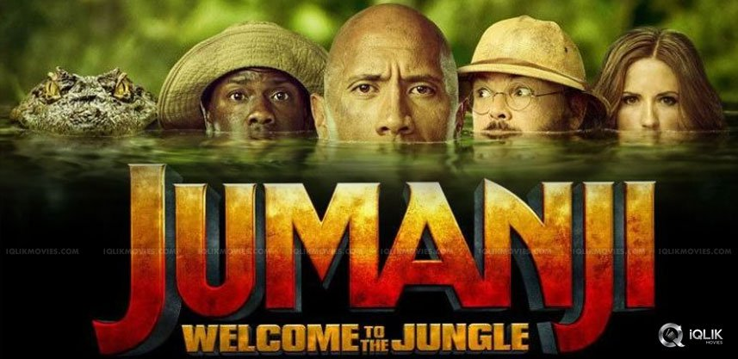
Thank you for listening

