Slide 1
Harry potter and chamber of secrets
By Nour Karsou 6d
This Photo by Unknown Author is licensed under CC BY-NC-ND

Slide 2
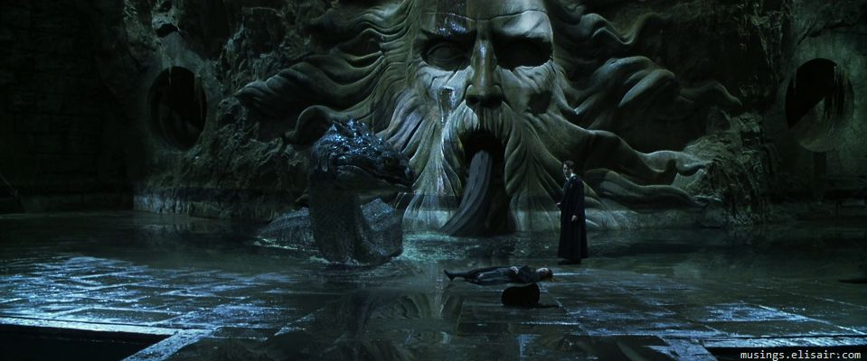
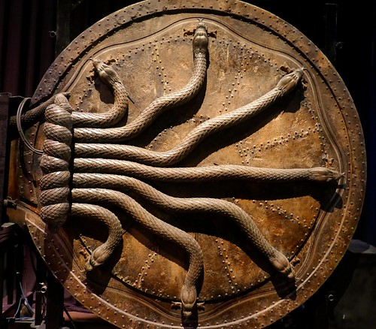
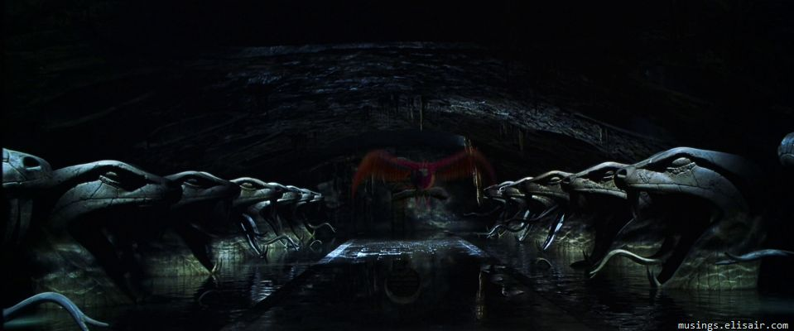
About the chamber of secrets
The story follows Harry's second year at Hogwarts School of Witchcraft and Wizardry, where the Heir of Salazar Slytherin opens the Chamber of Secrets, unleashing a monster that petrifies the school's students

Slide 3
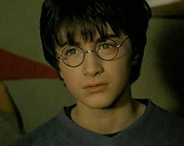
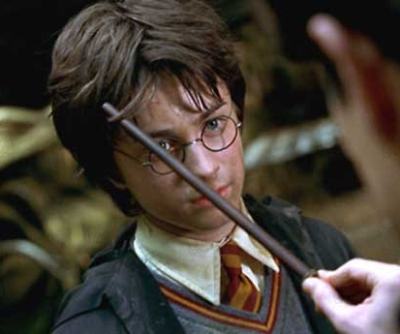
Harry potter
Harry Potter is a wizard, the only child of James and Lily Potter. He is famous for having survived an attack by Lord Voldemort when he was a baby. He is also sometimes known as 'The Boy Who Lived'. For the first eleven years of his life, Harry lives with his mean aunt and uncle and is unaware of his wizarding roots.

Slide 4
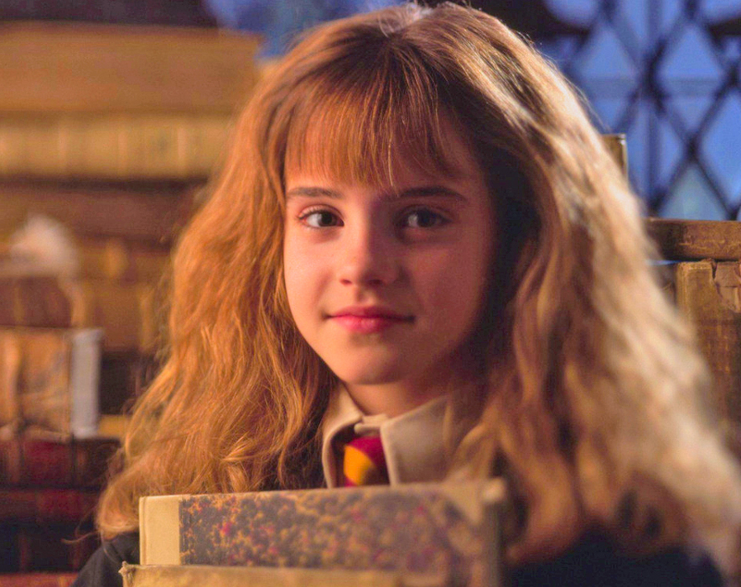
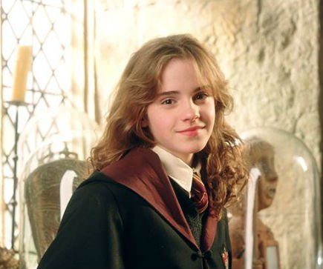
Hermione granger
Hermione granger was an English muggle born witch born to mr and mrs granger. At the age of 11, she earned about her magical nature and was accepted into Hogwarts school of witchcraft and wizardry. Hermione began attending Hogwarts in 1991and was Sorted into Gryffindor house. She possessed a brilliant academic mind and proved to be a gifted student in almost every subject that she studied, to the point where she was nearly made a ravenclaw by the sorting hat

Slide 5
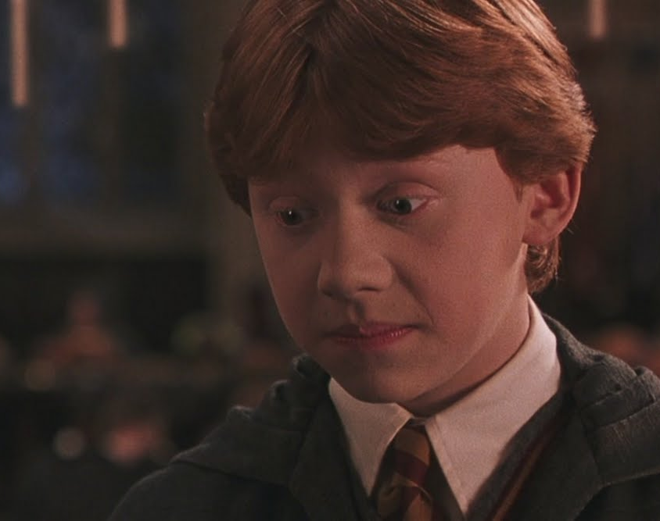
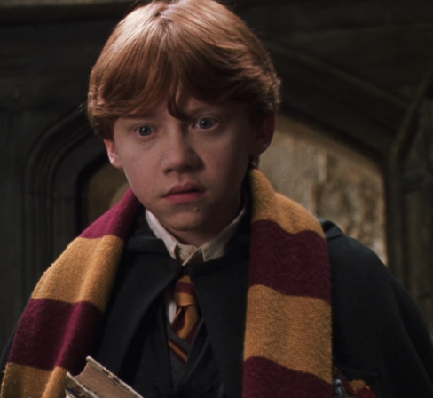
Ronald Weasley
Ron began attending Hogwarts School of Witchcraft and Wizardry in 1991 and was Sorted into Gryffindor House. He soon became close friends with fellow student Harry Potter and later Hermione Granger. Together, they made the Golden trio and faced many challenges during their adolescence, including keeping the Philosopher's Stone from Professor Quirinus Quirrell, rescuing Ginny from the Basilisk of the Chamber of Secrets

Slide 6
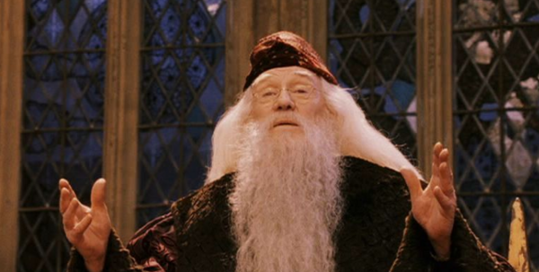
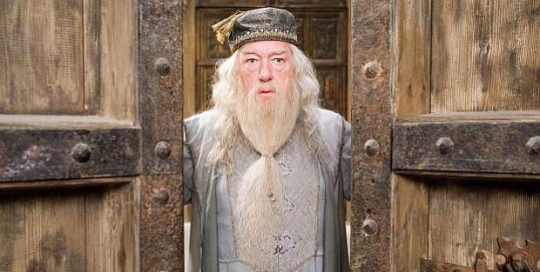
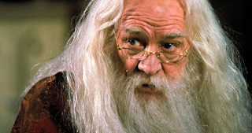
Profesor dumblerdore
Albus Dumbledore was called the greatest wizard of his age, and was the headmaster at Hogwarts during Harry's first year. He was remarkably kind and intelligent, and one of the main characters of the series.
As stated by himself in the foreword of Quidditch through the ages, he is a fan of the oldest and twenty-two-time league winning Puddlemere United Quidditch Club.

Slide 7
Thank you
I hope you liked the movie that I selected

