Slide 1
Instant Family
This Photo by Unknown Author is licensed under CC BY-SA-NC
By: Noor Hijazin 6E

Slide 2
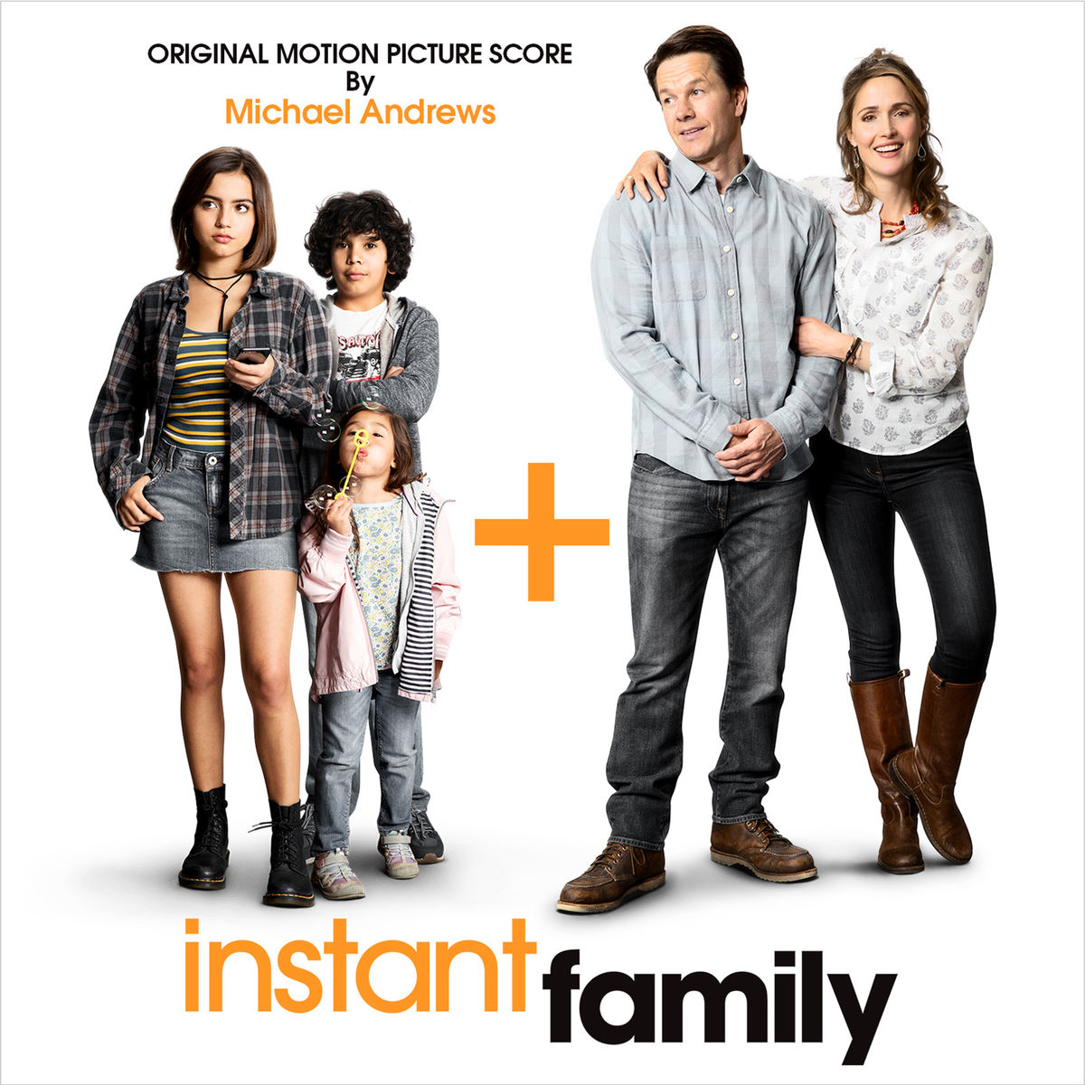
The main characters are:
Lizzie Wagner
Juan Wagner
Lita Wagner
Pete Wagner
Ellie Wagner

Slide 3
The movie talks about:
One day, a couple wanted to adopt 3 children. It was going well until the fights began happening, the next day, the children were asking them to meet their birth mom who was in jail, they agreed. After, the eldest child snuck out without her parents knowing another day she had friends over without them knowing but one day it went wrong she was driving off with friends, but the middle child was holding a drill and dropped it on his foot they went to the hospital he was okay but he was crying. After that, their real mom got out of jail and wanted to take her children back the parents were sad and all of them cried, the day they had to go, their birth mom didn’t come to take them, the people that were driving her said that she wasn’t ready so they were sad. They all cried and it took them a long time to adjust but they were all happy that they were together.

Slide 4
My favourite characters are:
Lizzie Wagner
Pete Wagner

Slide 5
Why I like this movie:
It’s entertaining
You can watch it with your family
It’s heartwarming
Talks about real life events

Slide 6
Thank You

