Slide 1
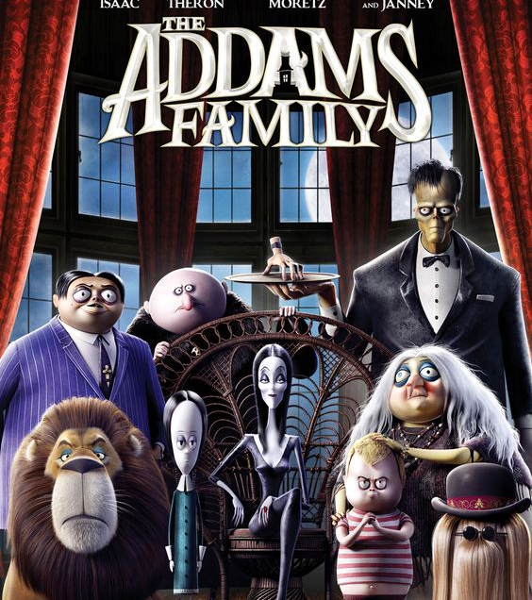
THE ADDAMS FAMILLY
BY SAIF MADANAT

Slide 2
The main charecters AND VOICE ACTORS
WEDNESDAY ADDAMS \CHLOE GRACE MORETZ
MORTICIA ADDAMS\CHARLIE THERON
GOMEZ ADDAMS\OSCAR ISAAC
PUGSLEY ADDAMS\ FINN WOLFHARD
UNCLE FESTER\NICK KROLL
GRANDMA\BETTE MIDLER

Slide 3
WHAT THE MOIVE IS ABOUT
An angry mob of villagers that rejects anything macabre in nature disrupts the midnight wedding ceremony of Gomez and Morticia and drives them away with the rest of the Addams clan. During the chaos, Grandma buys Fester time to evacuate Gomez, Morticia, and Thing. Gomez and Morticia decide to move to New Jerzy, a place "no one would be caught dead in." There, Gomez, Morticia, and Thing find their "perfect" home in an abandoned asylum on a hill. They meet Lurch, an escaped mental patient whom they hit when Thing was driving their car, and immediately recruit him as their butler.
Thirteen years later, the Addams family continue to live their gloomy lives in isolation from the outside world
. Members of the mysterious and spooky Addams family , Gomez, Morticia, Pugsley, Wednesday, Uncle Fester and Grandma are readily preparing for a visit from their even creepier relatives. But trouble soon arises when shady TV personality Margaux Needler realizes that the Addams' eerie hilltop mansion is standing in the way of her dream to sell all the houses in the neighborhood.
This Photo by Unknown Author is licensed under CC BY-NC-ND

Slide 4
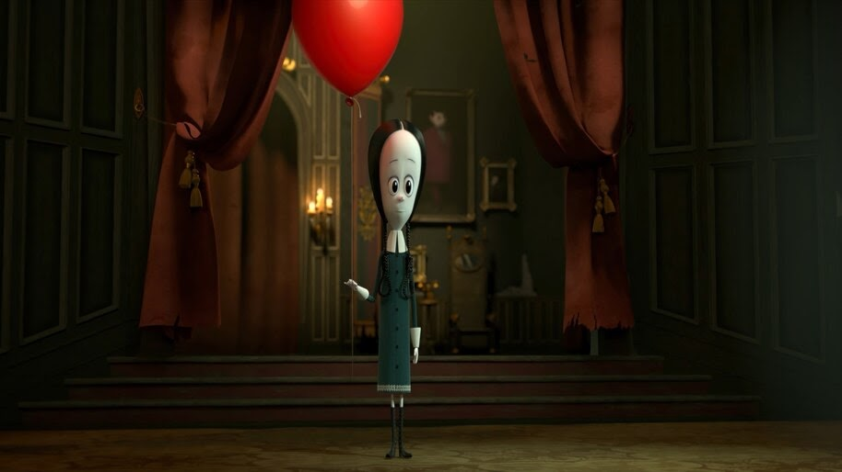
My favorite character
Wednesday addams because she is
Intelligent
Interesting

Slide 5
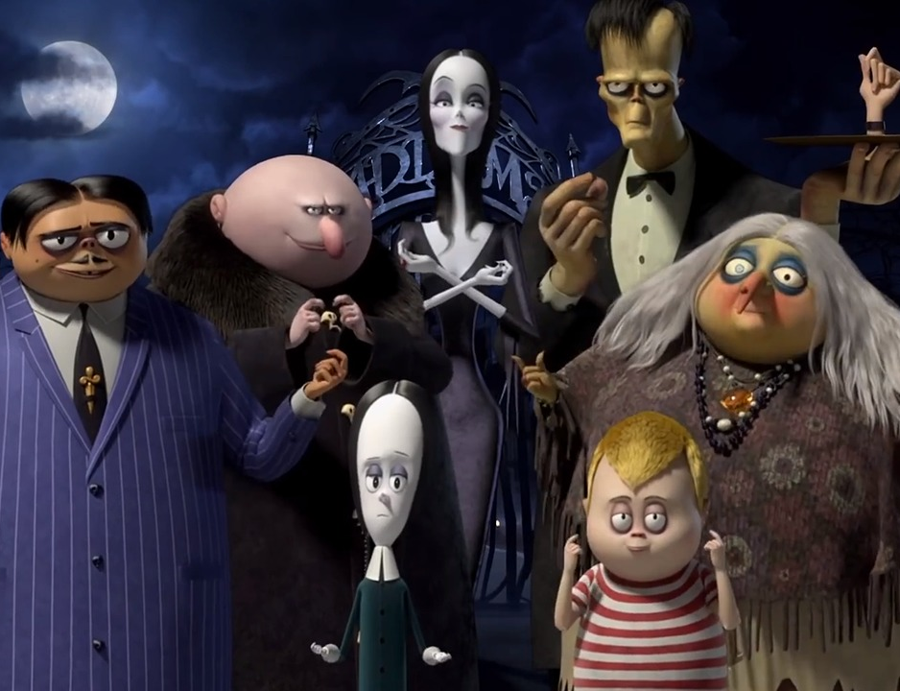
Why I like this moive
Its fun
Spooky
Entertaning
Great to watch with your family

Slide 6
THANK YOU

