Slide 1
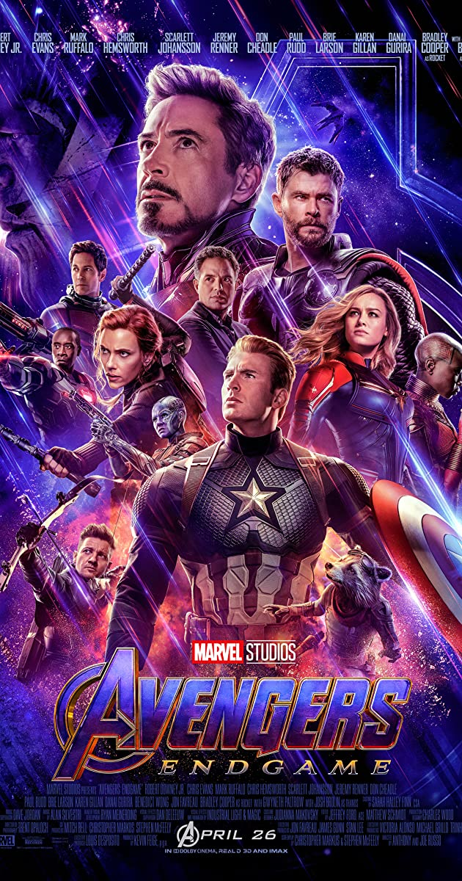
MY Favorite Movie
Avengers: Endgame
Mohammad Younes
6 CP E

Slide 2
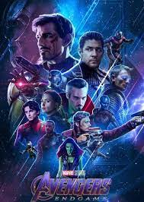
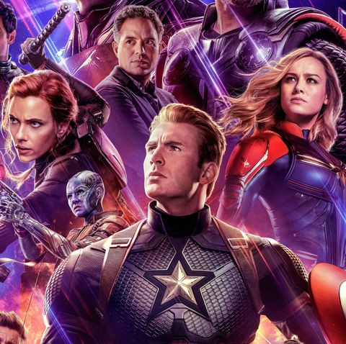
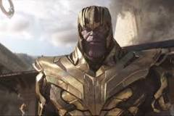
I am sure that everyone, from a 1-year-old child to a 70-year-old adult has a particular movie that holds the title of “ Favorite Movie “. We also might have a specific factor which made us to like that movie. For example, you might like a movie because it has excellent graphics, good actors, excellent plot etc. To me, my favorite movie is also one of the most popular one of all time and its none other than “AVENGERS ENDGAME”.
After half of all life is snapped away by Thanos, the Avengers are left scattered and divided. Now with a way to reverse the damage, the Avengers and their allies must assemble once more and learn to put differences aside in order to work together and set things right.
Adrift in space with no food or water, Tony Stark sends a message to Pepper Potts as his oxygen supply starts to dwindle. Meanwhile, the remaining Avengers -- Thor, Black Widow, Captain America and Bruce Banner -- must figure out a way to bring back their vanquished allies for an epic showdown with Thanos -- the evil demigod who decimated the planet and the universe.
Thanos' goal is to eliminate half the life in the universe using the stones' incredible power, but he doesn't do that for no reason. Thanos believes that the only way to save the universe is to thin out the life in it, to eliminate conflict for resources that would otherwise lead to death and suffering.

Slide 3
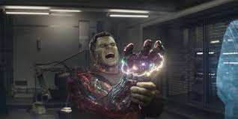
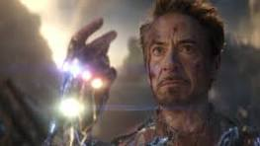
Instead of trying to rewind time once they have the Time Stone and undo everything that has happened in the last five years, they decide to use the Infinity Stones to bring back everyone who disappeared in this current timeline, five years later.
What Are The Names Of The Infinity Stones?
The Space Stone - Blue. ...
The Reality Stone - Red. ...
The Power Stone - Purple. ...
The Mind Stone - Yellow. ...
The Soul Stone - Orange. ...
The Time Stone - Green.
Iron Man, Thor, the Hulk and the rest of the Avengers unite to battle their most powerful enemy yet -- the evil Thanos. On a mission to collect all six Infinity Stones, Thanos plans to use the artifacts to inflict his twisted will on reality. The fate of the planet and existence itself has never been more uncertain as everything the Avengers have fought for has led up to this moment.
The Avengers built a time machine to travel back and return infinity stones after the battle, so why would they risk to return them during instead of hiding them? Thanos can't defeat them without the stones anyway.
Although the stones were destroyed in the beginning of Avengers: Endgame, Thanos had said that the stones had been reduced to atom. This had led to speculations that it was not fully destroyed. Towards the end of the movie, Captain America had returned the stones to their respective timelines in parallel universes.

Slide 4
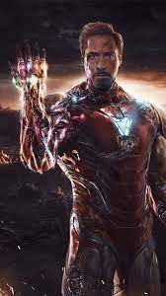
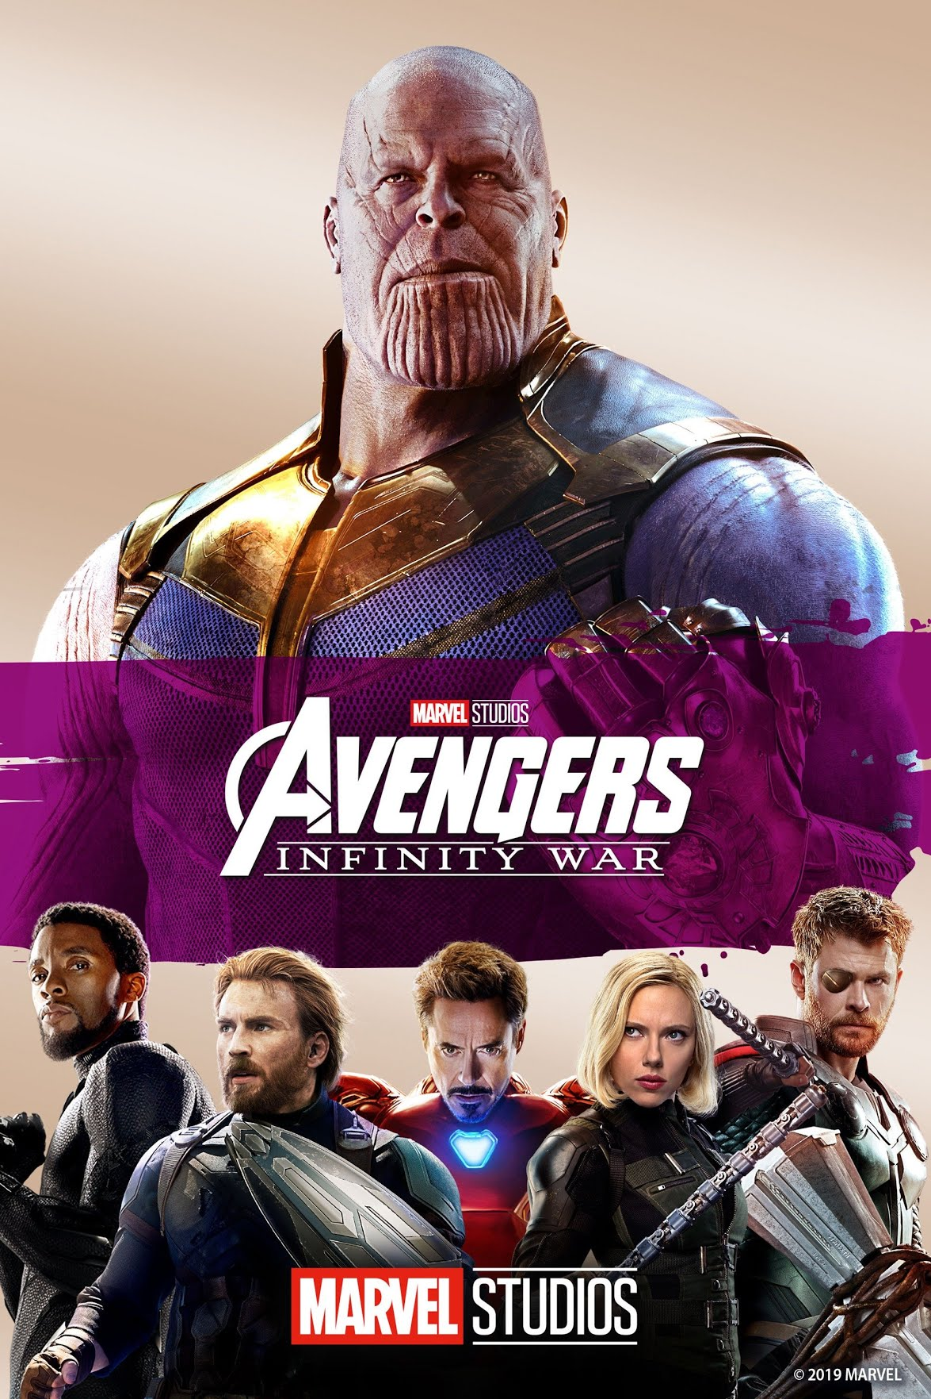
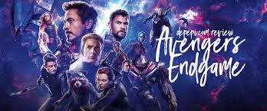
Tony Stark made the ultimate sacrifice in the final battle against Thanos. In order to defeat the Mad Titan once and for all, Tony stole the Infinity Stones from the Nano Gauntlet and collected them into his Iron Man armor.
Tony Stark sacrifices himself to wipe out Thanos once and for all. It's one hell of a way to bring closure
Avengers: Endgame' is a meditation on time – and it leaves us with a fittingly age-old message: that we should cherish the moments we have on this earth with our loved ones. As Tony Stark puts it, quoting his father to his father, “No amount of money ever bought a second of time.”

