Slide 1
How the Grinch stole Christmas!
By: nouf

Slide 2
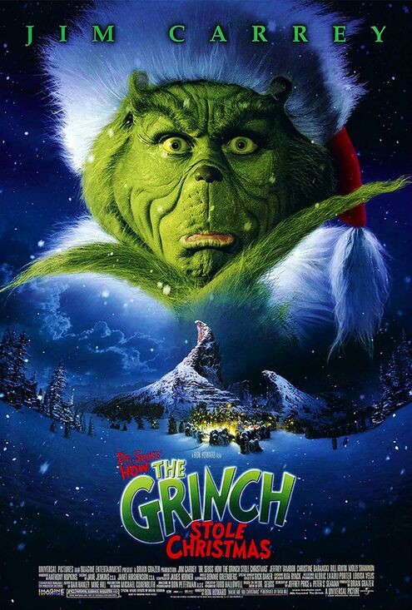
The Grinch
Main characters
Favorite characters
Grinch
Cindy Lou Who
Max
Mayor Augstus Maywho
Grinch
Cindy Lou Who

Slide 3
This movie is about:
Basically, it is when the Grinch hated Christmas so much he decided to destroy Christmas so he came up with a terrible plan with his dog max.

Slide 4
At the end of the movie:
The Grinch stole Christmas from the Whos for his own benefit despite thinking that he will decrease the Whos’ social income.
The Grinch returned the gifts because he realized that the Who’s will still celebrate Christmas.
So he returned the gifts and other stuff he stole.

Slide 5
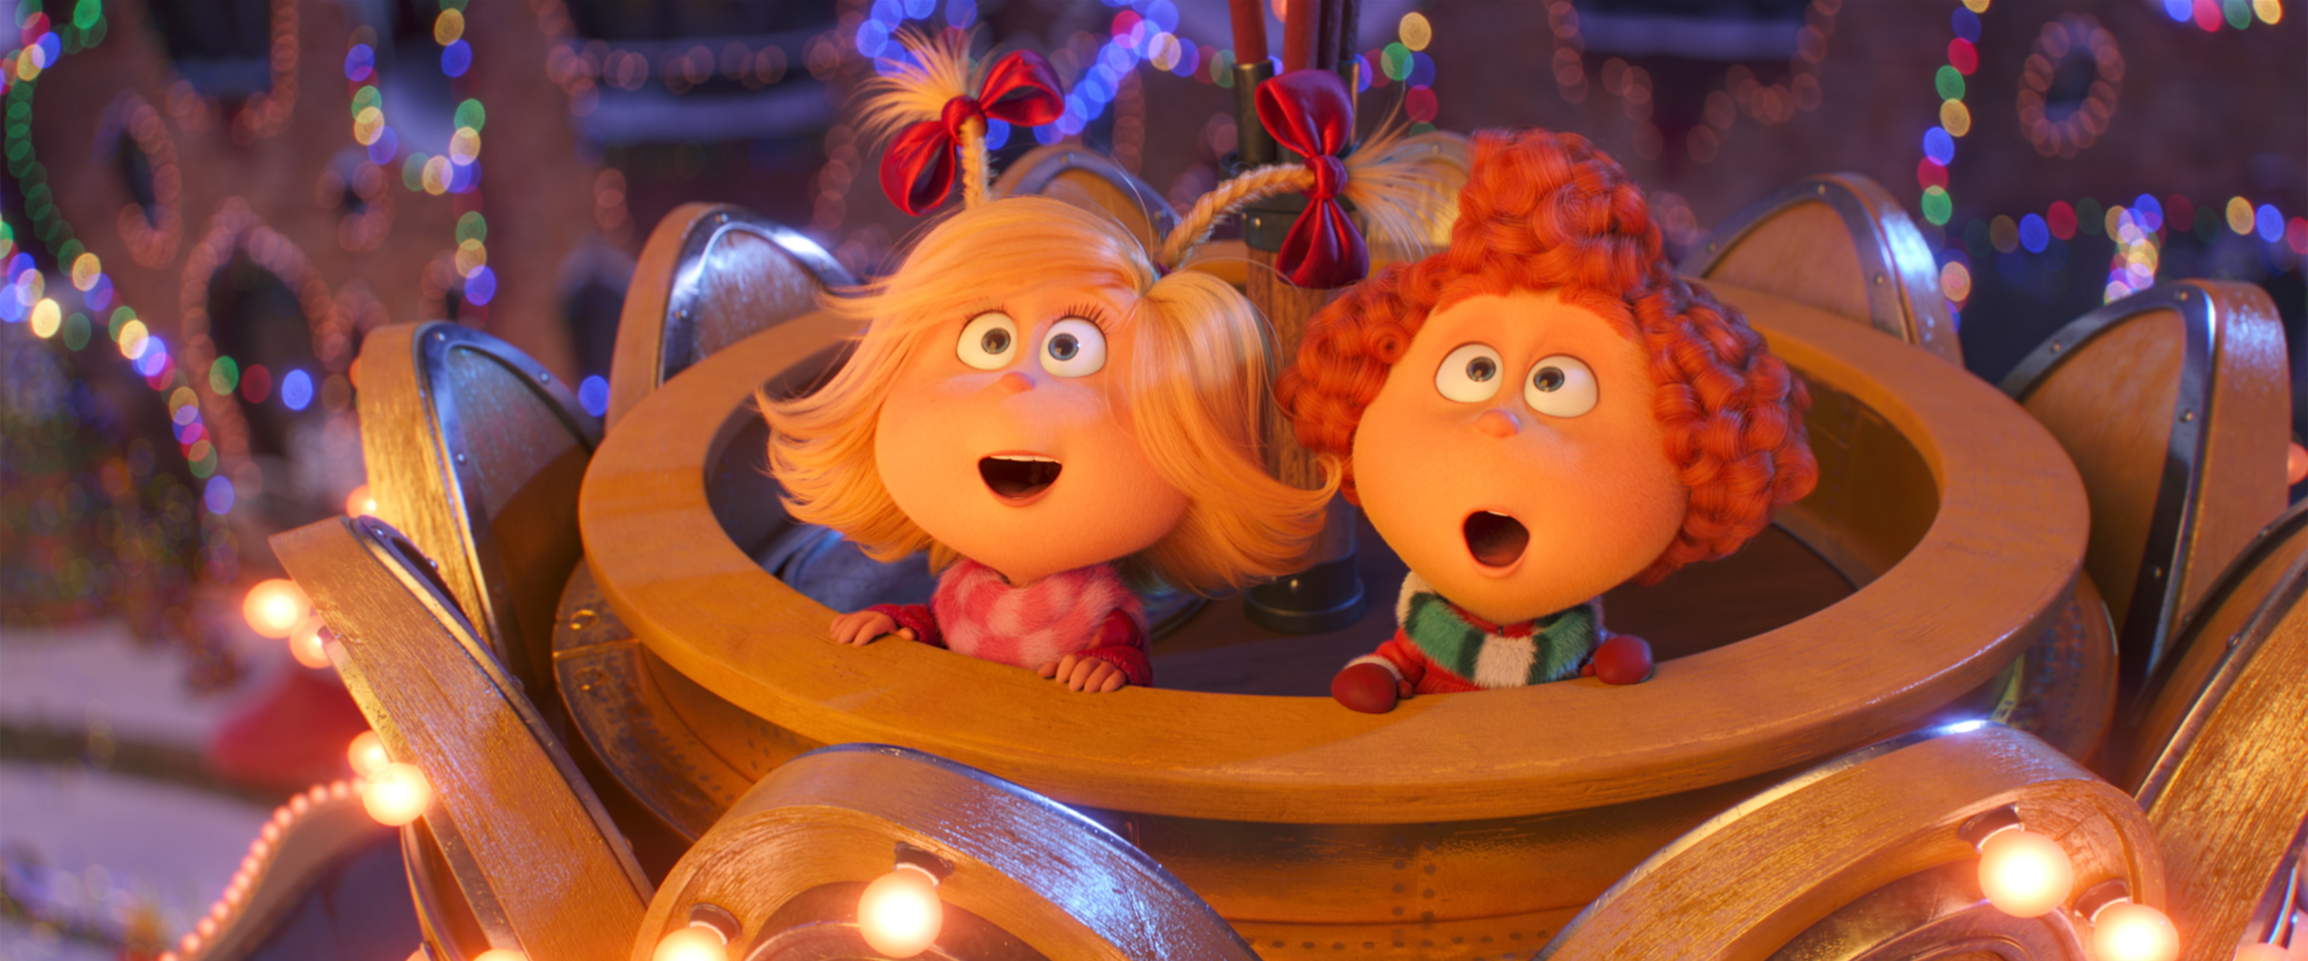
This is my favorite movie because :
It’s funny.
it’s entertaining.
It reminds me of Christmas.

Slide 6
THANK YOU!!

