Slide 1
Jumanji
Raya Halasa 6d

Slide 2
Jumanji 2
The film's plot takes place two years after Welcome to the Jungle, in which the same group of teenagers, along with an old friend and two unwitting additions, become trapped in Jumanji once again they face challenges and eventually find a way out, they each had three lives they also had strengths and weaknesses

Slide 3
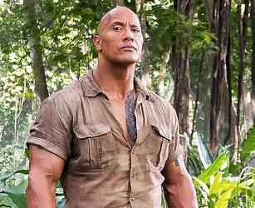
dr.smolder bravestone
Dr.smolder also known as the rock Dwayne Johnson
Is a funny and smart person who plays a big role in the movie
He had lots of strengths like fearless, speed, boomerangs, climbing, smoldering intensity
he had zero weaknesses

Slide 4
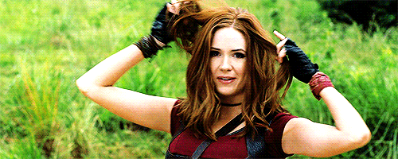
Ruby roundhouse
Ruby round house also known as Karen gillan is a very smart and open person also described as a "killer of men" in the game, being an expert in the arts of Karate, her strengths was snakes although her weakness was venom

Slide 5
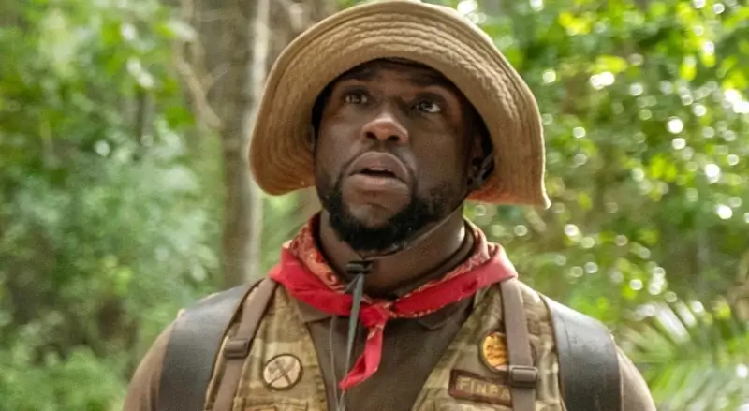
Franklin mouse finbar
Franklin mouse finbar also knowns as Kevin hart is a hilarious person not the smartest but had a lot of good ideas and ways to try and escape
his strengths were Zoology, Weapons Valet, Cranial Assault, Linguistics, And his weaknesses were Cake, Speed, Strength.

Slide 6
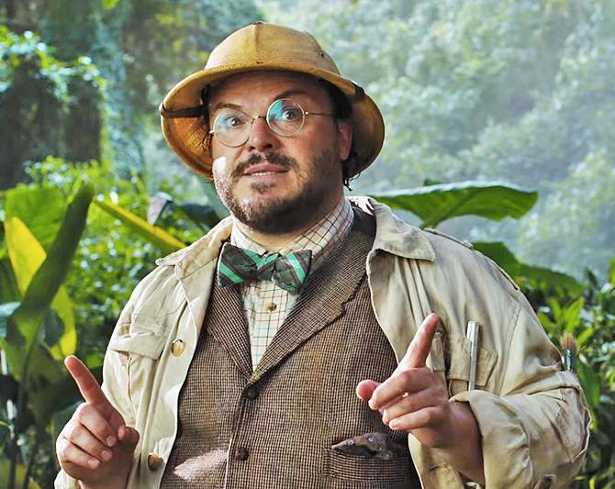
Professor Shelley Oberon
Professor Shelley Oberon also known as jack black is an expert in the study of maps, making him the only character who is able to read the Map of "JUMANJI“ his weakness is intense heat.

Slide 7
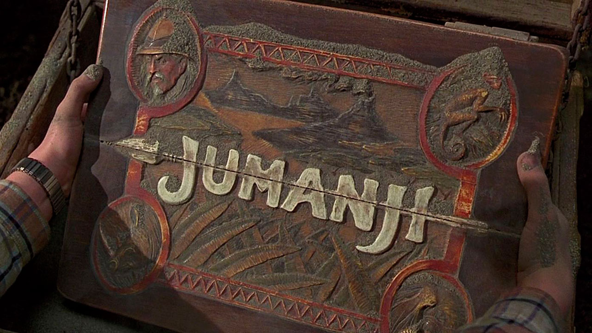
In the end they find their way home and arrive safely

