Slide 1
Roald Dahl
By kinda

Slide 2
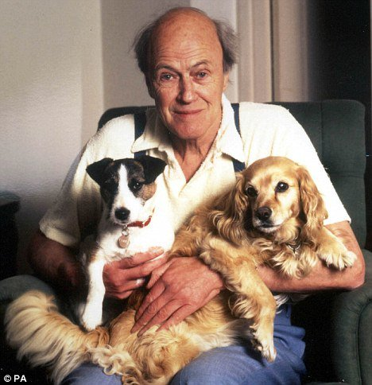
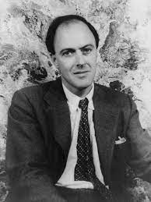
Roald Dahl
Roald Dahl born on September 13 1916 and died on November 23 1990.He was a British novelist, short-story writer, poet, screenwriter, and wartime fighter ace of Norwegian descent. His books have sold more than 250 million copies worldwide. Dahl has been called "one of the greatest storytellers for children of the 20th century".

Slide 3
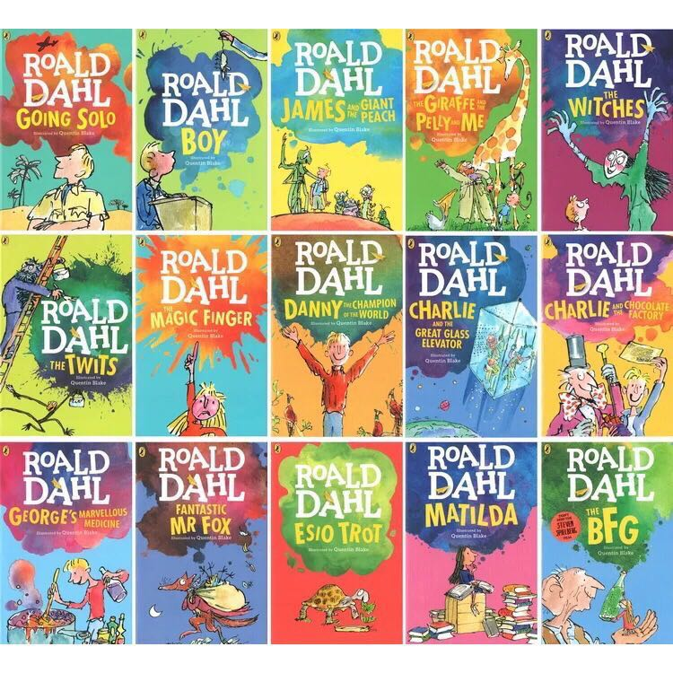
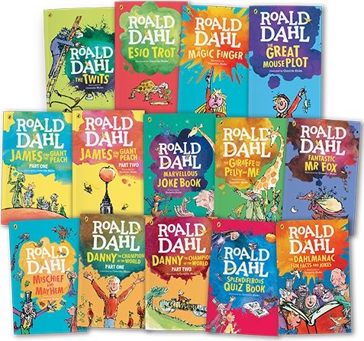
Roald Dahl has wrote 49 books in his life time

Slide 4
What makes Roald Dahls writing unique ?
Dahl's writing style involves a great deal of humour to engage his readers. His Humour and sarcasm appeal to his intended audience as children love reading funny stories with nonsense words and absurd behaviour. He normally writes from a child's perspective, one that children can familiarise themselves with

Slide 5
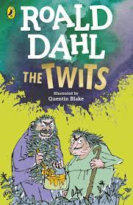
My favourite Roald Dahl book
My favourite Roald Dahl book is The Twits which talks about a spiteful, idle unkempt couple who continuously play nasty practical jokes on each other to amuse themselves, and exercise their wickedness on their monkeys.

