Slide 1
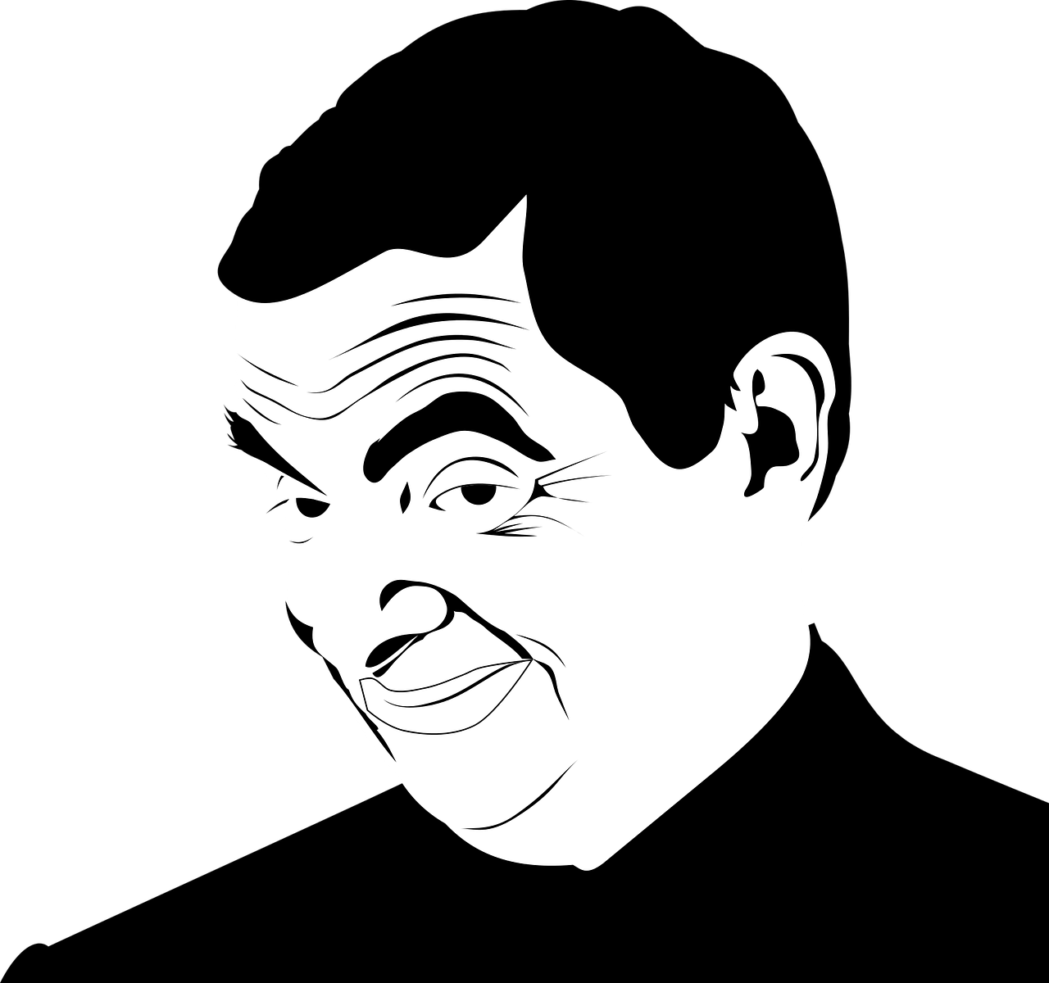
MR BEAN
Khalil saba
6 D

Slide 2
MR BEAN
What Mr beans name?
Rowan Atkinson, in full Rowan Sebastian Atkinson, (born January 6, 1955, Newcastle upon Tyne, England), British actor and comedian

Slide 3
Rowan Atkinson's job
In 1975 Atkinson went on to continue his studies to obtain a Master's of Science in electrical engineering from The Queen's College, Oxford. Although Atkinson did not complete his master's studies, he began his success working at the BBC as a member of the comedy-show

Slide 4
Where did Rowan Atkininson study
In 1975 Atkinson went on to continue his studies to obtain a Master's of Science in electrical engineering from The Queen's College, Oxford.

Slide 5
Why Mr Bean is a hero?
He is obnoxious, crazy and sometimes seems stupid. Though on the contrary, Mr. Bean is shown to be a very intelligent man, being able to teach a physics class with ease and creating multiple inventions in a time of need.

Slide 6
What is the message of Mr. Bean?
Bean's most important life lesson is to be yourself. He was odd, childish, impulsive, and occasionally repulsive, but no one could ever say he wasn't comfortable in his own skin
Which personality type is Mr Bean?
Mr Bean is an INTP personality type. Mr Bean seems to live in his own world. He naturally questions procedures and ideas

