Slide 1
Yes day
By: Sadeen AbuHazeem

Slide 2
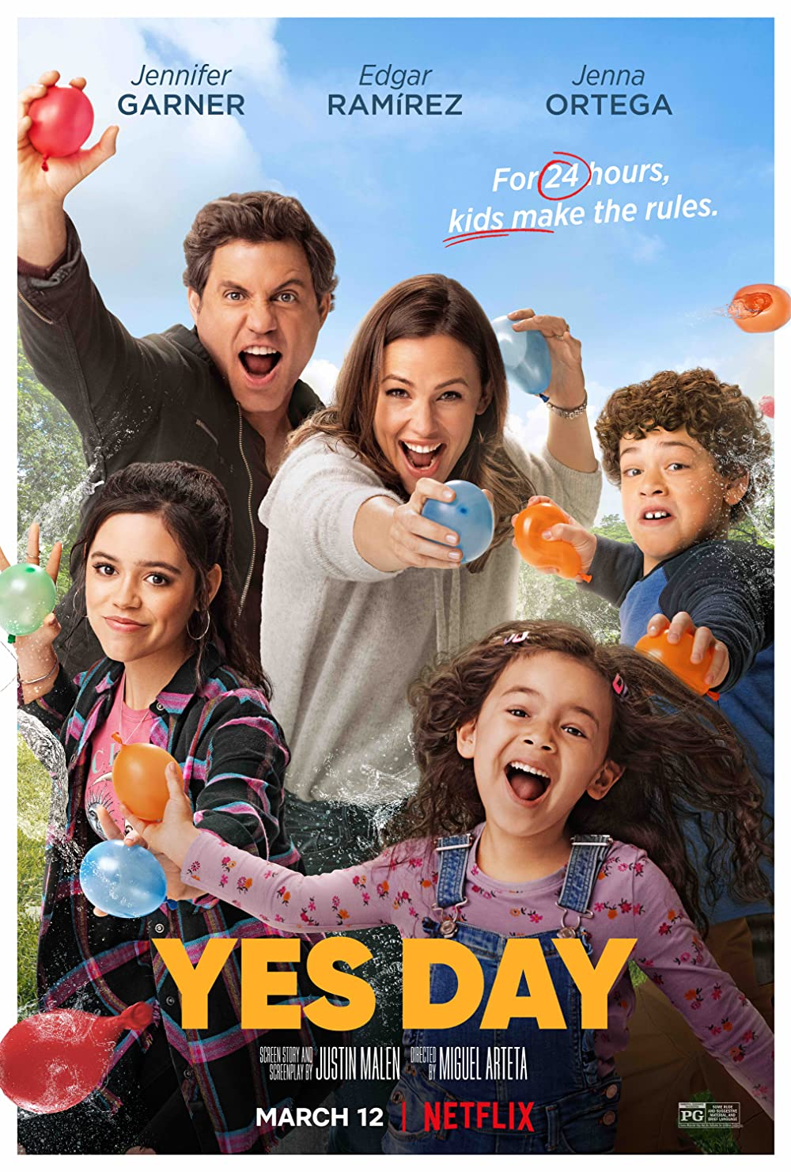
The main characters:
Jenna Ortega : Katie Torres
Jennifer Garner: Allison Torres
Édgar Ramirez : Carlos Torres
Julian Lerner : Evan Torres
Everly Carganilla : Ellie Torres

Slide 3
My favorite characters
My favorite characters
Why they are my favorite
Allison terros
Elli terros
Personality and kindness
Cuteness and she’s very adorable

Slide 4
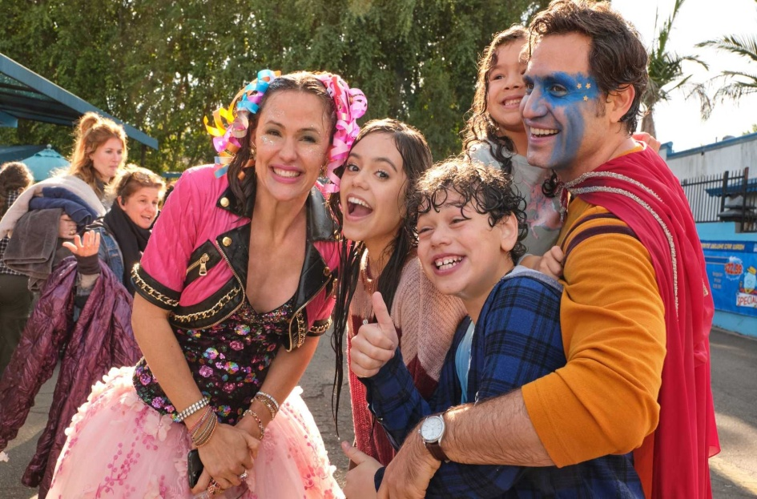
What is yes day about?
Yes day is family friendly movie that was published in march 2021 it’s about a family of 5. the mother used to say no to her children all the time, until one time she decided to do a yes day, where she said yes to her children for 24 hours. But there were rules and the eldest daughter did a bet with her mom

Slide 5
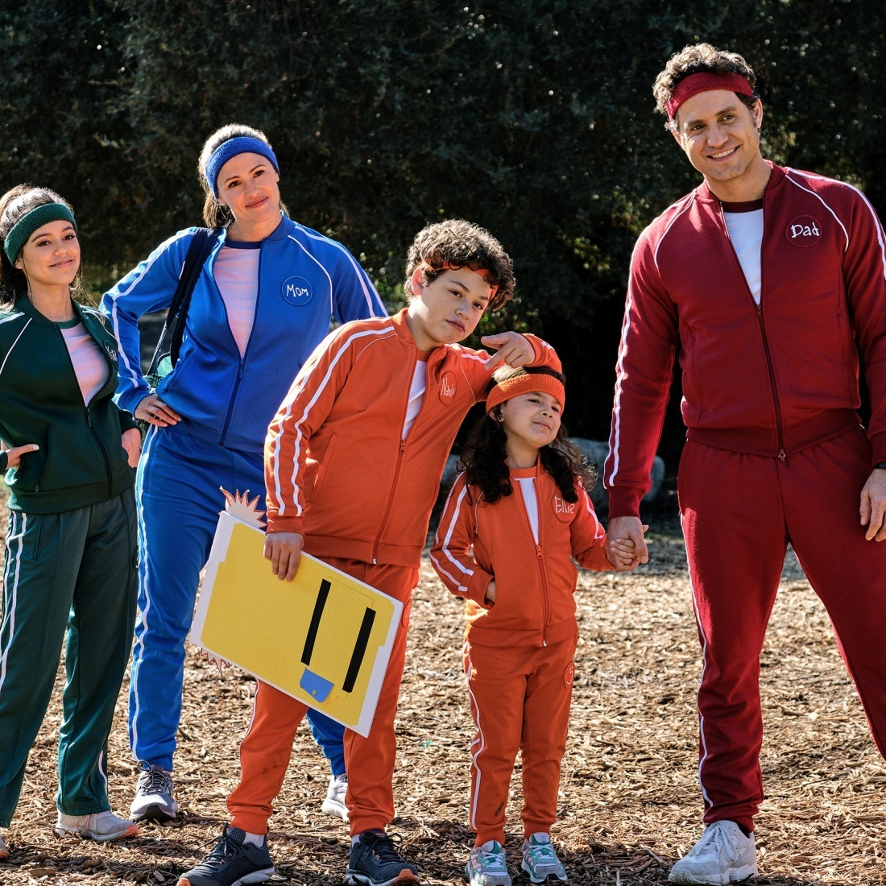

Thank you!

