Slide 1
My Favorite Series
By Tia Nazha
Grade Six D

Slide 2
Diary of a Wimpy Kid
By Tia Nazha
Grade Six D

Slide 3
The Diary of a Wimpy Kid
Diary of a Wimpy Kid is an American children's book series and media franchise created by author and cartoonist Jeff Kinney.
The series follow Greg Heffley, a middle-schooler who illustrates his daily life in a diary (although he constantly tells the audience that it is a journal).

Slide 4
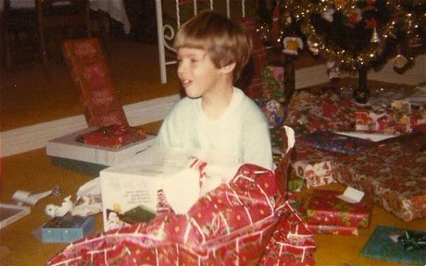
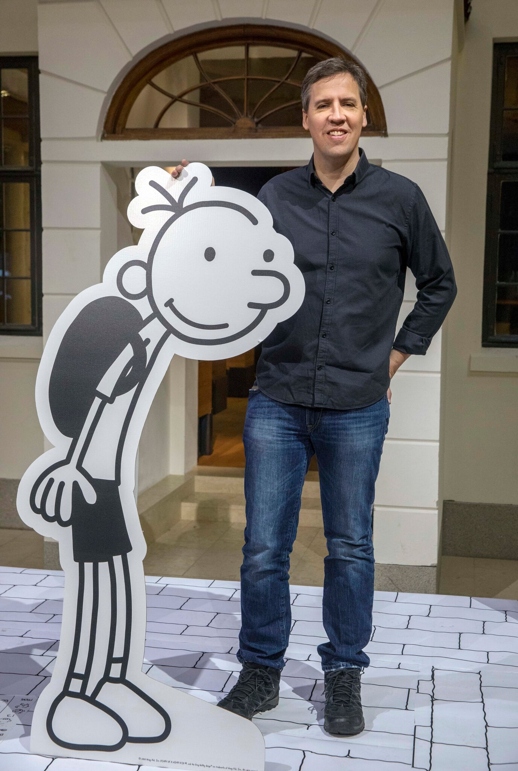
Jeff Kinney
Jeffrey Patrick Kinney is an American author and cartoonist. He was born on 19th of February, 1971. Jeff was born in Fort Washington, Maryland, United States. His parents are Bruce and Madeline Kinney. He has two kids, Will Kinney and Grant Kinney. Jeff Kinney is the writer of the amazing, exciting series The Diary of a Wimpy Kid.

Slide 5
From Jeff Kinney's illustrations:

Slide 6
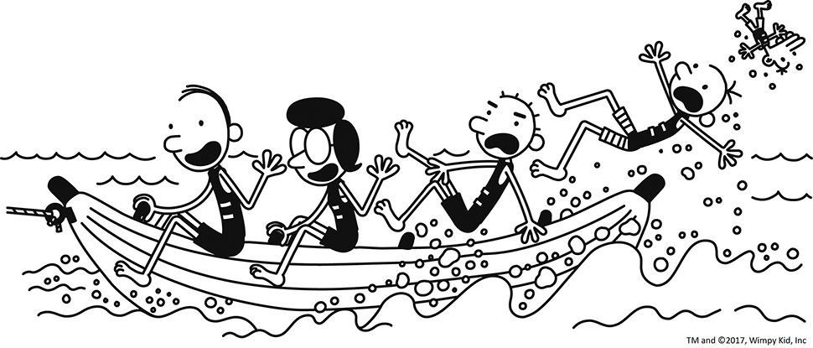
Meet the characters:
Greg Heffley
Manny Heffley
Rodrick Heffley
Susan Heffley
Frank Heffley

Slide 7
Greg Heffley
Greg Heffley is an American student and the main character of the Diary Of a Wimpy Kid novel series. Greg is constantly bullied by his brother Rodrick Heffley. Greg is mischievous, lazy, paranoid, and dishonest. He also tends to be a poor friend, something even he agrees with. Greg is usually selfish and lazy, much of which is shown from his frequent manipulation of Rowley. He sometimes makes Rowley do his chores. Greg often causes trouble and plots mischievous schemes.

Slide 8
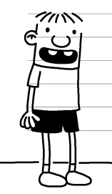
Rowley Jefferson
Rowley is best known for being a good best friend to Greg. Rowley is quite immature and seems a bit naive, but his charming, cheerful and innocence made him more popular with other students (particularly the girls) than Greg.
Likewise, he has a pure soul and only wishes the best for everyone.

Slide 9
Manny Heffley
Manny Heffley is the younger brother of Rodrick and Greg Heffley who is constantly pampered and spoiled by his parents. As the youngest child of the Heffley family, he plays a major role in Diary of a Wimpy Kid series, having appeared in all the main series books to date.

Slide 10
Rodrick Heffley
Rodrick Heffley is a 16- year old teenager and the semi-aggressive older brother of Greg Heffley and Manny Heffley. He is a major character in the Diary of a Wimpy Kid series, acting as a tertiary antagonist in the series overall and serving as the main antagonist of Rodrick Rules.

Slide 11
Susan Heffley
Susan Heffley is the wife of Frank Heffley and the mother of Rodrick, Greg, and Manny Heffley. She is a former member of the PTA who once worked as a preschool teacher, and once was the substitute teacher in Greg's class.

Slide 12
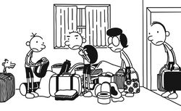
Frank Heffley
Frank Heffley is one of the main characters of the Diary of a Wimpy Kid series. Frank is hinted to be an office worker in many of the books. He is Greg's, Rodrick's, and Manny's unpredictable and serious father. He is the husband of Susan Heffley and the elder brother of Joe Heffley and Gary Heffley.

Slide 13
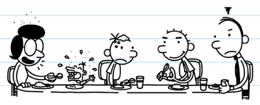
And this is the family of the Heffley!

Slide 14
Best of all, it is an excellent series children can read and get entertained. The series main messages are learning the importance of family and learning how selfishness can hurt others. It really amazes me. You must read it! Don’t miss it! It is the best series ever!

Slide 15
Thank you!

