Slide 1
After Earth
By Sanad Masannat
25/11/2022

Slide 2
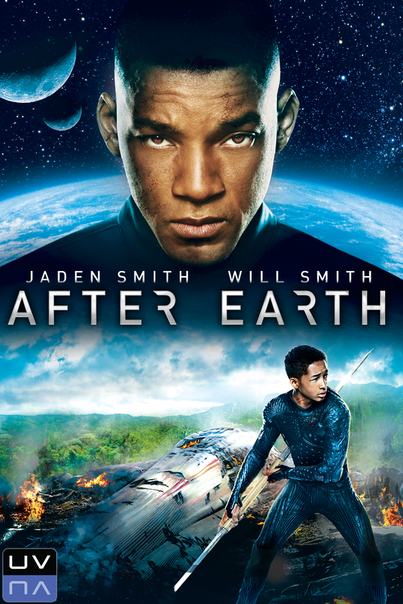
Who are the main characters?
Kitai Raige
Cypher Raige
Senshi Raige
Faia Raige

Slide 3
What this movies about:
When Earth was attacked by aliens people were forced to leave Earth a millennium ago to establish a new home on Nova Prime. Cypher raige leads Nova Prime and his teenage son kitai feels enormous pressure to follow in his father's legendary footsteps which break them apart. Cypher and Kitai set out on a trip to mend their bond, but when their craft crashes on Earth's hostile surface and The father becomes heavily wounded, so kitai has to activate the distress beacon but has to fight the queen alien in order to do so.
follow in his father's legendary enormous pressure to follow in his father's

Slide 4
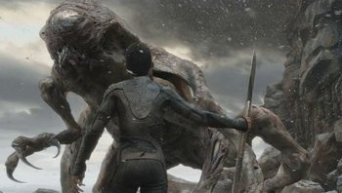
Why I love this movie:
It is a science fiction movie which includes action packed moments.
It is a thriller and suspense movie, it always keeps you guessing what's going to happen next.
The effects were very realistic.
The aliens were scary and can smell your fear.
It had good actors

