Slide 1
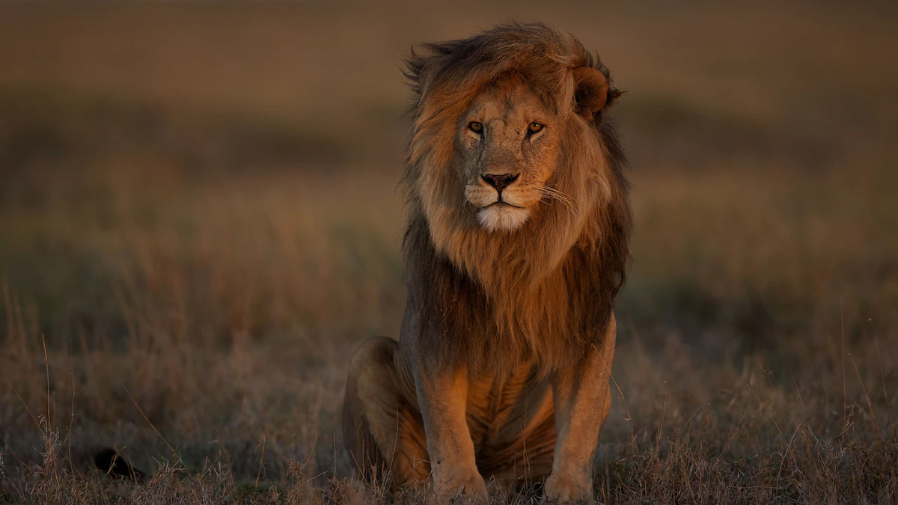
AFRICAN LIONS
Karam Gammoh
6E

Slide 2
African Lions are the most popular specie of big cats. They are the only big cats that live in large family groups called “prides” consisting of four to 12 related adult females with their offspring plus two to three unrelated adult males. Lions also hunt in groups using stalking and ambush techniques. Females do most of the hunting. All members of the pride share in the kill, with males eating first followed by females and then cubs. Males protect the females and cubs from other lions and hyenas.
Lions are an apex predator and, like all apex predators, play a crucial role in maintaining a healthy herbivore population and balanced ecosystem.

Slide 3
Habitat
African lions are typically found in savannas, plains, grasslands, dense bush and open woodlands where prey is abundant. They can also be found in smaller numbers in semidesert and mountain habitats
This species can be found in most countries of sub-Saharan Africa, primarily inhabiting eastern and southern Africa up to elevations of 13,700 ft. (4,200 m).

Slide 4
Statistics
Lion numbers have been decimated, with an estimated 23,000 remaining today, down from 450,000 in the past 50 years.
like many of Africa’s iconic species, lion populations are also shrinking rapidly and are expected to suffer an additional 50% decline in the next 2 decades.

Slide 5
Reasons behind Extinction
The main threats to African lions are hunting conflict and natural prey decline ( Death) as well as habitat loss, climate change and wildlife trade.
With around 23,000 African lions left in the wild, they're now officially classified as 'vulnerable'.
Unfortunately, lion hunting is legal in Africa. But at the same time, the government of South Africa, Botswana, Namibia, and Zimbabwe are the top countries that allowed the people to hunt wild animals.

Slide 6
What is being done now to preserve African Lions
Non-profit conservation organizations such as African Parks takes on direct responsibility for the rehabilitation and long-term management of protected areas in partnership with governments and local communities.
In African countries like Kenya, lions are largely restricted to protected areas and surrounding community conservation areas, where hunting is prohibited.
African Parks has heeded the call to safeguard and protect Africa's largest and most iconic cat through effective park protection at a landscape level, and species-specific interventions including reintroductions and translocations, monitoring and research and mitigating human-lion conflict.
With the continental population decreasing and threats continuing to mount, it’s become more important than ever to closely track this species. In Tanzania’s Manyara Ranch, National and International Organizations tagged the lions with high-tech collars equipped with radio transmitters to track the animals’ natural movements. This allows scientists and conservationists to monitor for potential disease outbreaks, home range, productivity, behavior, habitat use, survival, predator-prey interactions, and ultimately population estimates.

Slide 7
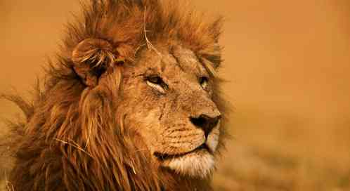
Thank you

