Slide 1
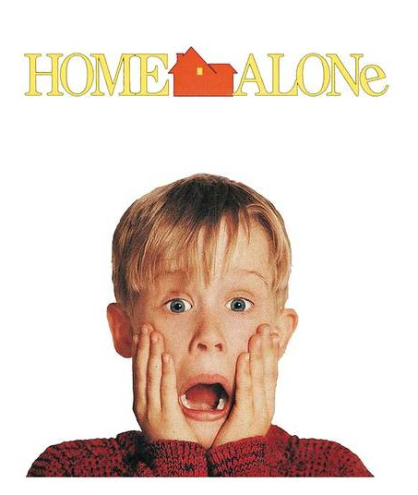
My Favorite Movie
HOME ALONE
1

Slide 2
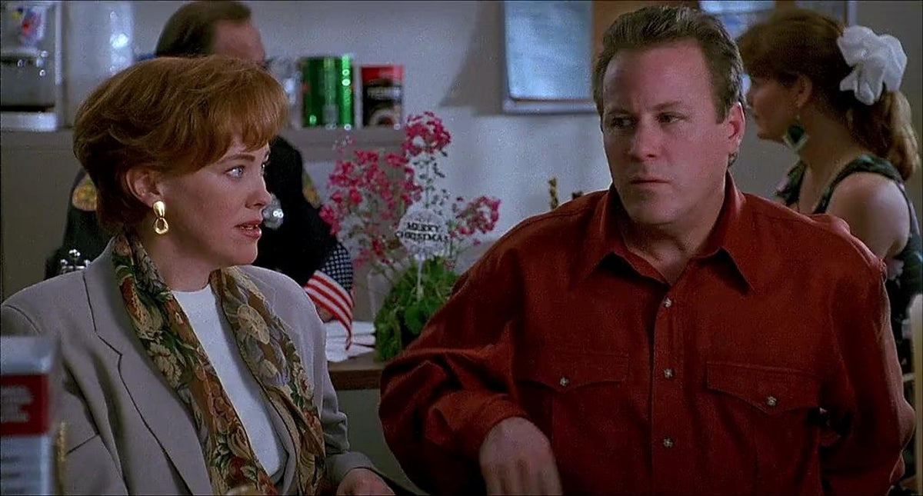
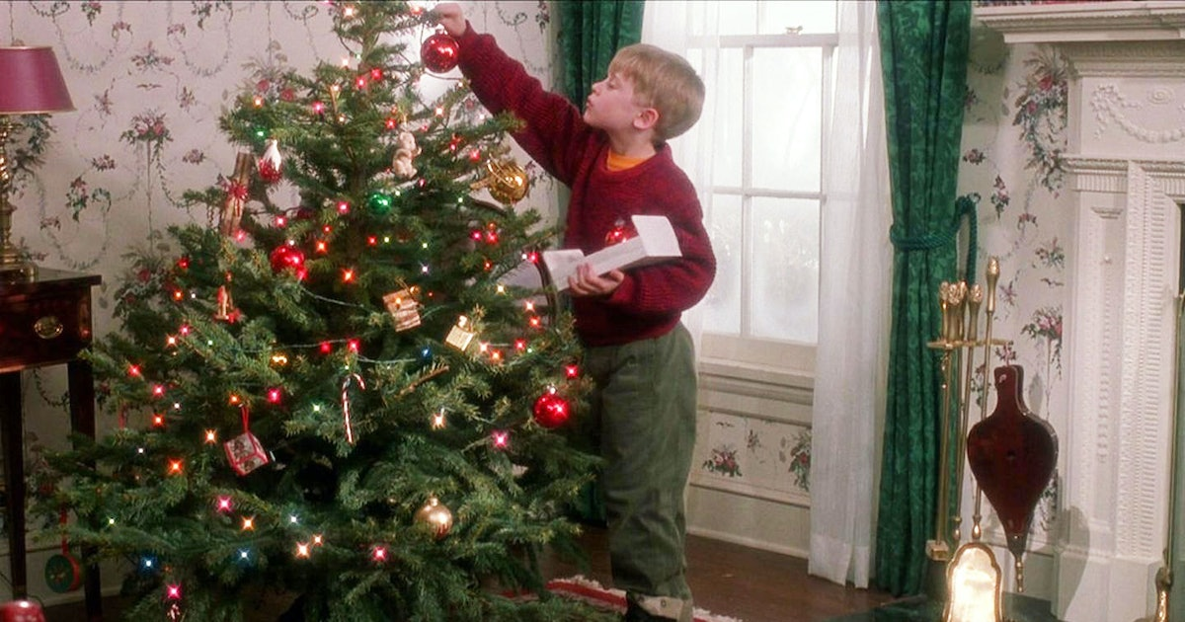
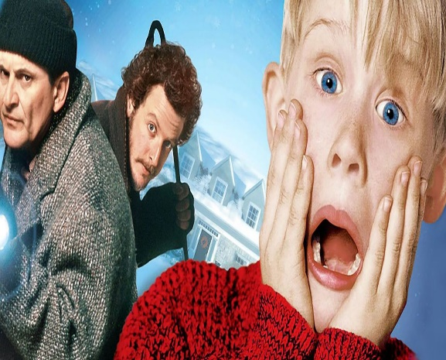
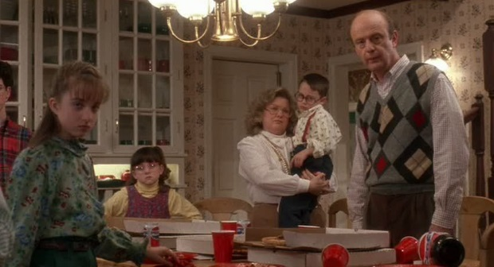
Home Alone 1 is an American Christmas family comedy movie first created in 1991.
Its a great movie that has something for everyone of all ages.

Slide 3
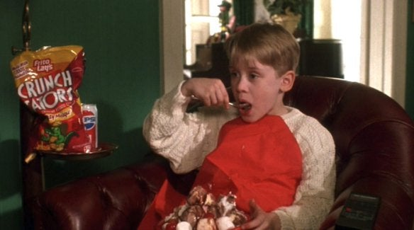
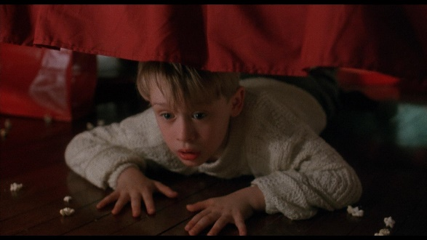
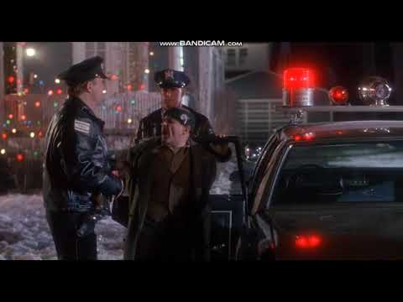
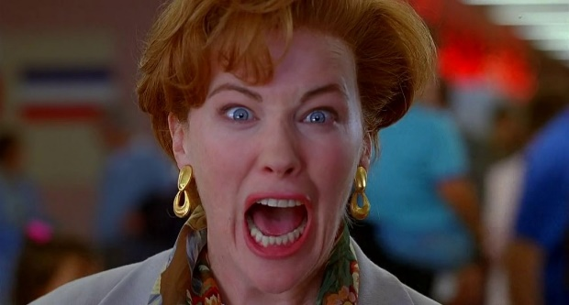
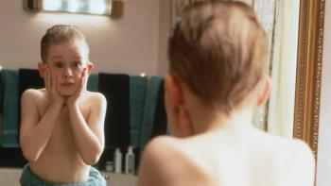
Story Plot
It is Christmas time and the McCallister family is preparing to spend the holidays in Paris, France.
But the youngest in the family, Kevin, got into a scuffle with his older brother Buzz and was sent to the attic room, which is on the third floor of his house.
Then, the next morning, while the rest of the family was in a rush to make it to the airport on time, they completely forgot about Kevin, who assumed when he wok up that his wish to have no family has came true and he got the house all to himself.
Being home alone was fun for Kevin, having a pizza all to himself, jumping on his parents' bed, and making a mess.
Then, Kevin discovers about two burglars, Harry and Marv, about to rob his house on Christmas Eve. Kevin acts quickly and smartly by wiring his own house with makeshift traps to stop the burglars and to bring them to justice.

Slide 4
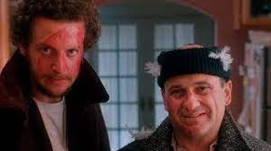
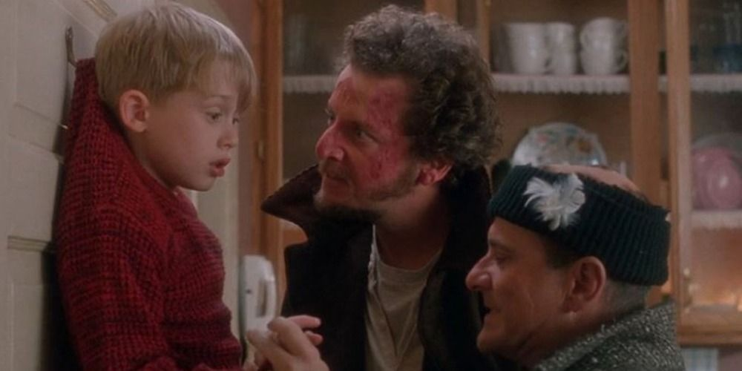
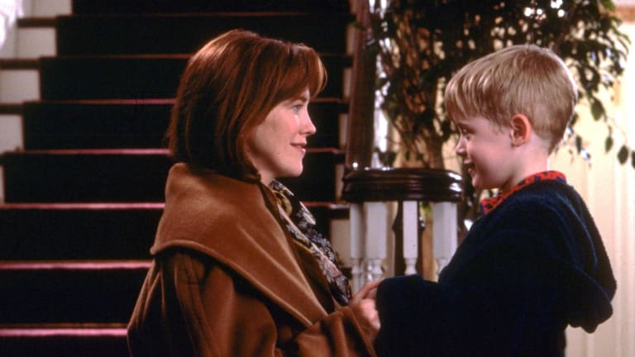
WHY Its my favorite movie?
It reminds me always with the most wonderful time of the year ( Christmas)
It is a brilliant movie for the entire family and that is what a good Christmas film should be
Its funny and always brings laugh
The traps and practical comedy moments will entertain everyone

Slide 5
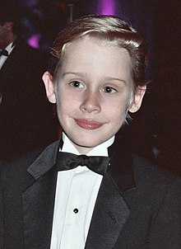
Macaulay Culkin Before and After
1990
2021

Slide 6
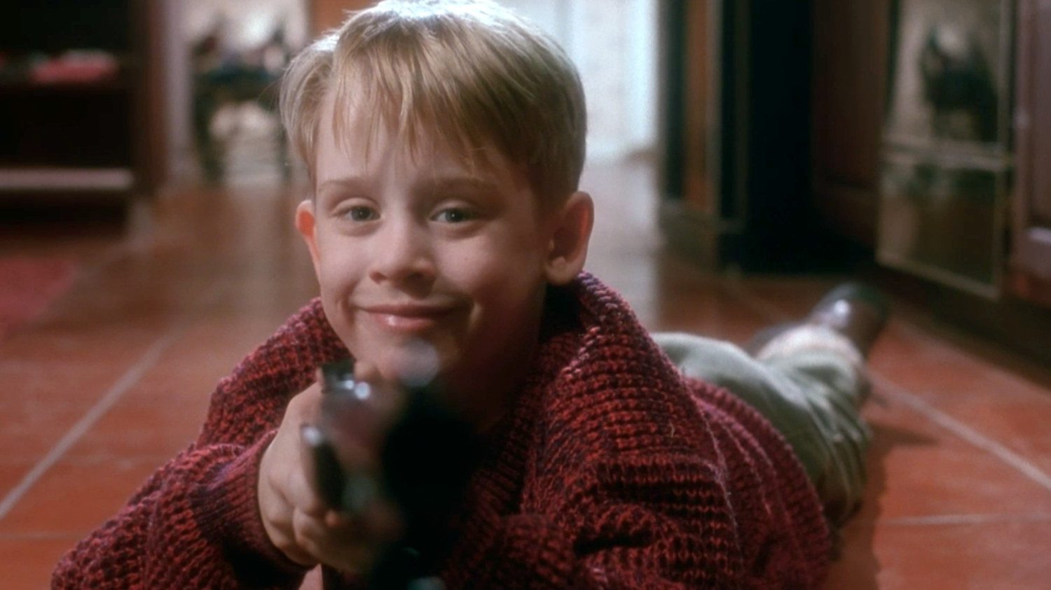
Thank You

