Slide 1
National traditions
by Salma.k , tia.h, ayoub.k, hussam.a, kareem.d

Slide 2
Arabic coffee
What is Arabic coffee?
Arabic coffee is a version of brewed coffee of coffea Arabic beans.
When do we serve Arabic coffee?
We serve traditional Arabic coffee in arab holidays and special events such as ramadan and eid.
Why do we serve it?
to show hospitality and give a generous welcome.

Slide 3
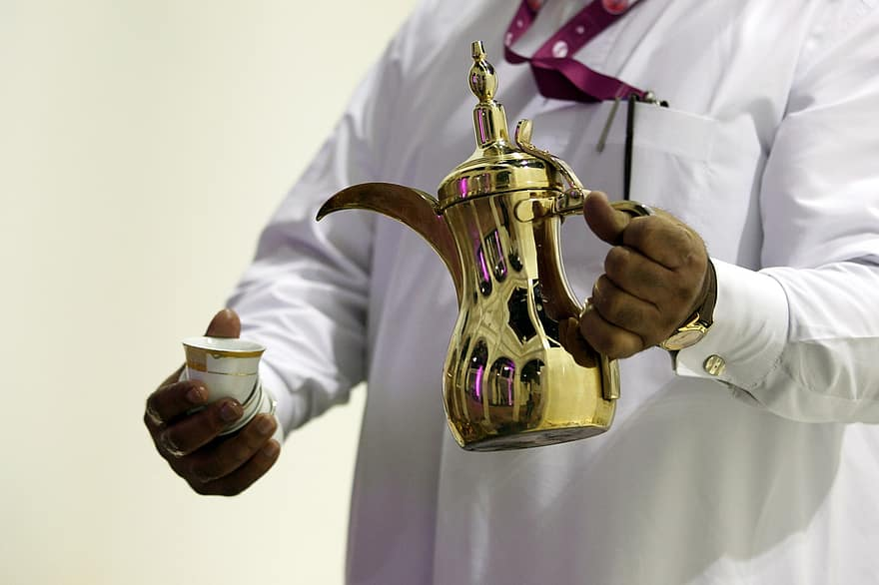
When was it invented?
Arabic coffee was invented in the 8th century
Our opinion: we think Arabic coffee is a delicious flavorful type of coffee and is a great way to welcome and show respect to new guests.

Slide 4
Jordanian traditional clothing
What is the traditional clothing of Jordan for men?
The traditional outfit worn by men is made out of a one piece full length dress called “dishdashi” or “thoub”
What is the traditional clothing of Jordan for women?
The woman's national outfit is a handmade full length black dress embroiderd with different patterns in red.

Slide 5
https://drive.google.com/file/d/1-Q-4bzCjEdtEpV2hHOb4EN85QbdaAnPv/view?usp=drivesdk
https://drive.google.com/file/d/1-Q-4bzCjEdtEpV2hHOb4EN85QbdaAnPv/view?usp=drivesdk
Why do they wear it?
It has been worn by “bedwans” and villagers it is used as a symbolcof honor and/or tribal identification.
This is a video about the bedwan culture in Arabic
Made by Saif Khlaifat: https://drive.google.com/file/d/1-Q-4bzCjEdtEpV2hHOb4EN85QbdaAnPv/view?usp=drivesdk

