Slide 1
Jordanian Traditions
Done by : Reena Abu Zalaf , Rami Hamarneh , Yara Ali , Rajai Samara , Miral Dababneh

Slide 2
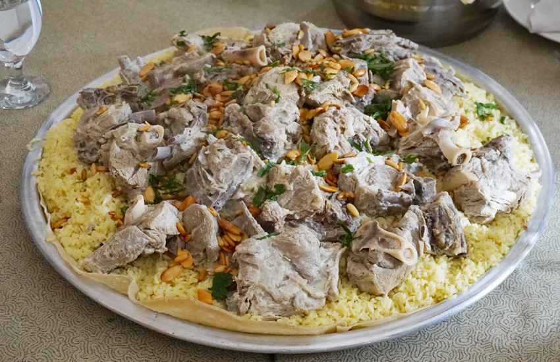
What is Mansaf ?
Mansaf is a traditional Jordanian dish .

Slide 3
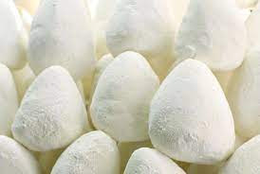
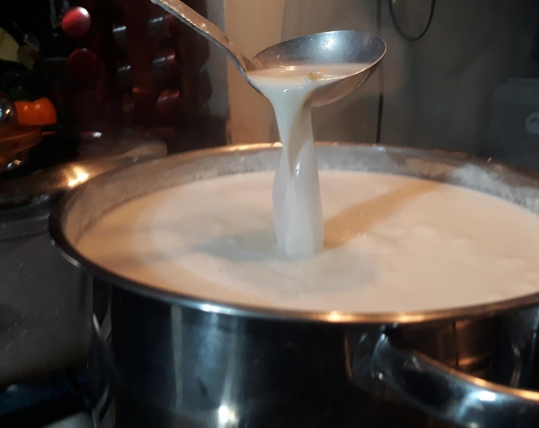
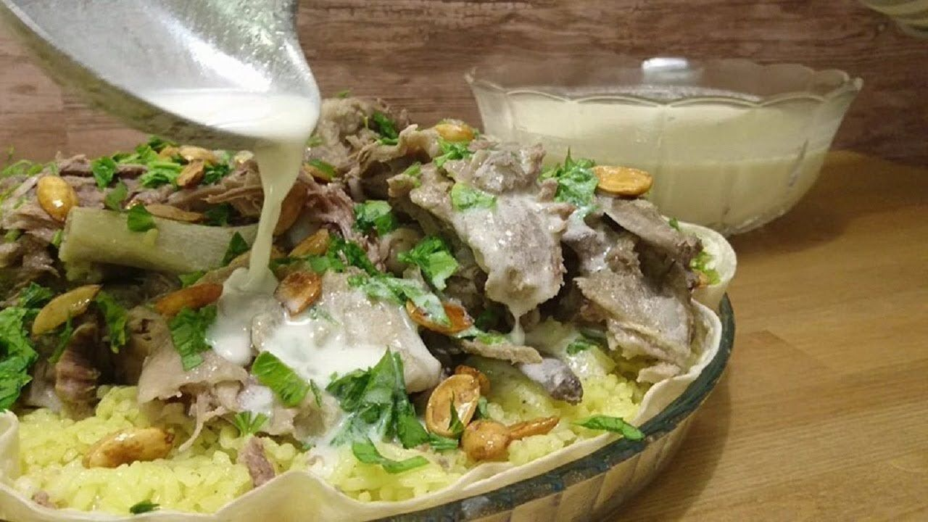
How Mansaf is made ? lamb cooked in a sauce of fermented dried yogurt and served with rice or bulgur.
https://www.youtube.com/watch?v=1-_KgpJOLR8

Slide 4
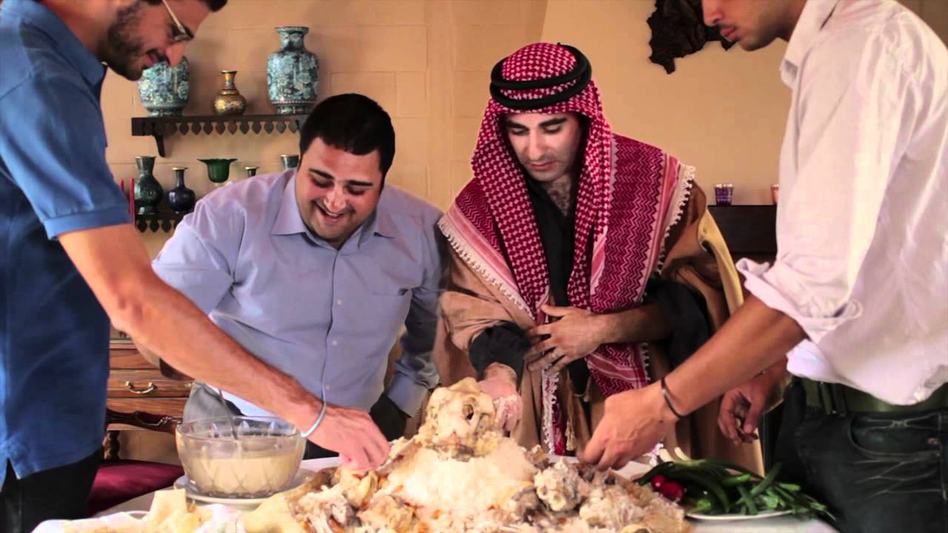
Mansaf is a delicious dish and in Jordan they eat it in wedding and funeral

Slide 5
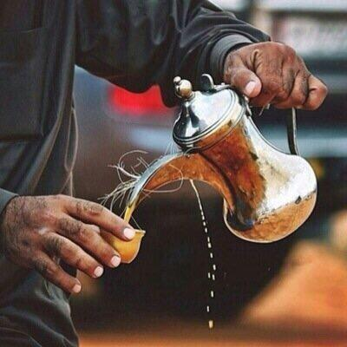
What is Jordanian coffee? Jordanian coffee, or “Al-Qahwa”, is made from coffee beans roasted very lightly or heavily from 165°C to 210°C and cardamom.
https://youtu.be/O0ef2ZEOE1w

Slide 6
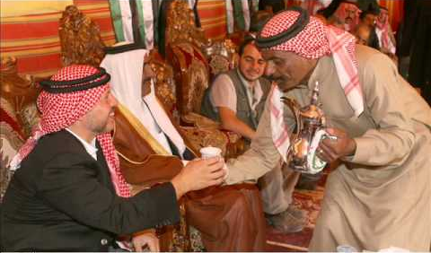
Coffee is a Bedouin way to communicate . One of the interesting facts about Jordanian and those who visit this hospitable country will come to realize, we drink coffee at parties and wedding and feast.

