Slide 1
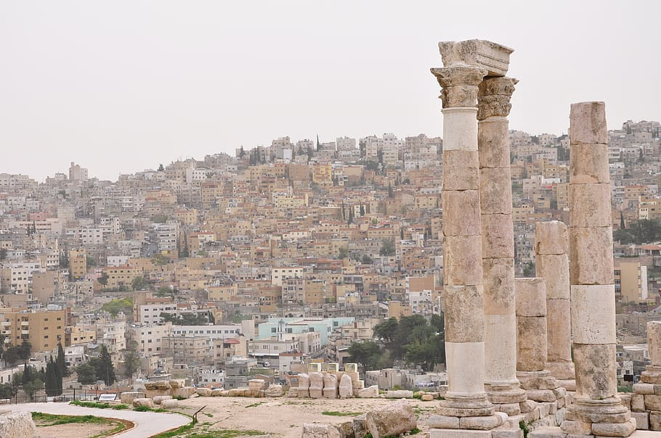
Global project
Jordan national traditions
Jordan traditional
By: Omar abutouq
Mohammed alrasheed
Sama alqamhawi
Maya al kurdi
Ayed hijazeen
Zaid shawareb

Slide 2
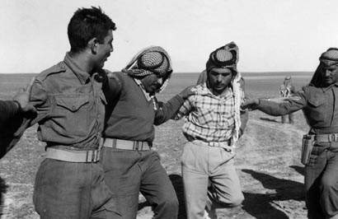
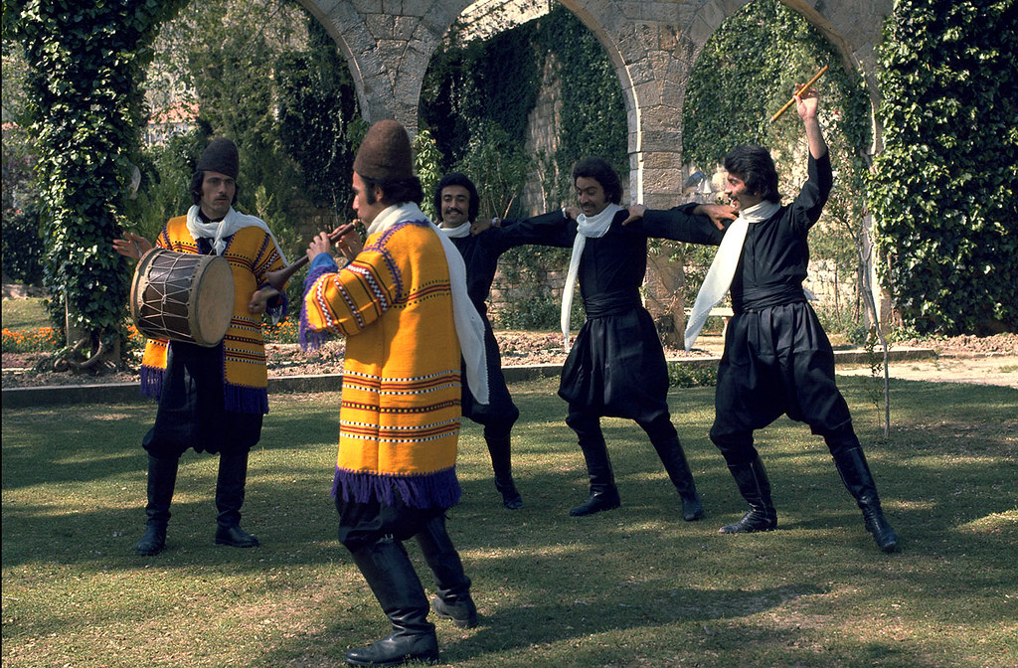
dabkeh
dabkeh
The name “Dabke” is thought to have been derived from the Levantine Arabic word dabaka دبكة) )which can be roughly translated to “stamping of the feet”. It perfectly describes the essence of the dance.Dabke is characterized by people stamping their feet rhythmically in lines or circles. The dancers’ arms will often be interlocked with one another. They will usually sing or chant along with the dabke music in the background, too.
The name “Dabke” is thought to have been derived from the Levantine Arabic word dabaka دبكة) )which can be roughly translated to “stamping of the feet”. It perfectly describes the essence of the dance.Dabke is characterized by people stamping their feet rhythmically in lines or circles. The dancers’ arms will often be interlocked with one another. They will usually sing or chant along with the dabke music in the background, too.
This Photo by Unknown Author is licensed under CC BY-SA-NC
This Photo by Unknown Author is licensed under CC BY-SA

Slide 4
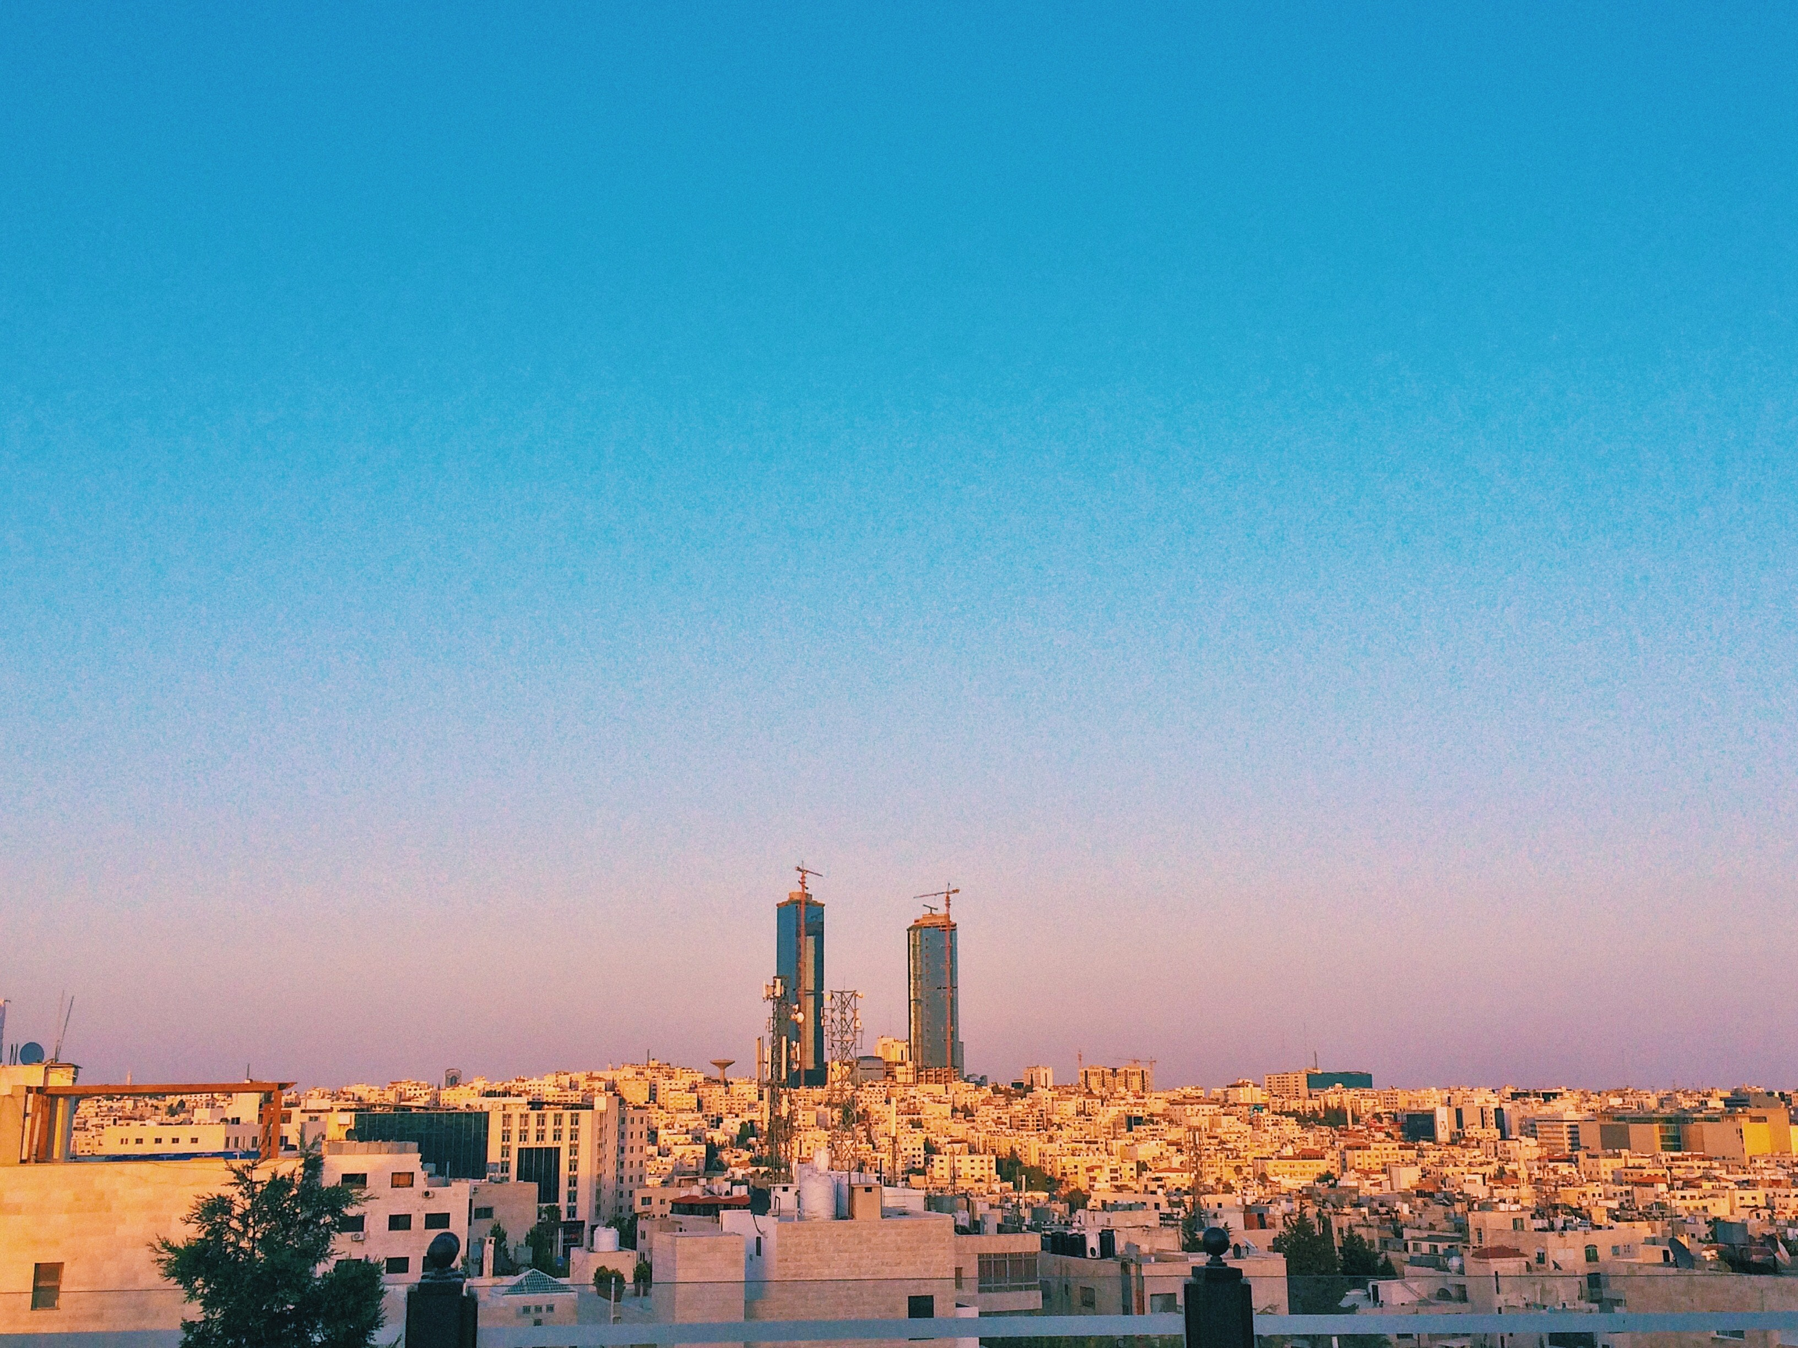
How do people practice dabkeh
The formation of dancers will form from left to right. At the head of the formation is the leader (called raas or lawweeh), who sets the rhythm and the steps for the rest. The lawweeh mustn’t just be an expert at dabke, but he must also be accurate, quick, and capable of improvisations. The leader will continuously alternate between facing the dancers and the audience.

Slide 5
Why do people practice dabkeh
Over time, the dabka dance was recognized to make the roof work fun. The union of the family and community members was considered a joyful way to keep things in sync and effective. This tradition was passed through generations as a reminder of the importance of family, community, and tradition. We see dabke performances at weddings, and even in the middle of a protest- which is what makes it s, dabke is considered a tradition in the Levanto special to the hearts of Arabs.
This Photo by Unknown Author is licensed under CC BY-SA

Slide 6
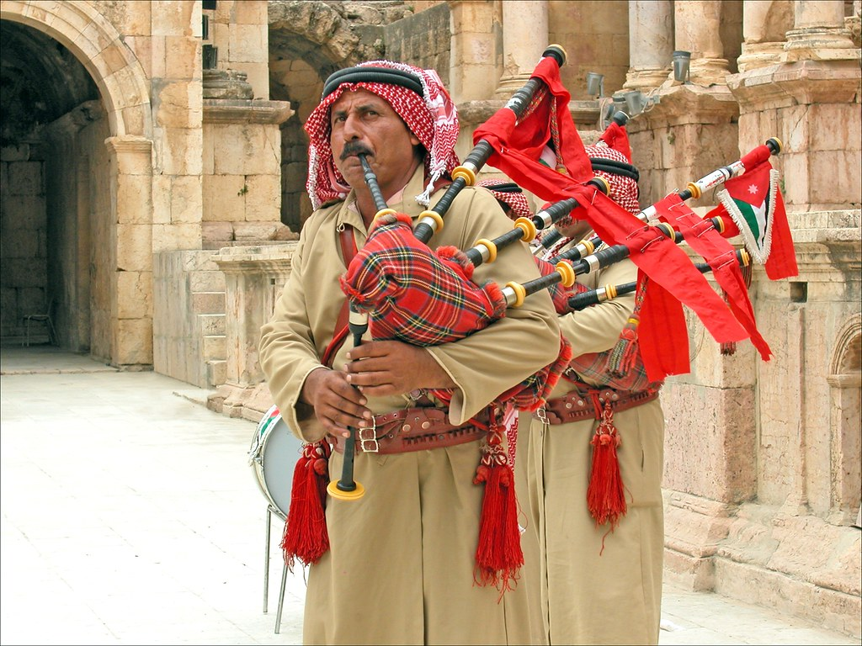
What is Jordan's traditional dress made out of
Cotton dresses women clothes are called thawb and in irbid to be exact its called shirsh and men's traditional clothes are called dishdashah
Site:www.amideastdabroad.org
This Photo by Unknown Author is licensed under CC BY

