Slide 1
Jordanian traditions
Nimer, Angelina,Zeina,Rama,Ghazal
Group 1

Slide 2
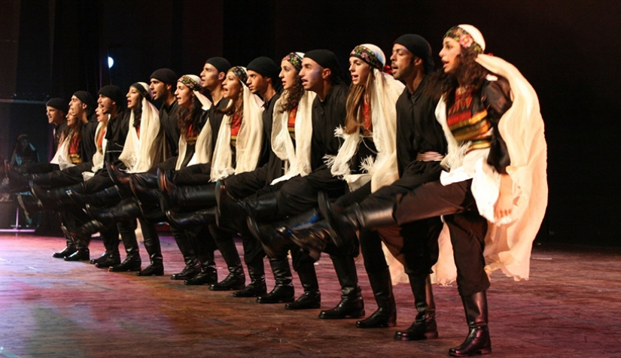
Dabke
Dabke is an Arabic dance. We dance it to show how happy we are and it is preformed at joyous occasions like weddings. It is practiced in Palestine, Jordan , Lebenon and Syria.
FROM : Dabke - Wikipedia

Slide 3
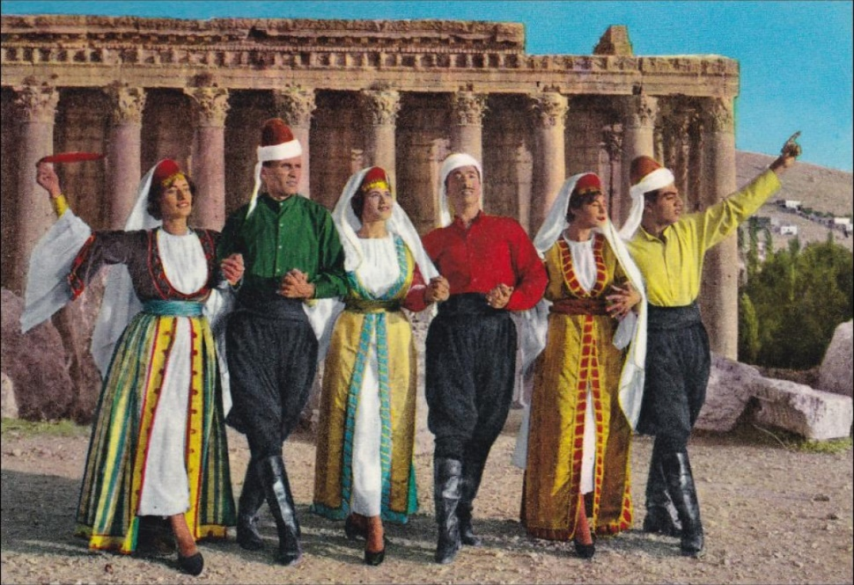
what we think of dabke
We think dabke makes us very special and unique. It helps us express our feelings and selves in a really fun and playful way.

Slide 4
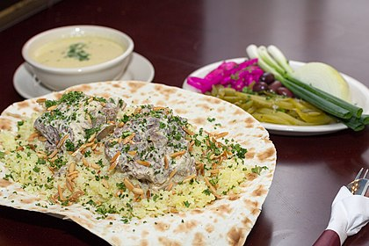
Mansaf
Mansaf is a traditional Jordanian dish. In special occasions like weddings and parties and family gatherings,mansaf is served. It is used to show pride and joy among other people.
From : A Brief History of Mansaf, Jordan's National Dish

Slide 5
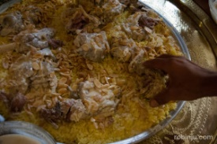
What we think of mansaf
Mansaf is a special and respectful traditions and it helps us show our feelings

Slide 6
THANK YOU FOR READING
FOLOW FOR MORE

