Slide 1
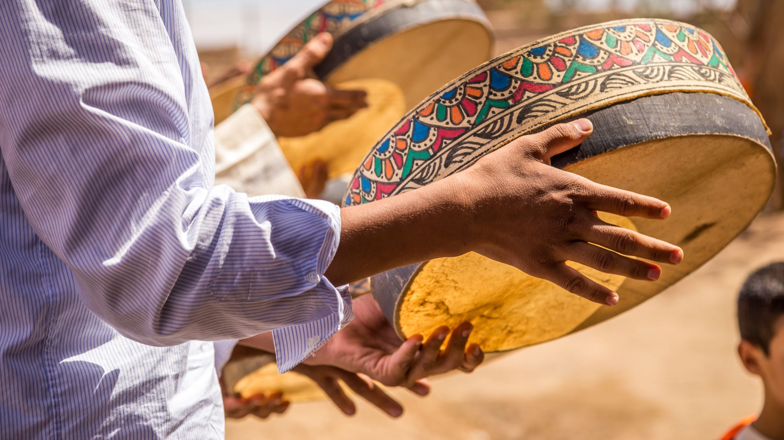
Jordanian TRADITIONS
By Sanad Masannat , Zaid Hishan, Nicola alfaraj, Faisal Thalji
6e 11/2/2022

Slide 2
Jordanian Traditions
Jordan has many traditions.
Today we will talk about two traditions:
MANSAF
DABKEH

Slide 3
1. MANSAF

Slide 4
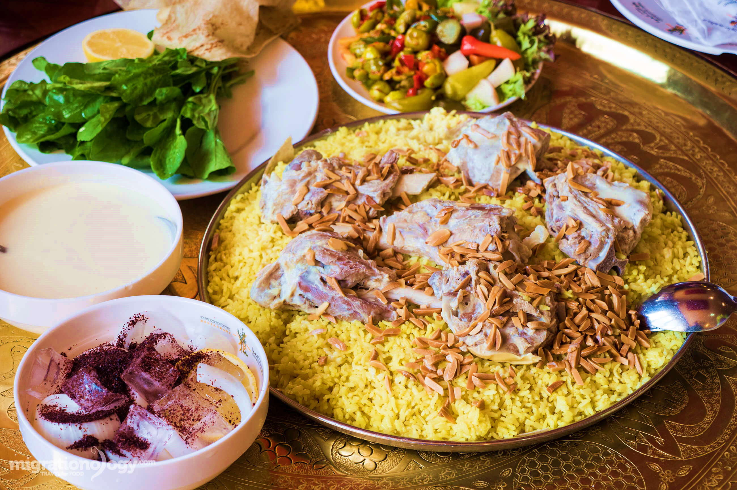
What is mansaf?
Mansaf is a Jordanian Traditional dish and Mansaf is a food that runs deep in the culture of Jordan, It is a delicious dish made with dried yoghurt and mean with rice.

Slide 5
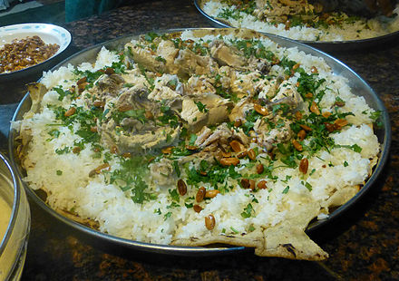
What is Mansaf about?
Mansaf includes lamb meat cooked with meat broth or ghee also some steamed white rice with dried ewe yoghurt and a side of shrak or tomatoes with green onions.

Slide 6
When is this tradition practiced?
Mansaf Is mostly served in ceremonies, weddings, at special occasions including receiving guests, holidays and greetings of relatives and family members.

Slide 7
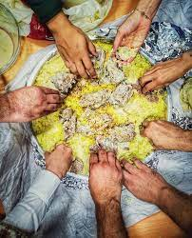
Where is this tradition practiced?
Mansaf Is mostly served almost anywhere. It can be served in homes, ceremony halls, outdoors or even in tents in the desert.

Slide 8
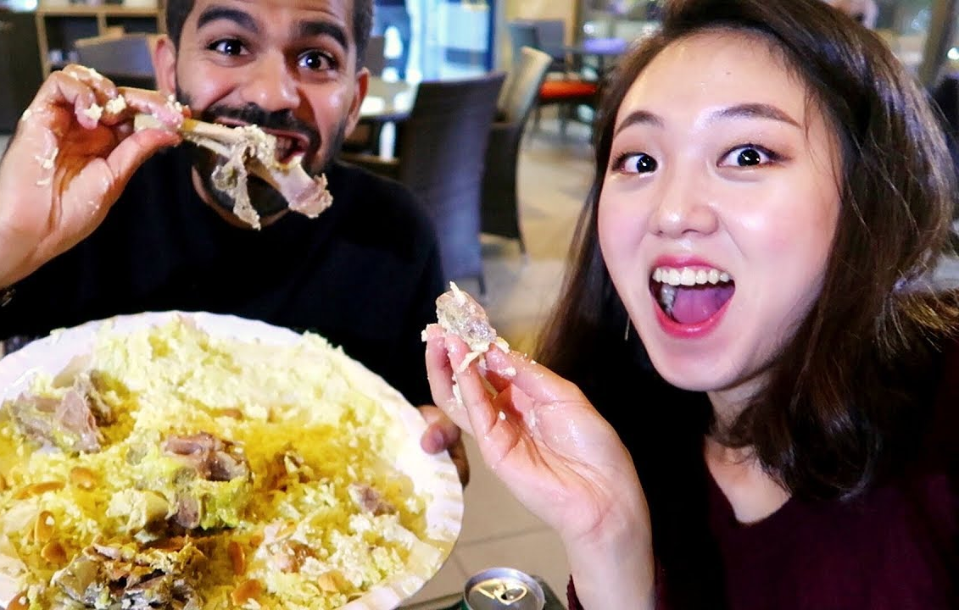
WHO EATS MANSAF?
All Jordanian families enjoy serving and eating Mansaf whenever there is a special occasion or gathering. Also foreigners who visit Jordan like to try Mansaf.

Slide 9
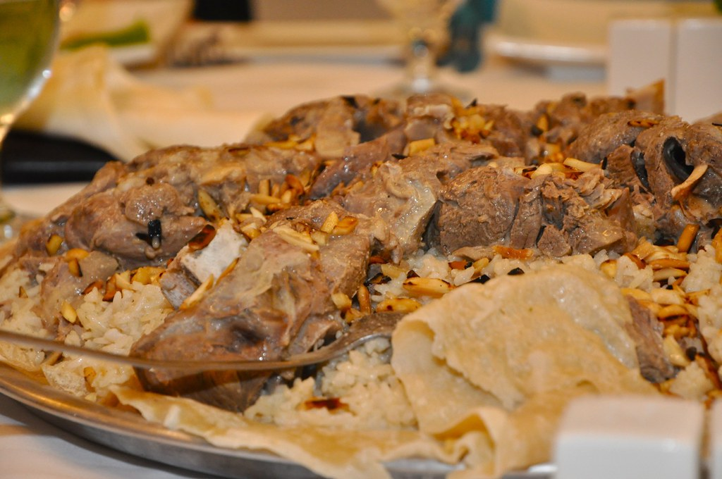
Why is this tradition practiced?
Mansaf is practiced for two reasons:
it symbolizes a joyous occasion and generosity or a special treat for guests.
it is delicious and is a regular dish in Jordan.

Slide 10
What is Dabkeh?
Dabkeh is a traditional folk dance or a dance between friends or family and it occurs each year and all of the Jordanians celebrate it

Slide 11
2. DABKEK

Slide 12
What is Dabkeh about?
Dabkeh is a traditional folk dance in Jordan and it goes way back in generations.
It is truly a wonderful dance by men or women or both.
It can be performed in front of family friends and guests.

Slide 13
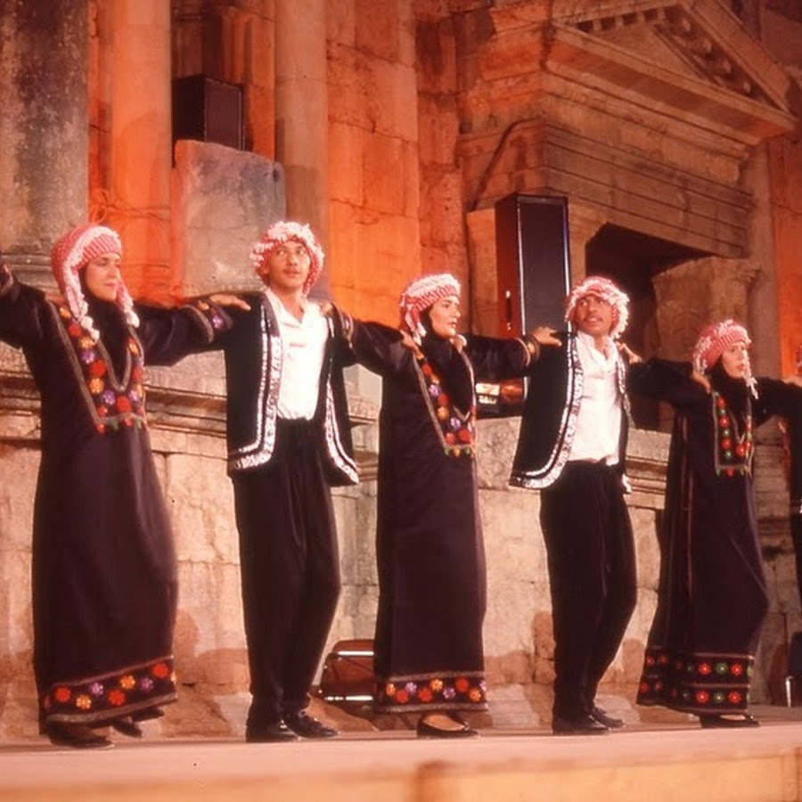
Where is Dabkeh practiced?
Dabkeh originated in the mountains of Levantine region in Jordan, Palestine, Lebanon and Syria.
It is practiced in homes, weddings, ceremonies even sometimes at parties.

Slide 14
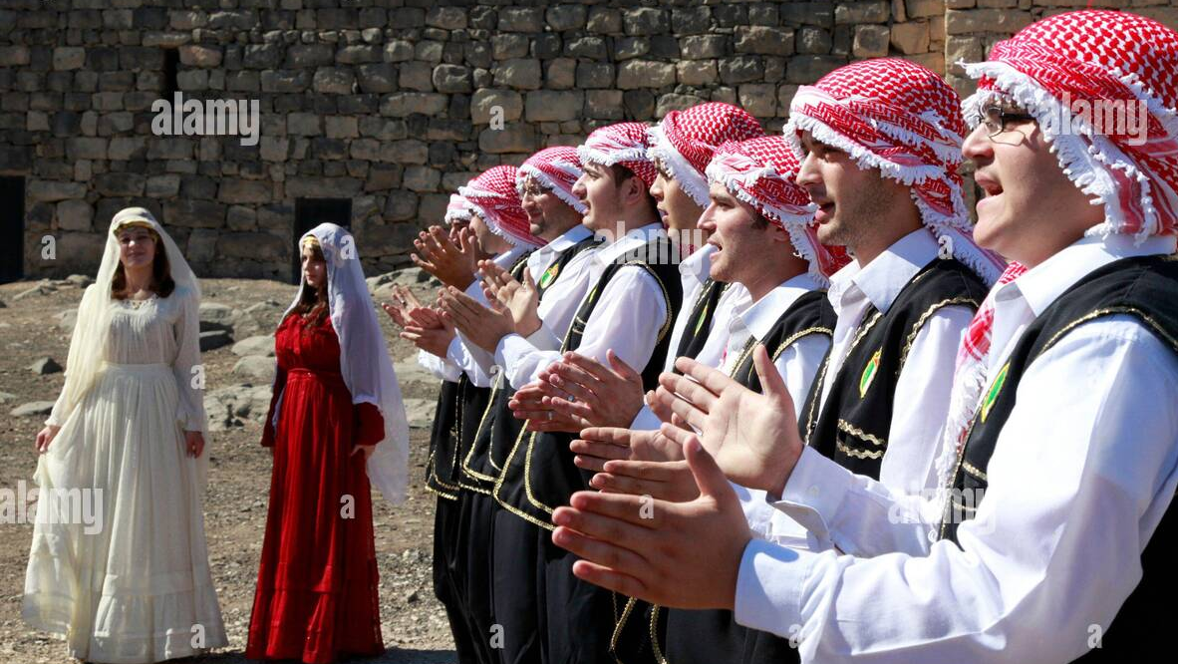
When is Dabkeh practiced?
Dabkeh is practiced whenever there is a special public occasion, or celebration.
It can also be performed in private occasions, weddings or celebrations.

Slide 15
Who practices Dabkeh?
Not all Jordanians can dance Dabkeh because it takes practice and being fit and a great dancer. Mostly it is performed by young groups of people.
Dabkeh can be performed by an all males group, all females or a mix of both.

Slide 16
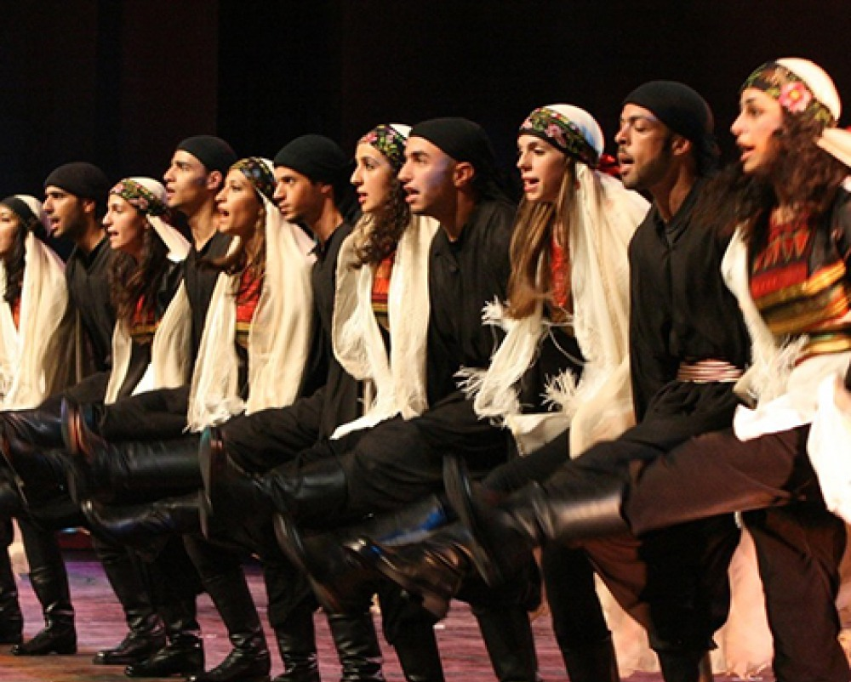
Why is Dabkeh practiced
Dabkeh is a tradition that goes way back in the centuries, Dabkeh is considered more of a cultural dance than just a folk dance.
It is a joyous dance that reflects the character of the people, especially in their dress and the songs they dance to.

Slide 17
Thank You

