Slide 1
Global Perspectives Presentation
By: Maya, Noor, Layan, Saif, Issa

Slide 2
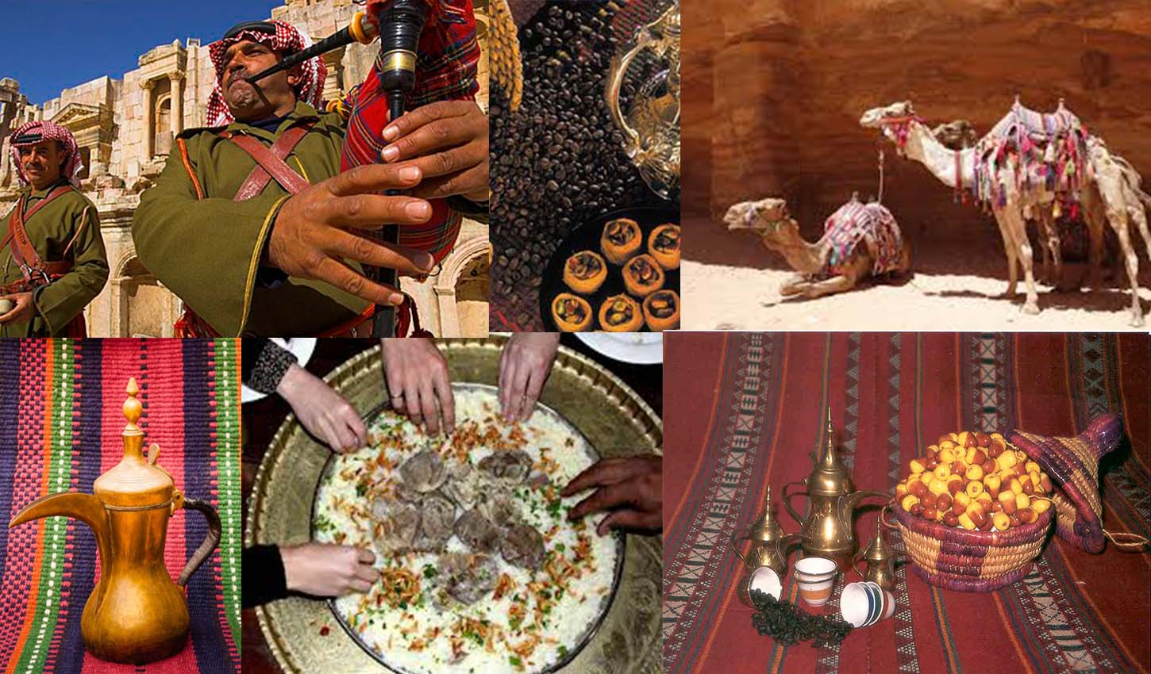

Slide 3
Jordan’s Tradition
-Mansaf:
Write down the question you are trying to answer | Write down information that answers the question | Write the source the information came from | Reflection write what you think of this information
Traditions being researched? | You eat mansaf with your hands | safari | It tastes very delicious
Describe the tradition: | You use your hands when you eat mansaf | safari | It tastes better with your hands
Where is this tradition practiced? | In a place | safari | To respect your guests
When is this tradition practiced? | When you eat mansaf | safari | It is a tradition
Who practices this tradition? | People in Jordan | safari | Jordanians
Why is this tradition practiced? | To respect your culture | safari | Respecting your culture

Slide 4
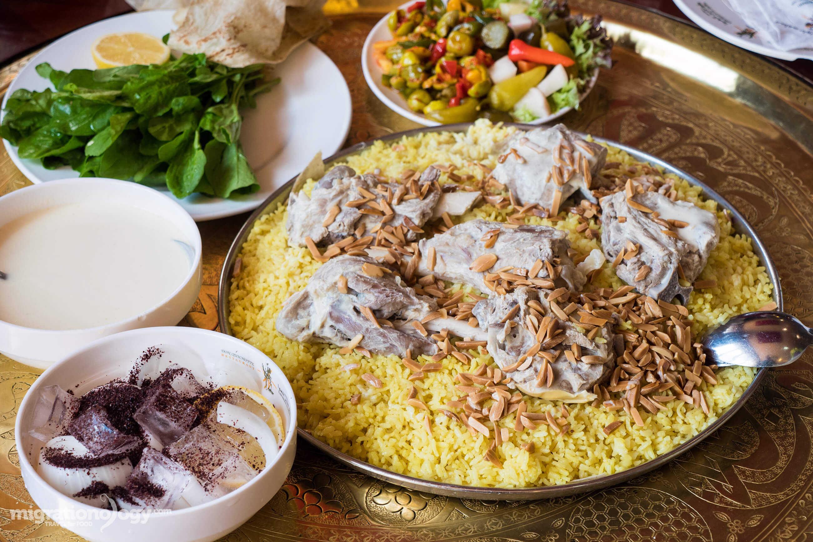

Slide 5
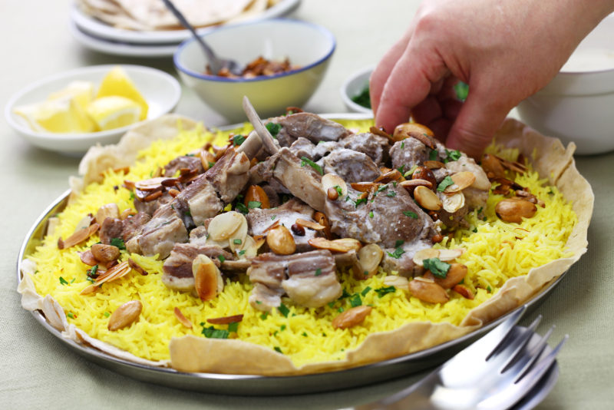
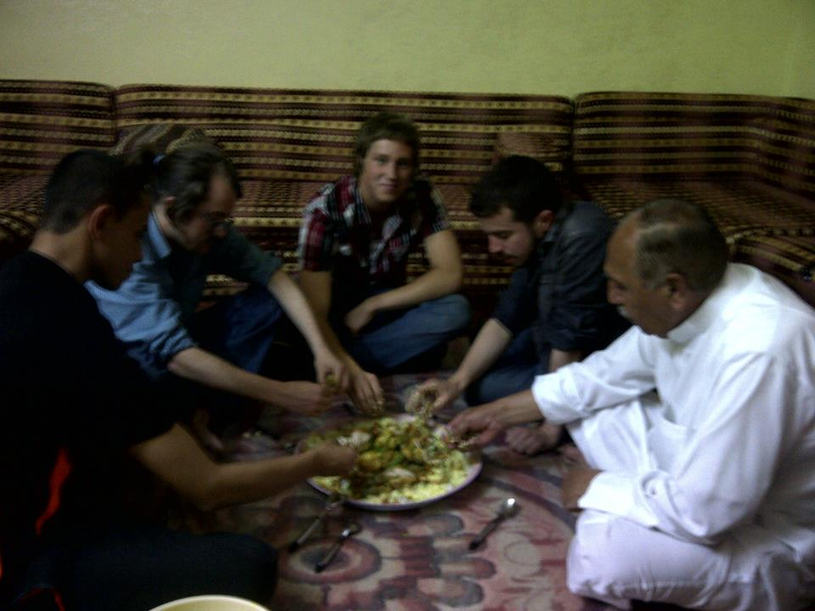

Slide 6
Jordan’s tradition
-Dabkeh:
Write down the question you are trying to answer | Write down information that answers the question | Write the source the information came from | Reflection write what you think of this information
Traditions being researched? | Dabkeh | safari | It represents your culture
Describe the tradition: | A dance in Jordan | safari | It is a dance in your culture
Where is this tradition practiced | In a party/wedding | safari | It is done in many places
When is this tradition practiced | When you are invited to a party/wedding | safari | It is a tradition
Who practices this tradition? | People in Jordan | safari | Jordanians
Why is this tradition practiced | To respect your culture | safari | Respecting cultures

Slide 7
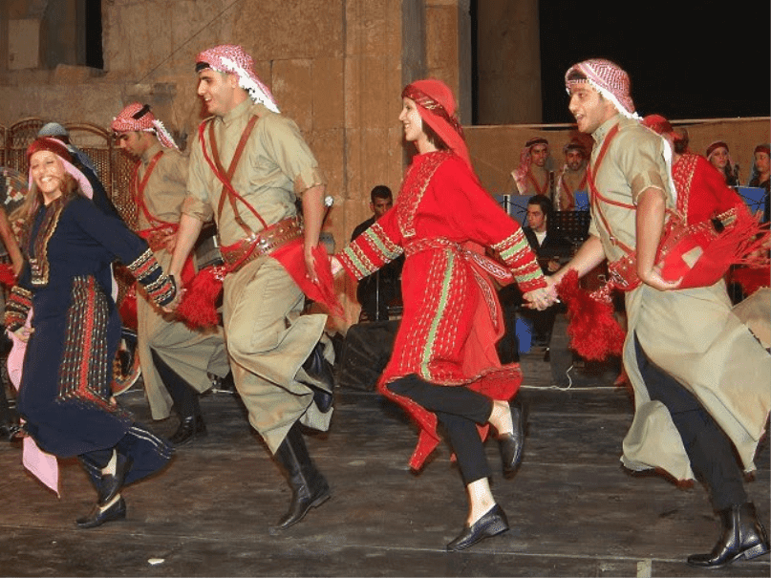

Slide 8
