Slide 1
Mansaf & Dabkeh
By:
Hashem Daoudi
Zaid Al Dalo
Abdullah Sharaab
Qais Abweh

Slide 2
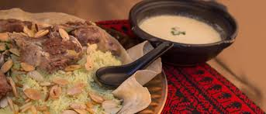

Slide 3
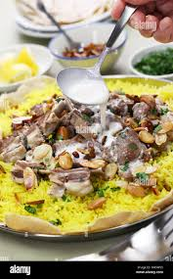
What is Mansaf
Mansaf is a dish of rice, lamb and dry yogurt made in a sauce called Jamed.
Mansaf is the traditional dish of Jordan.
Source: migrationology.com

Slide 4
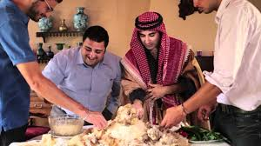
The description of Mansaf
Mansaf is the traditional dish of the country Jordan that all Jordanians eat.
I think that the description of Mansaf is really good.
Source: migrationology.com

Slide 5
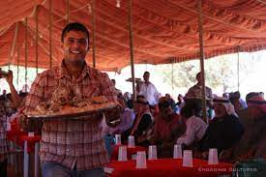
When do we eat Mansaf
We eat Mansaf at weddings, funerals and when we have guests over.
I look forward to every event so we can eat Mansaf.
Source: migrationology.com

Slide 6
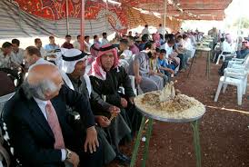
Who practices Mansaf
All Jordanians eat Mansaf.
Jordanians make really good Mansaf .
Source: migrationology.com

Slide 7
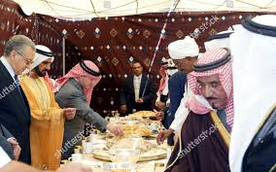
Why do we practice Mansaf
Mansaf is made to celebrate weddings and such like events.
Celebrating events by eating Mansaf is really good.
Source: migrationology.com

Slide 8
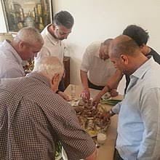
Where is Mansaf practiced
Mansaf is practiced at home in Eid, Christmas and in Ramadan.
I think where we practice Mansaf is a good place.
Source: migrationology.com

Slide 9
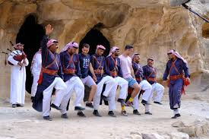

Slide 10
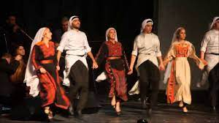
What is Dabkeh
Dabkeh is the traditional dance for all Arab Countries but each country has its own dancing style.
Dabkeh is a really good dance.
Source: migrationology.com

Slide 11
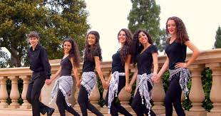
Who practices Dabkeh
All Arab Countries practice Dabkeh.
All Dabkeh practiced by the Arab Countries has a very good style.
Source: migrationology.com

Slide 12
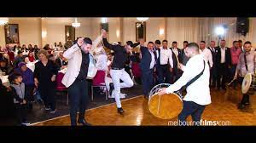
Where do we practice Dabkeh
We practice Dabkeh at weddings and such like events.
Arabs are really good Dabkeh dancers.
Source: migrationology.com

