Slide 1
Jordanian Traditions
By: Christina, Adnan, Raya , Fadwa
Start
Table of contents
Back
Next

Slide 2
Table of contents
01
02
Dabke
Mansaf
Start
Table of contents
Back
Next

Slide 3
01
Dabke
Start
Table of contents
Back
Next

Slide 4
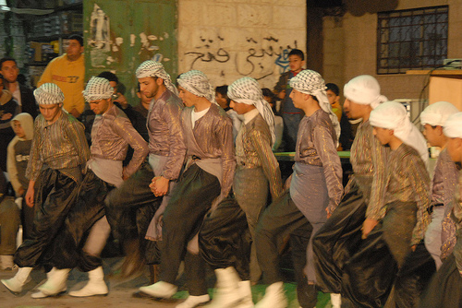
What is Dabke?
Dabke is an exuberant, joyful form of traditional line and circle dancing with origins in Middle Eastern culture and Bedouin tribes.
Start
Table of contents
Back
Next

Slide 5
Where is dabke practised?
when is Dabke practised?
Why is Dabke practised?
Dabke is practiced in Middle East this includes the countries of Palestine, Lebanon, Jordan, and Syria.
Dabke is done at a variety of occasions but is most popular at weddings.
Who practises Dabke?
Dabke originated in the mountains of the Levantine region. This region in the Middle East includes the countries of Palestine, Lebanon, Jordan, and Syria.
Dabke signifies hope, struggles, and history of the Palestinian people- making it one of the most important cultural forms of art in their culture.
Start
Table of contents
Back
Next

Slide 6
Mansaf
02
Start
Table of contents
Back
Next

Slide 7
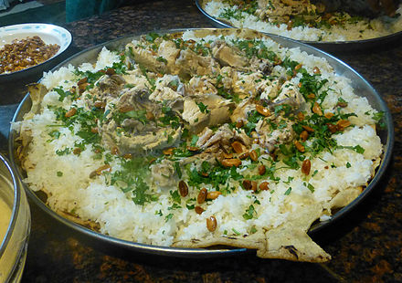
What is Mansaf?
Mansaf is a traditional Jordanian dish made of lamb cooked in a sauce of fermented dried yogurt and served with rice or bulgur.
Start
Table of contents
Back
Next

Slide 8
Where is mansaf practised ?
When is mansaf practised?
Who practises mansaf?
Why is mansaf practised?
Mansaf is considered the national dish of Jordan, and can also be found in Kuwait, Saudi Arabia and Syria
A large platter of mansaf must be present at every major occasion: funerals, weddings, births, graduations, religious holidays,
Jordanian Citizens and other country in the Levant
Mansaf ties together the key elements of Jordanian culture; Bedouin customs, the love of good food, and, most importantly the camaraderie of the Jordanian community.
Start
Table of contents
Back
Next

Slide 9
THE END
Start
Table of contents
Back
Next

