Slide 1

Global project
By: Natalie Mansour ,Haya baqleh , Mary Abu Lail ,Hanna Al Farrah , Saif Haddad , aoun azar .
6 “A”

Slide 2

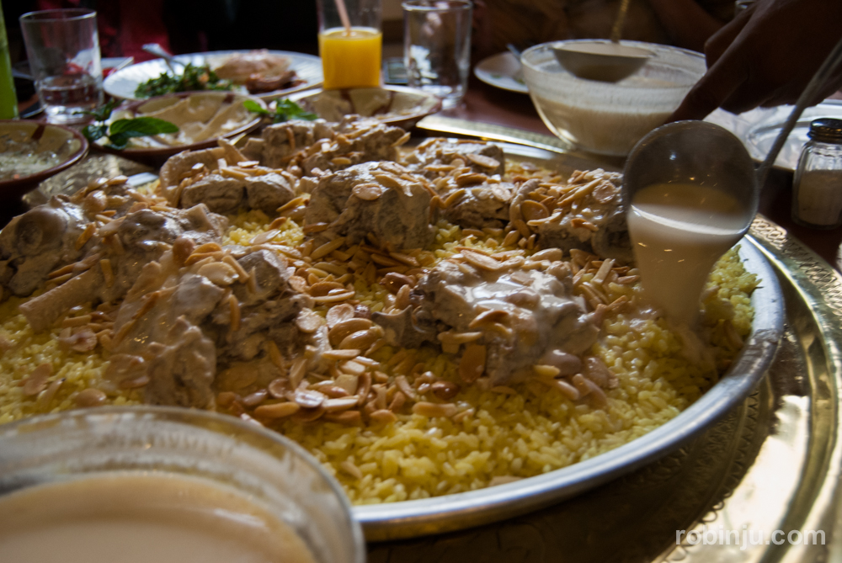
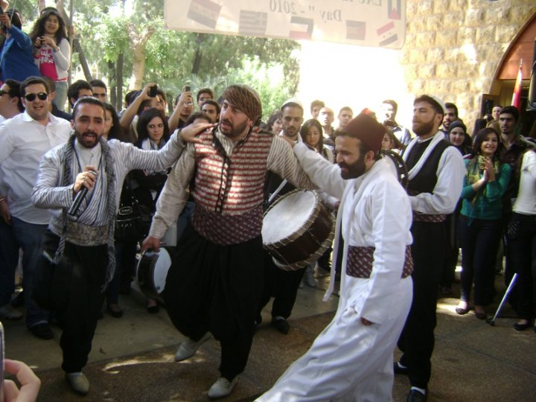
Mansaf and Dabkeh

Slide 3
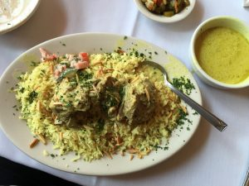
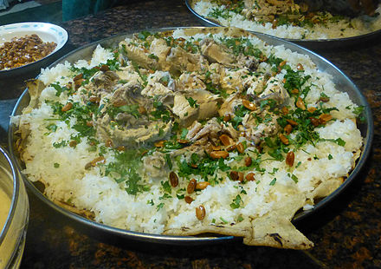
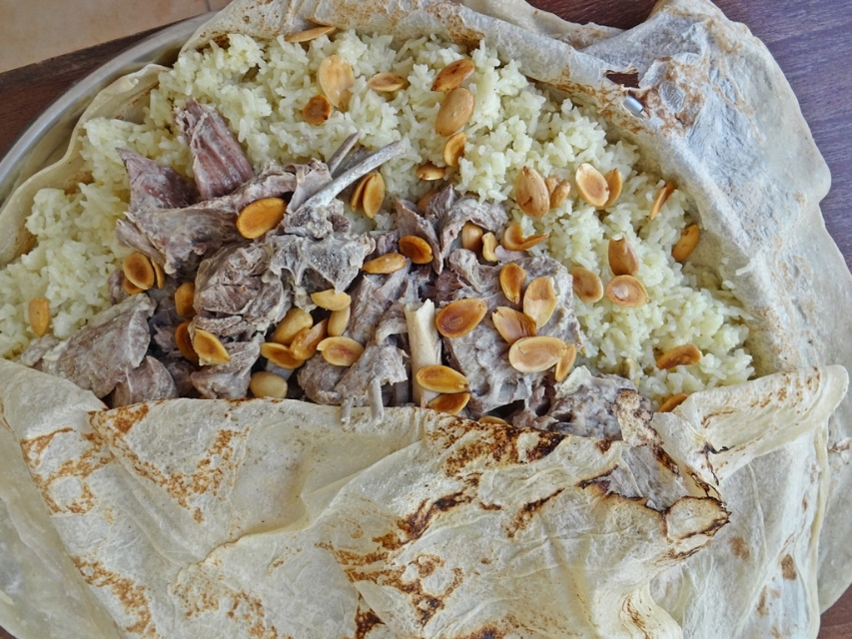
What is mansaf?
Mansaf is a traditional dish that is made of lamb cooked in a sauce of fermented dried yogurt and served with rice or bulgur. It is considered the national dish of Jordan.

Slide 4
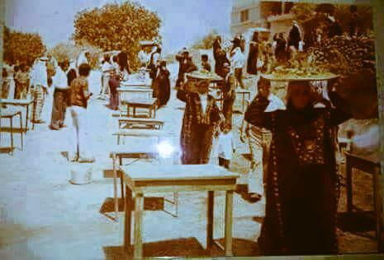
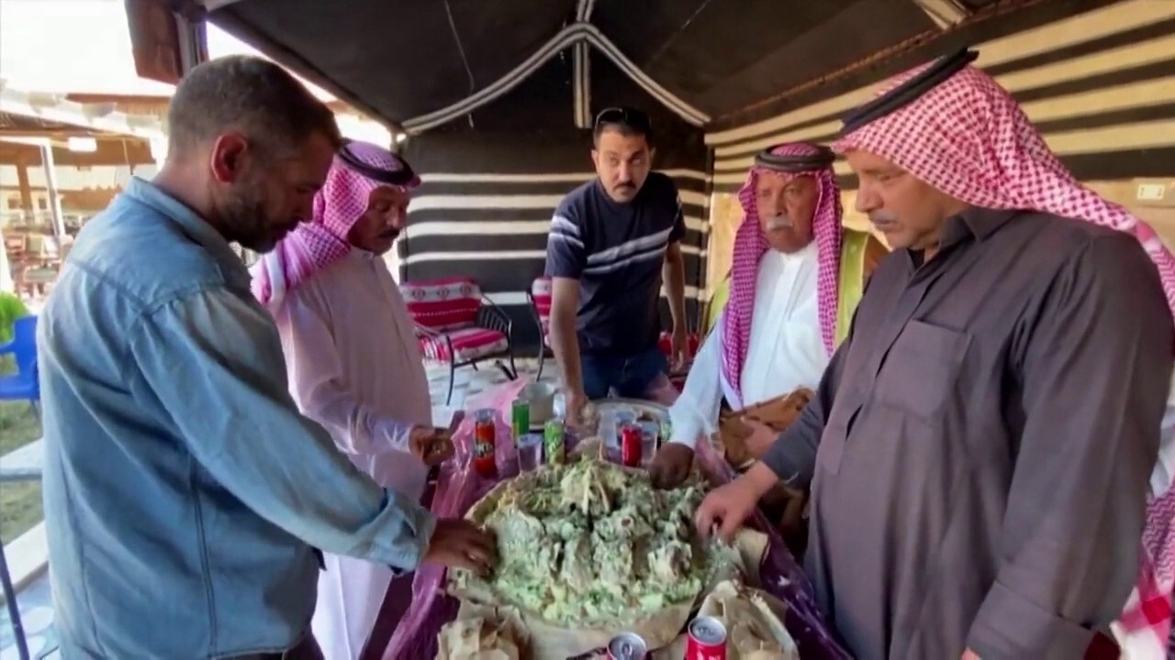
When is Mansaf practised?
Mansaf is practised in Jordan like in most of celebrations and weddings.

Slide 5
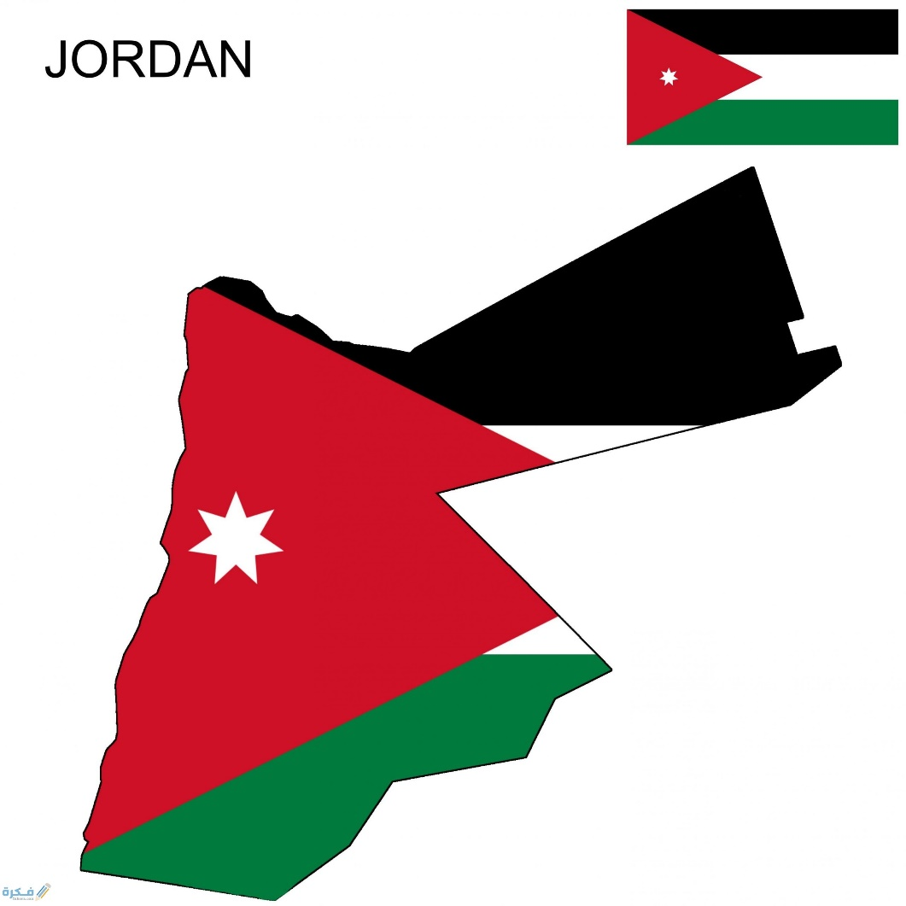
Where is Mansaf practised?
Mansaf is practised in Jordan.

Slide 6
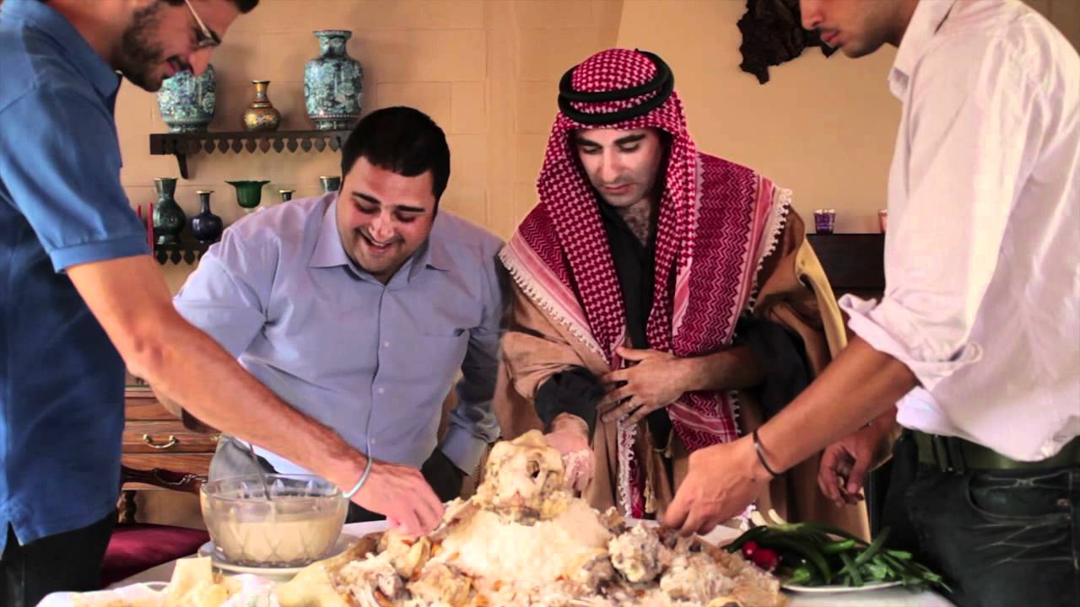
Who practice mansaf ?
Most of the Jordanian people and other people practice mansaf .
What do you think about this information ?
I think that we need more people to know more about mansaf and Jordanian cultures .

Slide 7
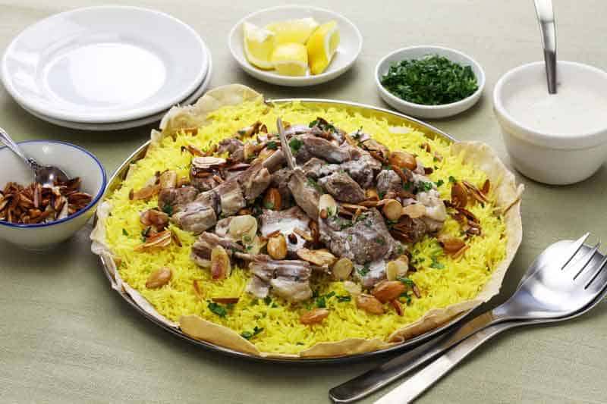
Why is Mansaf practiced ?
Because it’s been known to resolve conflicts and restore peace with tribes in Jordan.
What do you think about this information?
It’s a good thing to resolve conflicts and to also restore peace with tribes in Jordan .

Slide 8
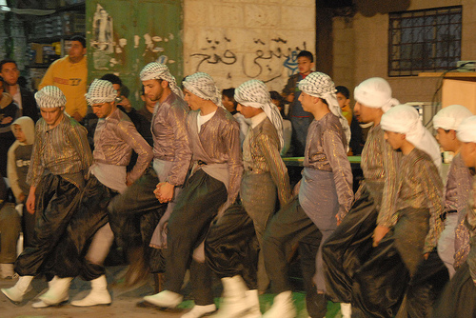
What is dabkeh ?
dabkeh Is an exuberant ,joyful form of traditional line and circle dancing with origins in middle eastern culture and Bedouin tribes
What do you think abut this information?
It’s a great thing and people love to practice it

Slide 9
Where is dabkeh practiced ?
It is practiced in Jordan especially in occasions .
What do you think about this information?
I think that we need more people to know more abou dabkeh and other Jordanian culture . Also it’s a good thing because its joyful thing that .

Slide 10
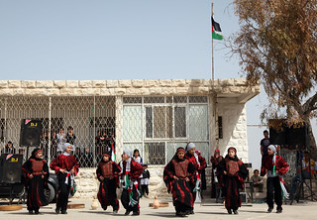
When is dabkeh practiced?
Dabkeh is practiced in Jordan, in most of the parties and celebrations.

Slide 11
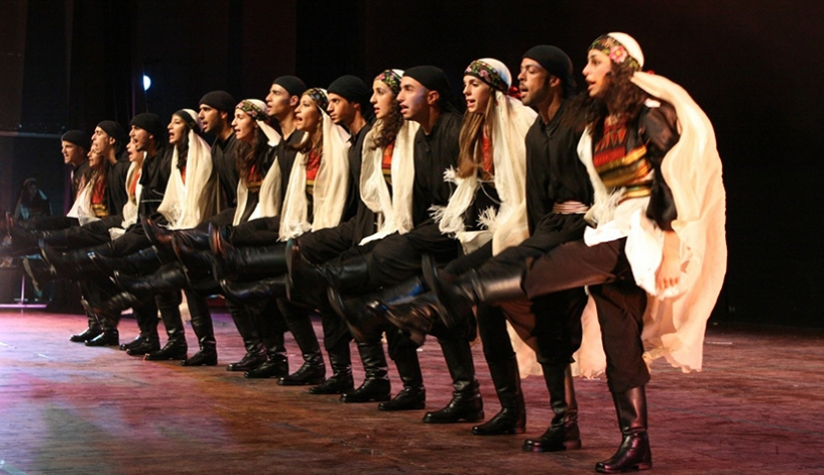
Who practices dabkeh?
Some Jordanian people think its so fun to practice it, and the love it.

Slide 12

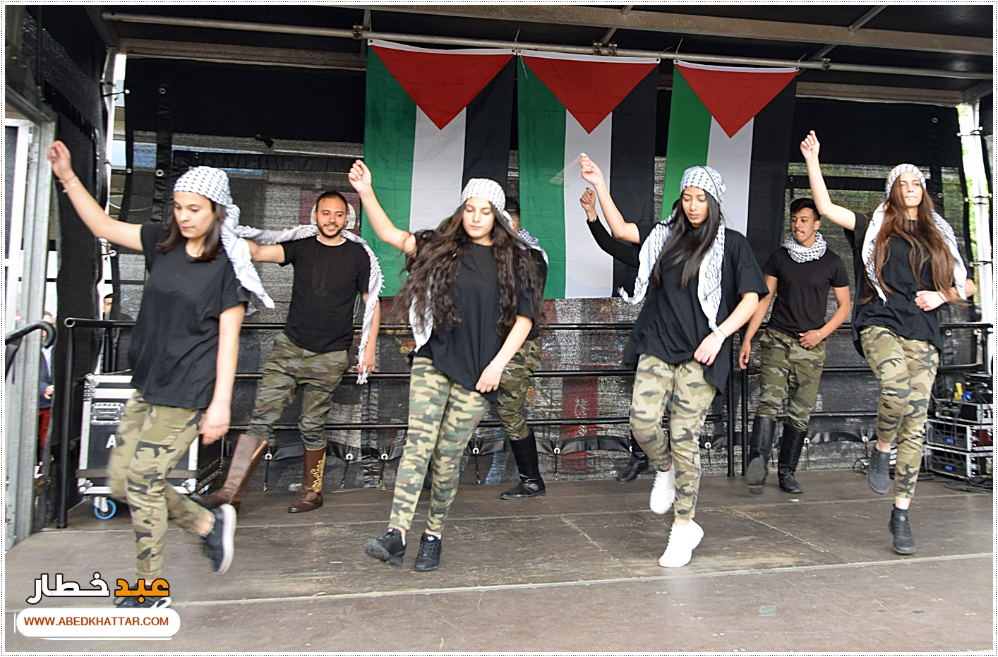
Why is dabkeh practice
Because it is a joy form of traditional line and circle dancing with origins in middle culture .
This Photo by Unknown Author is licensed under CC BY-SA

