Slide 1
Jordanian Traditions
Salma Nabulsi, Joury Bader, Adam Nemeh, Muhanad Halasa, Alazar Girma 6D
Page 43

Slide 2
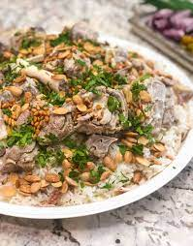
1. What is Mansaf
Mansaf is a traditional Jordanian dish
Source: www.wikipedia.orgie
Reflection: Appetizing

Slide 3
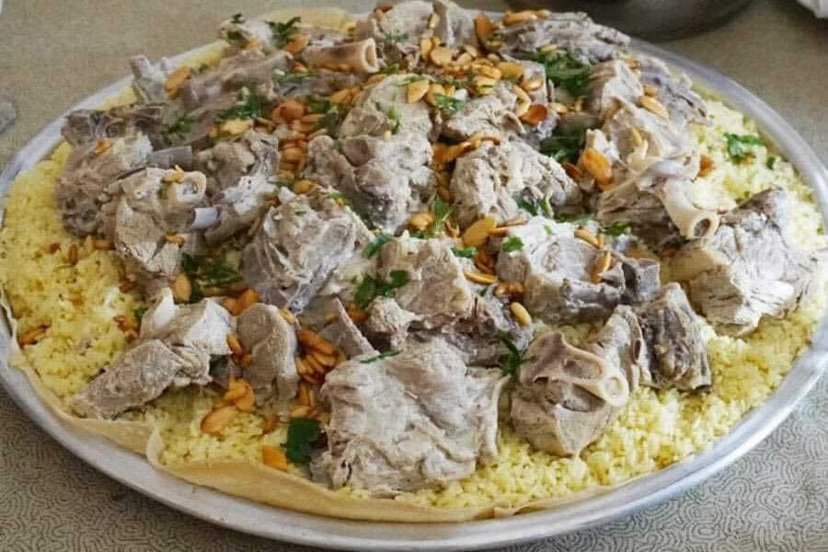
2. Describe mansaf
Mansaf is a dish made of lamb cooked in a sauce of fermented dried yogurt and served with rice or bulgur.
Source: www.wikipedia.org
Reflection: Delicious

Slide 4
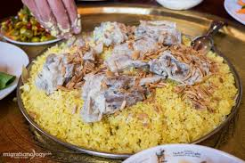
3. How do they eat it
Mansaf is usually eaten with the use of a person’s right hand only while the left is behind the person’s back.
Source: www.wikipedia.org
Reflection: unnatural

Slide 5
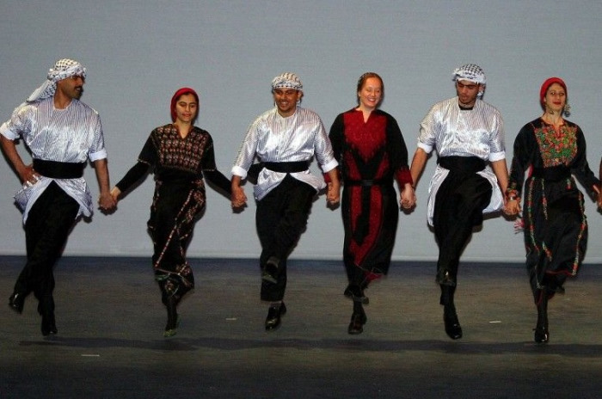
4. When is Dabke practiced
Dabke is done at a variety of occasions but most popular at weddings
Source: www.wikipedia.org
Reflection: Joyful

Slide 6
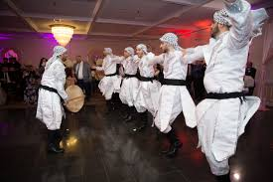
5. Who practices Dabke
It generally involves a long chain of dancers who preform a range of- synchronized steps, stomps, jumps, kicks.
Source: www.wikipedia.org
Reflection: interesting

Slide 7
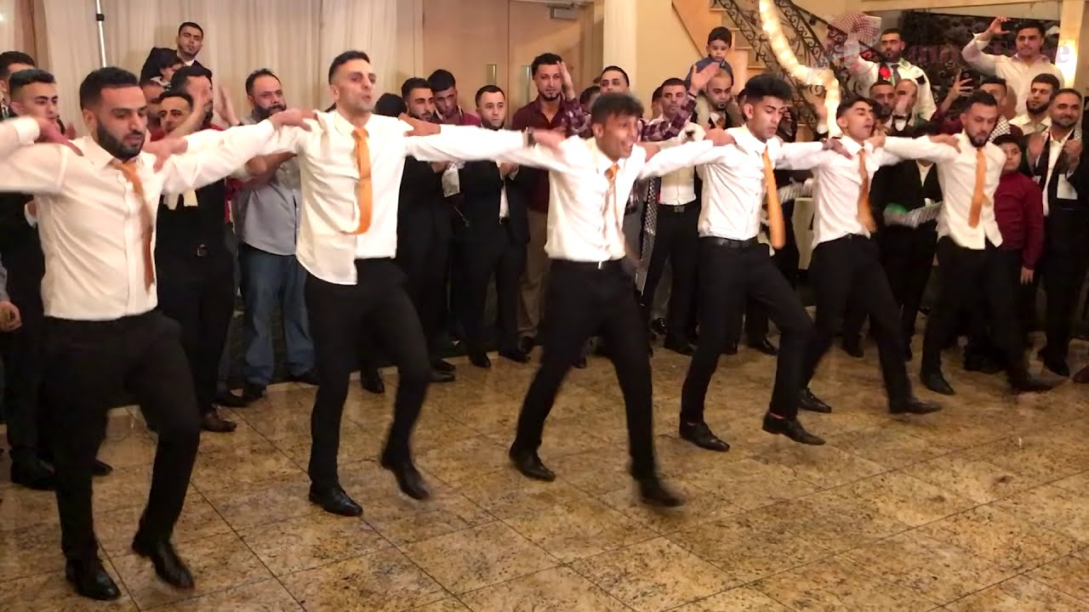
6. Why is Dabke practiced
to show their happiness and that they are celebrating the event
Source: www.wikipedia.org
Reflection: Special

