Slide 1
The traditions in Jordan
By : lareine, fares, Yousef, omar

Slide 2
Arabic coffee
Who practices making Arabic coffee : The citizens of Jordan mostly Bedouin make this coffee on special occasions, and on daily basis.
Source of information: https://stepintojordan.com
Reflection: this information was enough for our ppt

Slide 3
Where is Arabic coffee made: The Bedouin usually make their coffee by placing it in a coal stove, they also keep it on the fire’s coal to keep it hot
Source of information : https://stepintojordan.com
Reflection: I think making Arabic coffee is an interesting process
Why is Arabic coffee made : Arabic coffee is made for hospitality preparing coffee for guests is a ceremony
Source of information: https://coffeeaffection.com
Reflection: I think it is very moral to make our traditional coffee for our guests

Slide 4
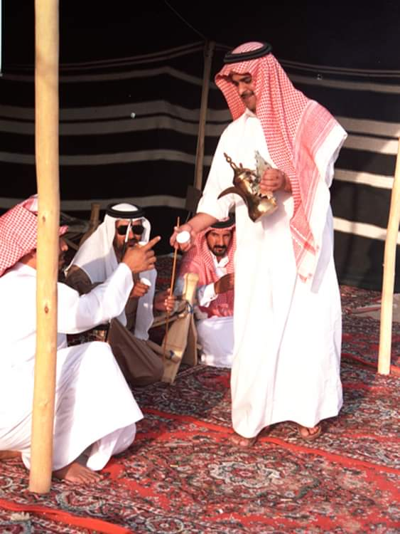
When is Arabic coffee made: on special occasions and on daily basis
Source: no website used
Reflection : this information was enough for our ppt
Coffee being made :https://www.youtube.com/watch=KFDYf-fYBw

Slide 5
Dabke
Who practices dabke: Arab folk
Source: no website used
Reflection : this information was enough for our ppt
Where is dabke preformed: Palestine, Lebanon, Jordan, Syria
Source: https://www.osu.com
Reflection: this information was enough for our ppt
When is dabke preformed: dabke is preformed in special occasions
Source: no website used
Reflection : this information was enough for our ppt

Slide 6
Reflection: this information was enough for our ppt
Why is dabke preformed: dabke is preformed to share historial narratives and vibrant folk lagacies
Source: https://eurpitapita.com
Reflection: this information was enough for our ppt
Dabke being preformed : https://www.youtube.com/watch?v=R0gY4S_GLIQ

