Slide 1
Jordanian tds
by: SADEEN,JOY,MOHAMMAD,NABEEL,RAMZI
CLASS:6E

Slide 2
DABKEH
What is dabke
Description for dabke
Dabke is a joyful form of a traditional line and circle dancing with origins in middle eastern, and it’s a great and fun activity for occasions.
Large group of people interlock their arms, tap and stomp their feet and sing

Slide 3
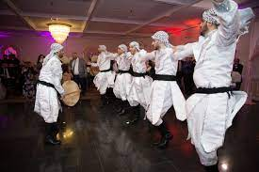
Where and when is dabke practiced
The dance at a variety of occasions, but is mostly done at weddings and I very popular at weddings.

Slide 4
who practices dabke
It is very popular in lebanon,so in almost every Lebanese household. But a lot of middle eastern people practice it too

Slide 5
mansaf
What is mansaf
Description for mansaf
Mansaf is a traditional dish that people love to cook and eat
It is a dish of rice, lamb, and a dry yoghurt made into a sauce called jameed

Slide 6
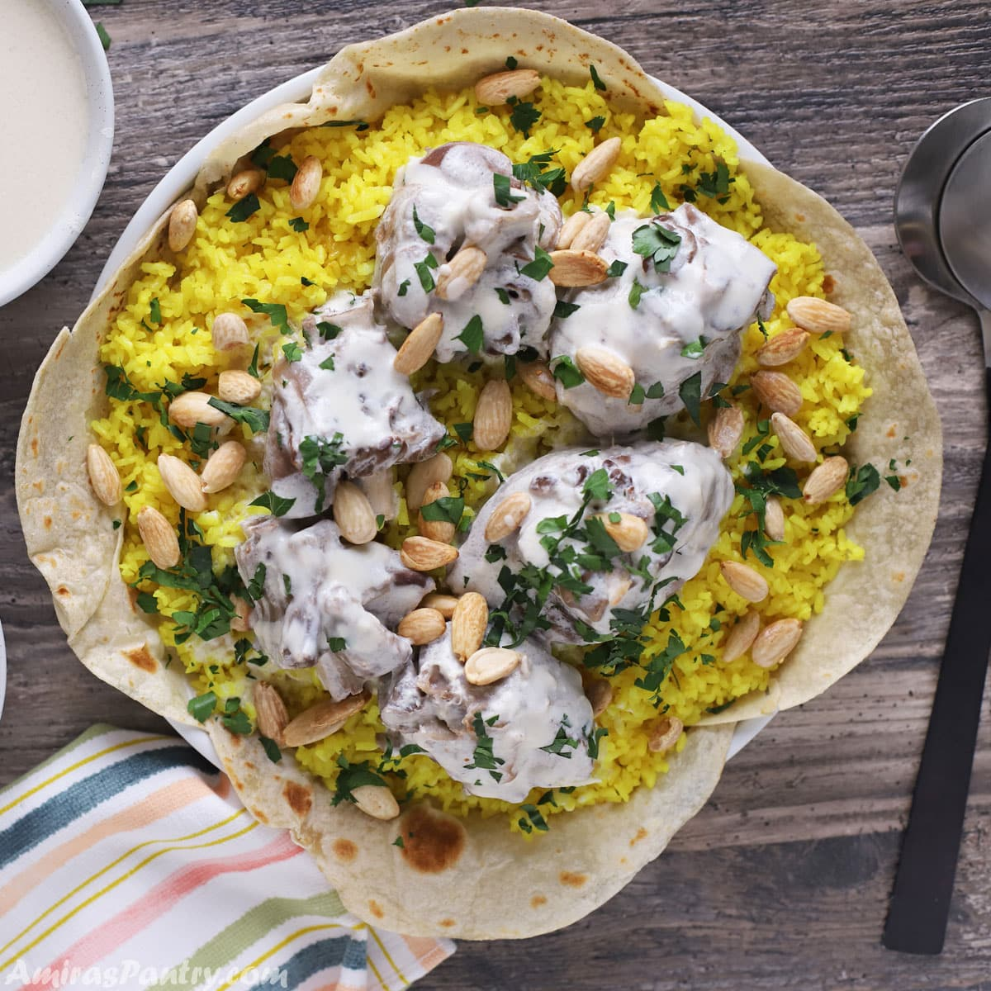
When and where is mansaf served
Its usually served at celebrations such as weddings, gradutions and of course much more

Slide 7
Who eats mansaf
Mansaf is free for everyone to eat, and anyone could try it, but a lot and mostly Jordanians eat it as it is very famous there

