Slide 1
Global perspictives
Hanna,Faisal,Zaid

Slide 2
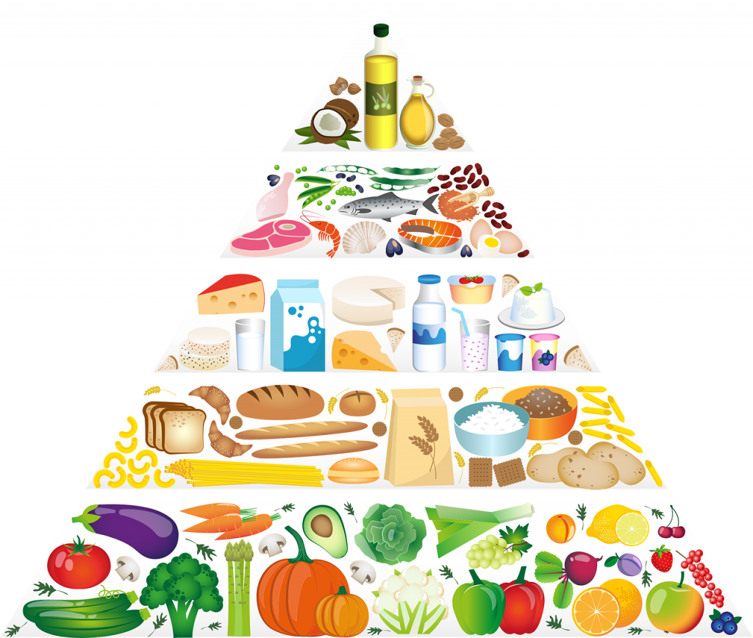
How to mentain a healthy lifestyle
1 measure and watch your weight
2 Limit unhealthy Foods and Eat Healthy meals
3 Take Multivitamin Supplement
4 Drink Water and stay hydrated
5 Exercise regularly and be physically active
6 reduce sitting and screen time
7 get enough good sleep
8 find ways to manage your emotions
9 use a app to track of your movement sleep and heart rate

Slide 3
What is healthy lifestyle
Good nutrition, daily exercise and adequate sleep are the foundations of healthy living. A healthy lifestyle keeps you fit, energetic and at reduced risk for disease. According to WHO, Healthy living is a way of living that helps you enjoy more aspects of your life. It is a way of living that lowers the risk of being seriously ill or dying early. Health is not just about avoiding a disease or illness. It is about physical, mental and social well-being too.

Slide 4
Three benefits of living a healthy lifestyle
Maintaining a healthy weight – Having a balanced diet and exercising regularly can help you avoid excess weight gain and maintain a healthy weight.
Feeling more energetic – When you have a healthy lifestyle, your metabolism works faster and you have higher levels of natural energy.
etting a better sleep – A healthy lifestyle with adequate exercise helps you fall asleep faster and reach a deeper non-REM (deep sleep) stage easier.

Slide 5
resorces:
Healthy Lifestyle | National Health Portal Of India (nhp.gov.in)
The importance of a healthy lifestyle in reducing your chances of becoming unwell — Icon Health Screening

Slide 6
THANKS FOR SEEING OUR PROJECT

