Slide 1
The Hashemit Kingdom of Jordan
Jordanian Traditions (TD)

Slide 2
Done By:
Yazan Halaseh
Ramez AlZraikat
Amir Hadadin
Salma Hantoush
Karam AlSaleh
Supervised by:
Ellen Mitri

Slide 3
Contents
What are Jordanian Traditions?
Mansaf
What is this tradition?
Where is Mansaf practiced (eaten)?
When is Mansaf practiced (eaten)?
Who Practices this tradition?
Why is this tradition practiced?

Slide 4
Contents (cont.)
Dabkeh
What is this tradition?
Where is Dabkeh practiced?
When is Dabkeh practiced?
Who Practices this tradition?
Why is this tradition practiced?
Reflection (what do we think about Dabkeh and Mansaf) ?

Slide 5
What are Jordanian Traditions?
Jordanian Traditions:
Mansaf.
Dabkeh.

Slide 6
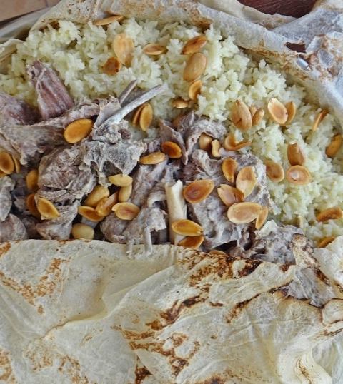
Mansaf
What is this tradition?
Mansaf is the traditional Jordanian Dish in Jordan.
Its is made from lambs in boiled yogurt sauce called (Jammeed) with rice, with almonds and all on top a piece of bread.

Slide 7
Where is Mansaf practiced (eaten)?
Mansaf is served in Amman and all cities of Jordan, many restaurants serve Mansaf, and it's eaten in different households.

Slide 8
When is Mansaf practiced (eaten)?
Most of the time, It is served on parties and family gathering such as Eid Al-Fitr, Eid Al-Adha, Christmas, Easter, on happy occasions like birth of new baby and especially on May 25 that is Jordans Independence Day.

Slide 9
Who practices this tradition?
People all around Jordan eat Mansaf this includes men, women and a children.
r

Slide 10
Why is this tradition practiced?
Along with just being unique and delicious, Mansaf is an important piece that is well known for solving problems.
Mansaf is also used by people in Jordan to show that they have manners and that they are nice.

Slide 11
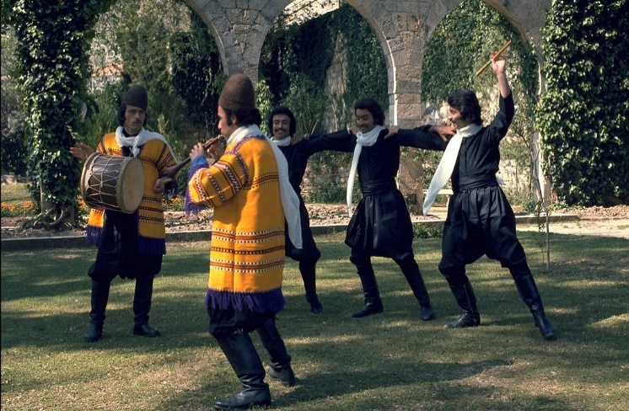
Dabkeh
What is this tradition?
Dabkeh is an exuberant, joyful form of traditional line and circle dancing with origins in Middle Eastern culture and Bedouin tribes. Large groups of people interlock arms, tap and stomp with their feet, and sing or chant. Their purpose is to share historical narratives and vibrant folk legacies.

Slide 12
Where is Dabkeh practiced?
Its often danced at weddings, banquets and occasional parties.

Slide 13
When is Dabkeh practiced?
Dabkeh is danced on special places like graduations or Jordans independence day that’s on 25 of May.

Slide 14
Why is Dabkeh practiced?
Dabkeh is danced when people are proud of something or somebody or if people are happy about an event.

Slide 15
Who practices this tradition?
Most Jordanians practice the Dabkah, and it is just holding each others hands, stomping the ground and move around in a circle.

Slide 16
Reflection (what do we think about Dabkeh and Mansaf) ?
Dabkeh: Is completely normal, even though some people think it’s weird, because of how it’s practiced.
Mansaf: Is the best dish in Jordan because of how it’s done, and with that yogurt (Jameed) that makes our mouth water of how fantastic it really is.

