Slide 1
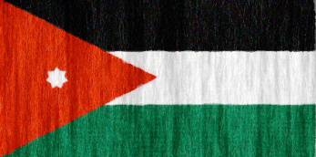
Jordanian Traditions
By Rayan/Sama/Karam/Nouf/Joseph

Slide 2
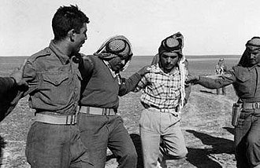
Dabkeh
Why do we use Dabkeh?
To share historical narratives and vibrant folk legacies.
Who practices Dabkeh?
Jordanian people.
From where did you get this information?
Dabkehmasters.com
What do you think about this tradition?
Fun and amazing.

Slide 3
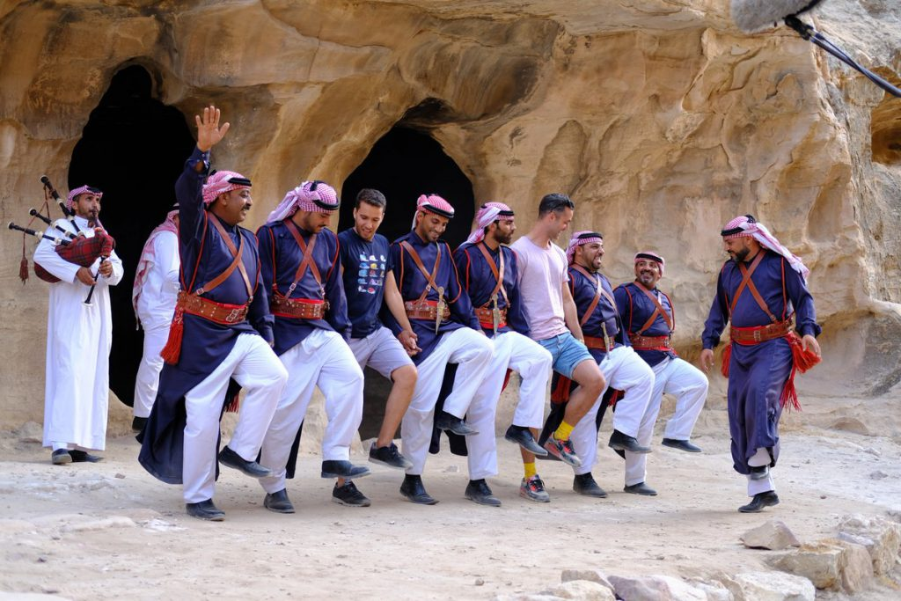
More info about Dabkeh…
When is this tradition practiced?
Weddings and people traditional occasion.
Where is this tradition practiced?
Everywhere in Jordan.

Slide 4
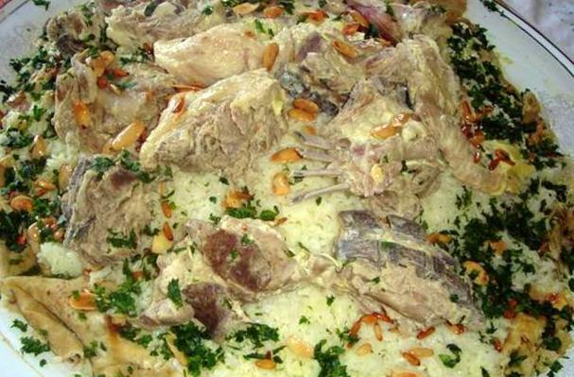
Mansaf
Why do Jordanian people eat Mansaf?
To show respect for guests and Jordanian cultures.
Who eats Mansaf?
Jordanian people.
When do people eat Mansaf?
Occasion and weddings.
Where does it come from?
Jordan.

Slide 5
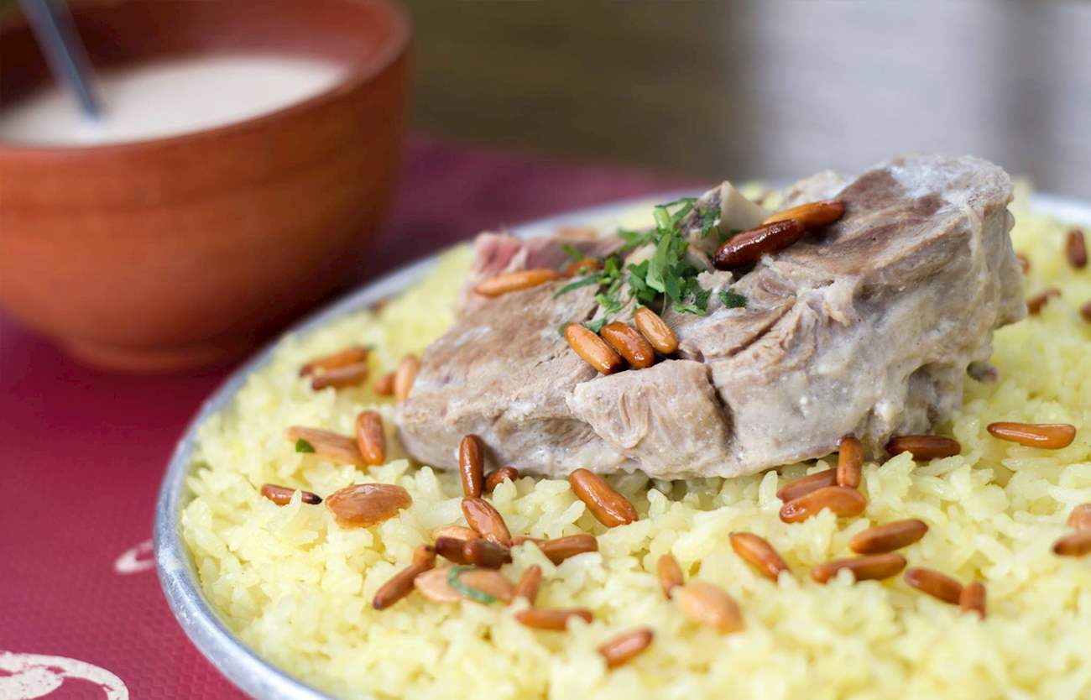
More info about Mansaf
Where is it shipped to?
Everywhere around the world.
From where did you find this information?
Wikipedia.
What do you think about Mansaf?
Very tasty.

Slide 6
Thank you for reading our personation

