Slide 1
Arab Traditions
Randa, Talin, Yasmine, Majd ,Rashed

Slide 2
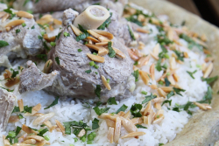
1st TD: Mansaf
What is Mansaf?
Mansaf is the Jordanian traditional dish and is eaten at events.
What is it made up of?
Well it has dried yoghurt, cooked lamb and optional toppings.
Where is it practiced?
Anywhere really, mostly kitchens
This Photo by Unknown Author is licensed under CC BY-NC-ND

Slide 3
1st TD
Who’s practices this td?
Anyone of any gender or age.
Why is this td practiced?
Well, its served for occasions almost half an hour after the event has started.

Slide 4
Write down the source the info came?
https://migrationology.com/

Slide 5
What do you think of this info?
I think its useful for any immigrant coming to Jordan.

Slide 6
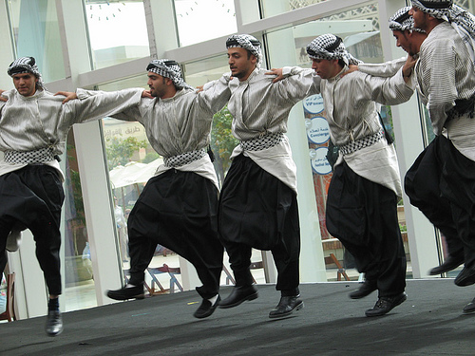
2ND TD: Dabkeh
What is Dabkeh?
Dabkeh is the traditional dance for all the middle east, and is danced at occasions.
How is it danced?
It is an energetic dance which includes many people at gatherings in a moving circle.
Where is it practiced?
At events, everyone dances energetically.
This Photo by Unknown Author is licensed under CC BY-NC

Slide 7
2ND TD: Dabkeh
When is it practiced?
Its when the loud music starts and everyone starts dancing.
Who practices this td?
Anyone of any age.
Why is it practiced?
There is no specific reason behind this other than its fun and energetic.

Slide 8
Write the source this info came from?
https://migrationology.com/

Slide 9
Write what you think of this info?
I think that this is beautiful tradition.

