Slide 1
GLOBALPERSPECTIVES RESERCH ABOUT JORDANIAN TRADTIONS
DONE BY : MOURAD,ALIA,MIRIELLE,ALFAISAL

Slide 2
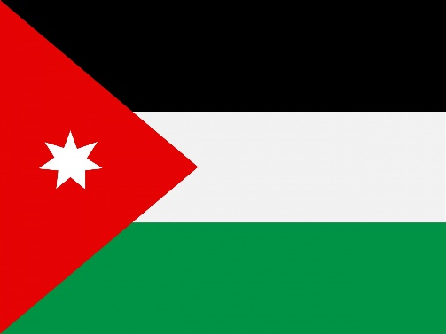
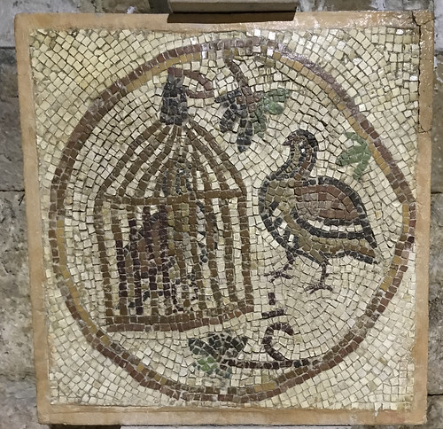
What is Tradition
A tradition is a belief or behavior passed down within a group
or society with symbolic meaning or special significance with origins in
the past. Tradition helps us to feel like we belong in this world when
we've come from somewhere else.We practice customs and traditions
in our daily lives and on occasions .

Slide 3
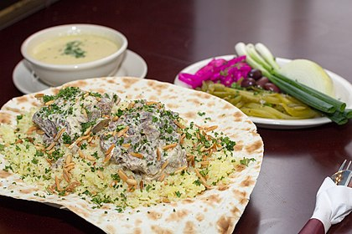
FIRST: Jordanian traditional food
Mansaf is a traditional food in Jordan that is eaten on special occasions like party’s, weddings or family gatherings

Slide 4
What is Mansaf made of?
Mansaf is made of lamb meat and liquid yogurt “jameed” with yellow rice and Sautéed nuts
Some people use Markook bread to eat it with Mansaf and some people use their hands
Some people use tomato or onions/green onions to add on Mansaf
https://www.youtube.com/watch?v=4sPZZ3XCG_E

Slide 5
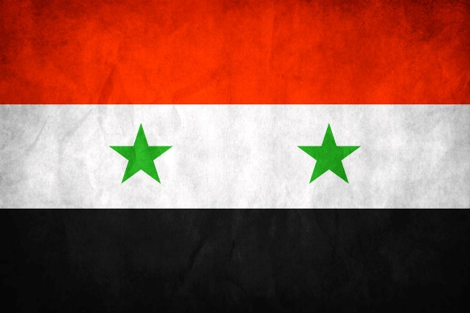
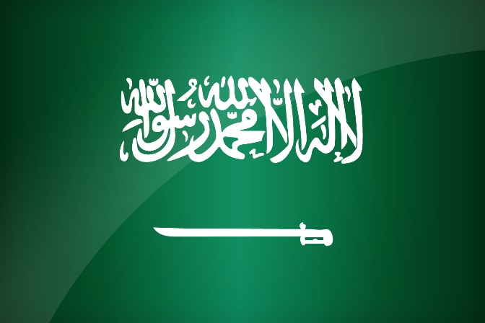
Where can I find/eat Mansaf
You can find Mansaf in many Arabian countries like
Jordan ,SaudiaArabia, Palestine, Kuwait and Syria

Slide 6
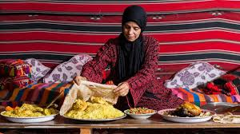
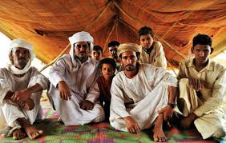
Who practiced Mansaf
First prepared in the Bedouins of Jordan with lesser-known ingredients, Rice was not introduced into the dish until the late 1920s, and jameed is a recent development.
Nowadays , there is a modern version of Mansaf like how it is known these days and it has become Jordan’s national dish.

Slide 7
Why mansaf is practiced in jordan
Mansaf ties together the key elements of Jordanian culture: Bedouin tradition, food, and most importantly- community.
Along with just being completely unique and delicious, Mansaf is so important in Jordan that it’s been known to resolve conflicts and restore peace with tribes in Jordan that’s the power of food.
It’s also common to eat at Jordanian celebrations, parties, family get-togethers, and festivals.

Slide 8
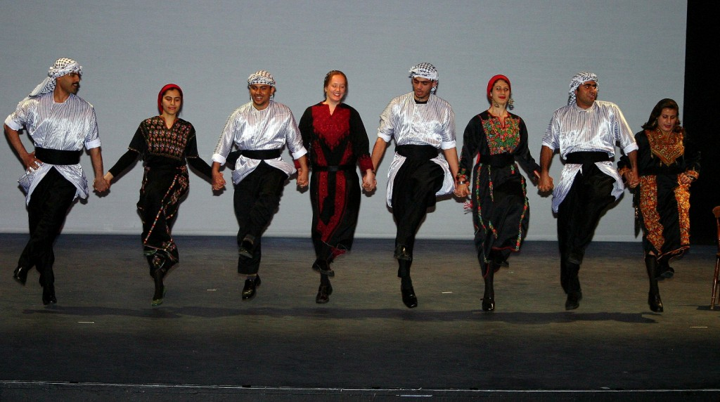
SECOND: Jordanian traditional dance Dabkeh
The Dabkeh is the traditional folk dance of Jordan, going back generations. It can be danced by men, women, or both, with different steps and different rhythms .
https://www.youtube.com/watch?v=CKz9-4Qp68Y

Slide 9
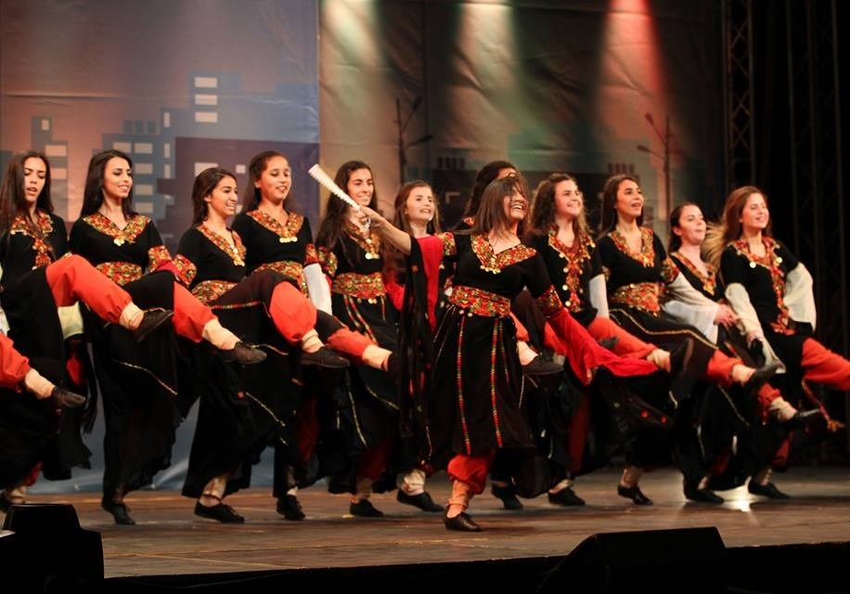
Traditional Jordanian Dance / DabkeH
Dabkeh may be performed as gender-segregated or co-ed groups. The dancers line up shoulder-to-shoulder, holding hands or placing arms over the neighboring two dancers’ shoulders, then move as a group in a circle using steps that are punctuated by kicks and stomps. The accompanying music includes a flute called a ney, a drum called a tableh, and a reed instrument called a mizmar.

Slide 10
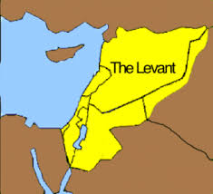
Where Dabkeh is practiced ?
it is an Arabic folk dance which originated in the mountains of the Levantine region.
This region in the Middle East includes the countries of Jordan,Palestine, Lebanon, and Syria.

Slide 11
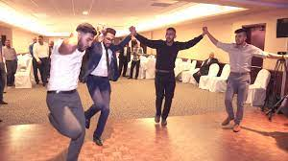
WHEN DABKEH IS PRACTICED
Dabkeh is seen all throughout the world at weddings, family gatherings, and celebrations.

Slide 12
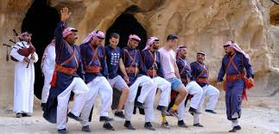
Who practiced Dabkeh
When the Dabkeh dance was first created it was mainly danced by people of the villages and towns .
Dabkeh is popular among Bedouins and non-Bedouins alike, and is often performed at weddings.

Slide 13
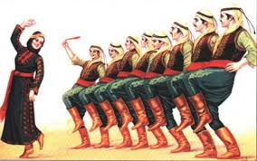
WHy DABKEH IS PRACTICED
Dabkeh is a tradition spanning the centuries, it is considered more of a cultural cornerstone than just a folk dance. Practiced across Jordan, we explore its roots and the unique interpretations that have made it more popular than ever.

Slide 14
Resources and websites
https://www.jdtours.com/dance-like-a-jordanian/
https://en.m.wikipedia.org/wiki/Dabke
https://alepharabic.wordpress.com/2019/11/10/traditional-jordanian-dance-%D8%A7%D9%84%D8%B1%D9%82%D8%B5-%D8%A7%D9%84%D8%A3%D8%B1%D8%AF%D9%86%D9%8A-%D8%A7%D9%84%D8%AA%D9%82%D9%84%D9%8A%D8%AF%D9%8A/
https://en.m.wikipedia.org/wiki/Mansaf
https://alepharabic.wordpress.com/2019/11/10/traditional-jordanian-dance-%D8%A7%D9%84%D8%B1%D9%82%D8%B5-%D8%A7%D9%84%D8%A3%D8%B1%D8%AF%D9%86%D9%8A-%D8%A7%D9%84%D8%AA%D9%82%D9%84%D9%8A%D8%AF%D9%8A/
https://u.osu.edu/sellman.13/2021/05/01/dabke-dance-a-shared-tradition-of-the-levant/

