Slide 1
Jordanian traditions
By Shawqi Edward Luna Maria

Slide 2
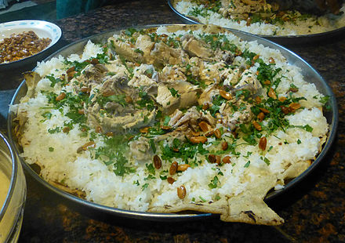
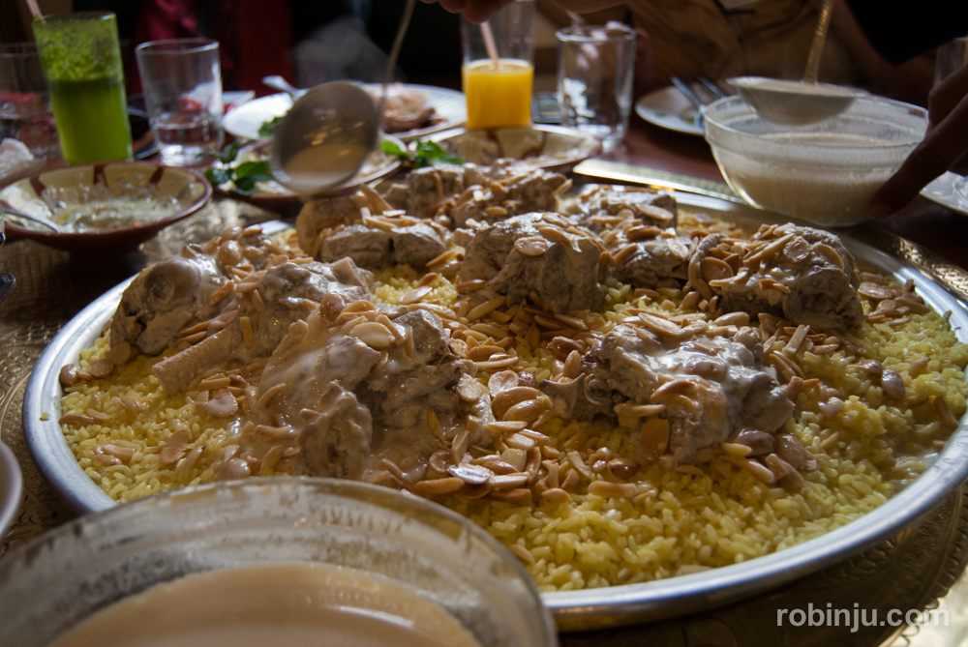
What is Mansaf
Mansaf is a Jordanian traditional food in Jordan. it is a popular dish eaten threw out the Levant's. It is made from three ingreadints jammed ,white rice and cow meat Mansaf was created during the Hashmite Manatory era of early 20th century, this tradition is practiced in funerals and weddings.

Slide 3
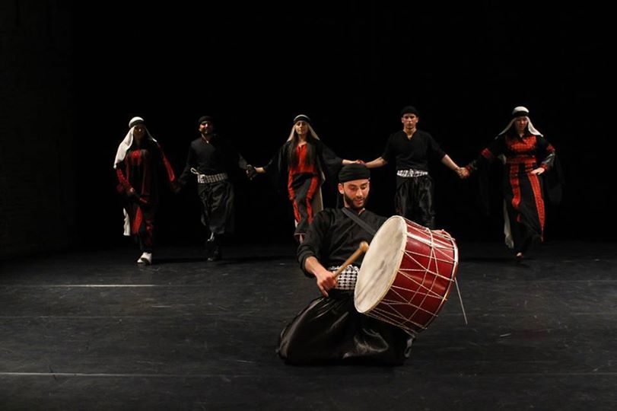
What is dabkeh?
Dabkeh is Dabkeh is the traditional dance in Jordan .
a popular Arab folk dance wide spread throughout the Levantine region .the dance is done at a variety of occasions but is most popular at weddings while there are many variations of dabkeh ,it generally involves dancers who can perform synchronized steps,stomp,jumps and kicks.

Slide 4
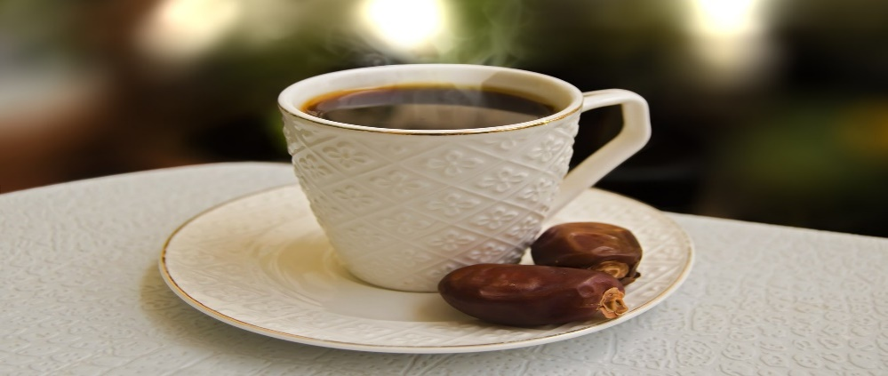
What is the Arabian coffee?
The Arabic coffee is made from lightly roasted coffee beans infused with a mix of fragrant spices such as cloves and ginger.
The Arabian coffee was invented in the 15th century and the place of origen is Yemen and the region arab world.
The temperature of serving is hot, warm. The Arabic coffee is boiled coffee that is not filtered. Another name for Arabic coffee is Qahwa.
It is practiced in Jordan and the beduins practice it.
Its practiced in occasions, funerals to show respect and to greet people.

