Slide 1
Mansaf & Dabke
Celina Tayseer Ryan Zaid Rafael

Slide 2
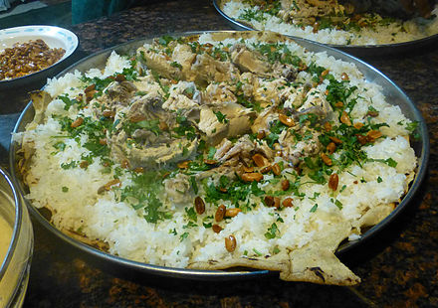
What is mansaf
Mansaf is a trational jordanian dish that people eat at celebrations and sometimes when guests come
Mansaf is a source of lamb cooked meat with fermented dried yougurt and served with rice or bulgur

Slide 3
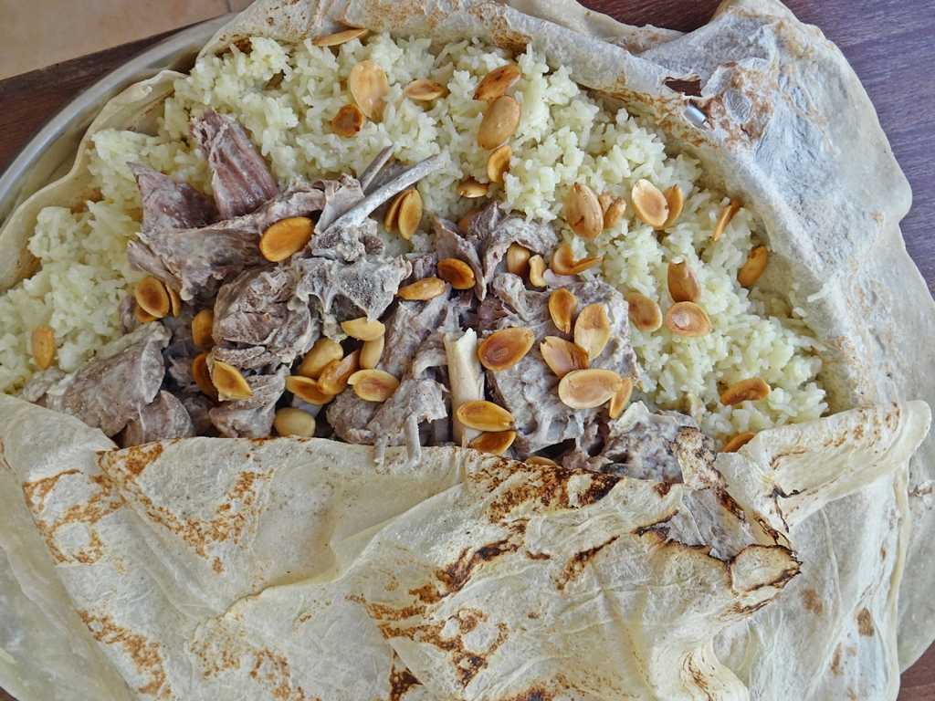
Where/when is mansaf practiced
Mansaf is normally practiced in weddings and special occasions

Slide 4
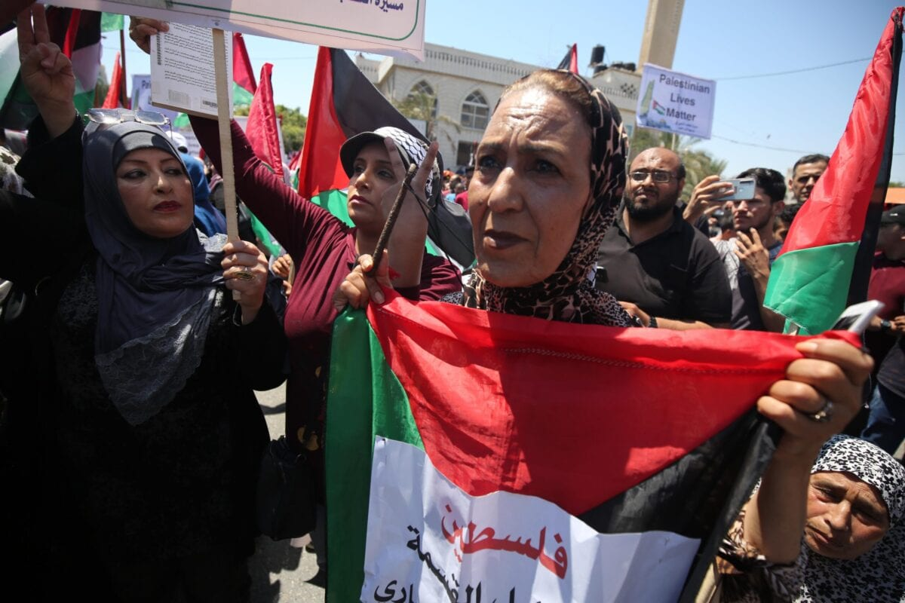
Who practices mansaf
Arab Bedouins and Arabian peninsula , Arabs practice Mansaf because it is the traditional food and also to show respect

Slide 5
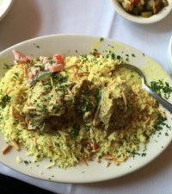
Why is mansaf eaten
Mansaf is one of the popular jordanion foods and it is also the trational food of the middle east

Slide 6
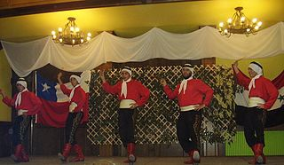
Dabke

Slide 7
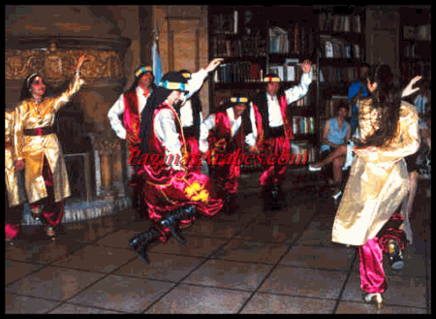
What is dabke
Dabke is a popular of folk dance preformed at arab weddings and ceremonies

Slide 8
Where/when is dabke practiced
Dabke is practiced in weddings because it was jordainans tradional dance
This Photo by Unknown Author is licensed under CC BY-SA-NC

Slide 9
who Practices is that dabke
Dabke is practiced by the eastern culuture and bedouins tribes

