Slide 1
Traditions in Jordan
By:George,Ayman,Michael,Jad,Fahd

Slide 2
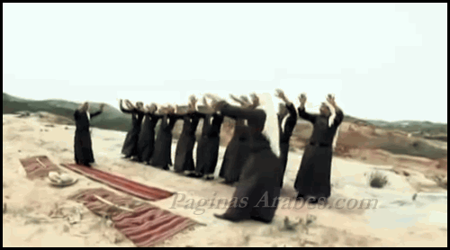
Dabke
What is the tradition?
Dabke

Slide 3
Describe the Tradition
Dabke is a Levantine Arab folk dance.

Slide 4
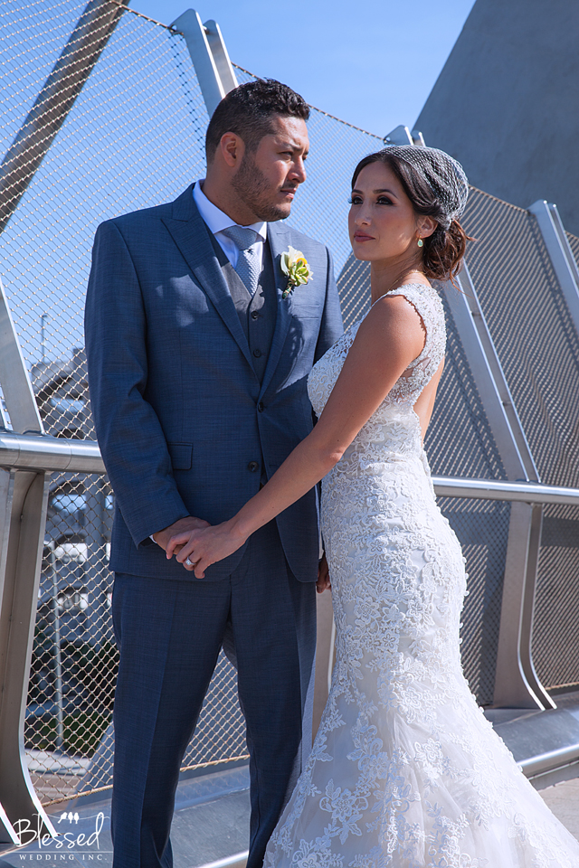
When and Where is this tradition practiced?
most popular at weddings,celebrations,and parties

Slide 5
Who practices this tradition?
the Levantine countries:Palestine, Jordan, Lebanon, and Syria.

Slide 6
Why is this tradition practiced?
chasing off evil spirits a protecting young plants, and because signifies hope, struggles, and history of the Palestinian people

