Slide 1
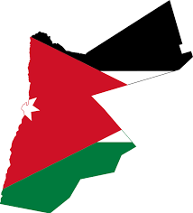
Jordanian Traditions
Global Perspective Project
By
Celina, Mustafa , Raya , Kinda and Fuad

Slide 2
What is Dabka?

Slide 3
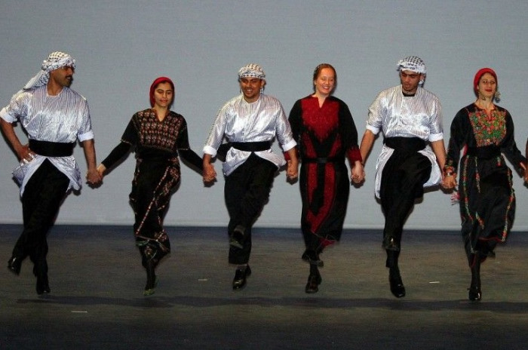
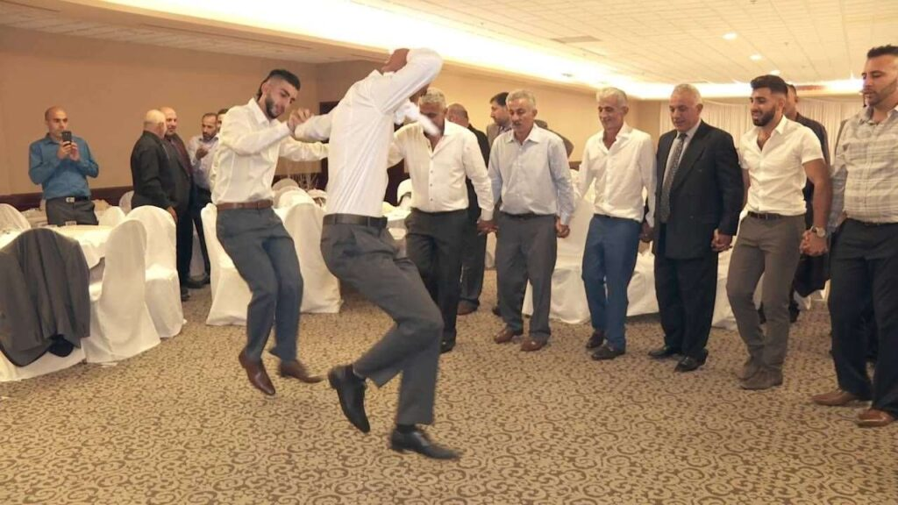
Search
What is Dabka?
Dabka
Dabka is an Arabic dance that is originated in the Arabic region, it is celebrated in weddings, graduations and in special events. It is a way to show happy feelings.
Dabka is practiced for a joyful form of traditional line.
https://www.youtube.com/watch?v=MhNUVgnFA9g

Slide 4
What is Thobe?

Slide 5
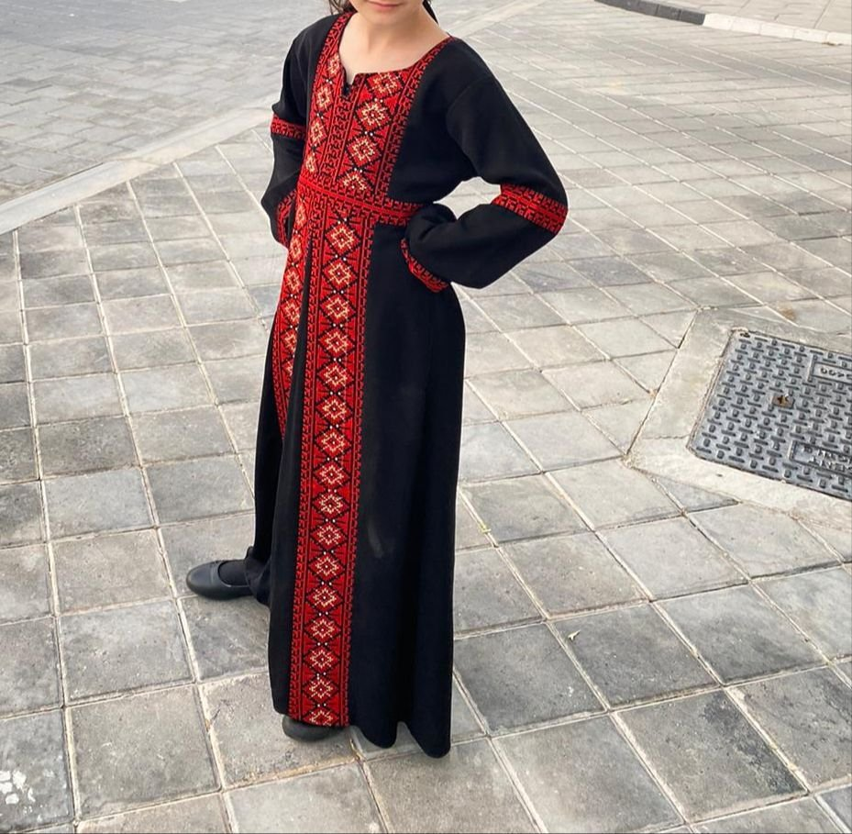
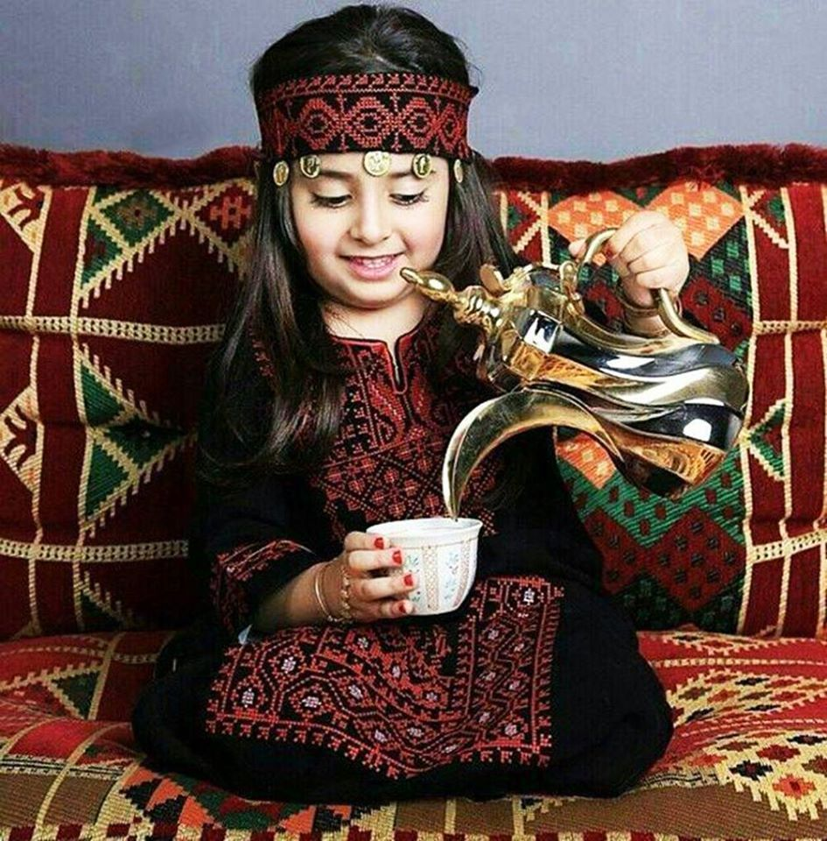
Search
What is Thobe?
Thobe
Thobe is an Arabic clothing worn in the middle east and in large cultural events or weddings, its an amazing dress used to indicate a status of royalty or maybe sometimes a religious position.
In Jordan its worn to assert national pride at weddings and special occasions.

Slide 6
What is Mansaf?

Slide 7
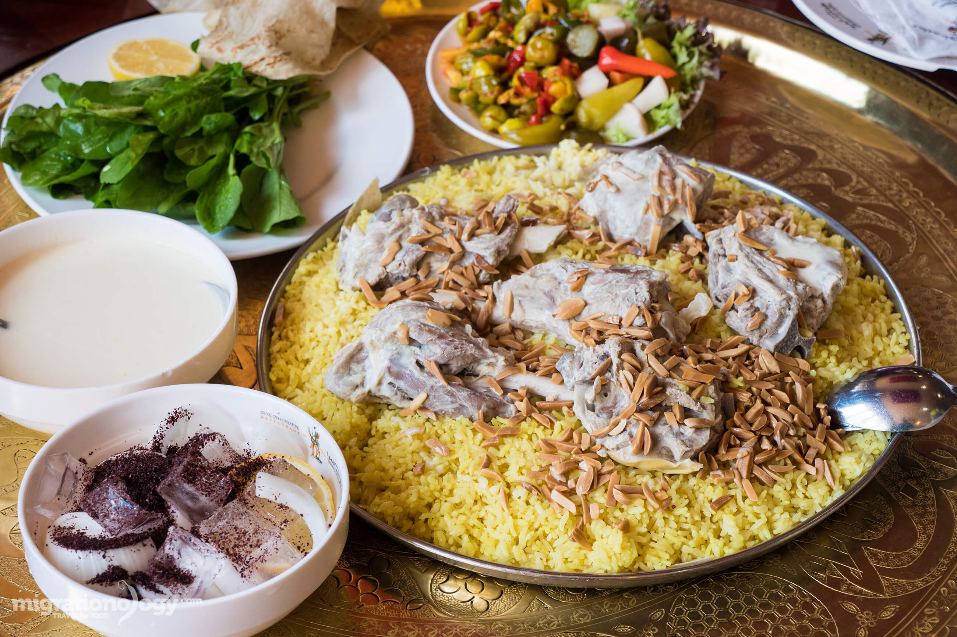
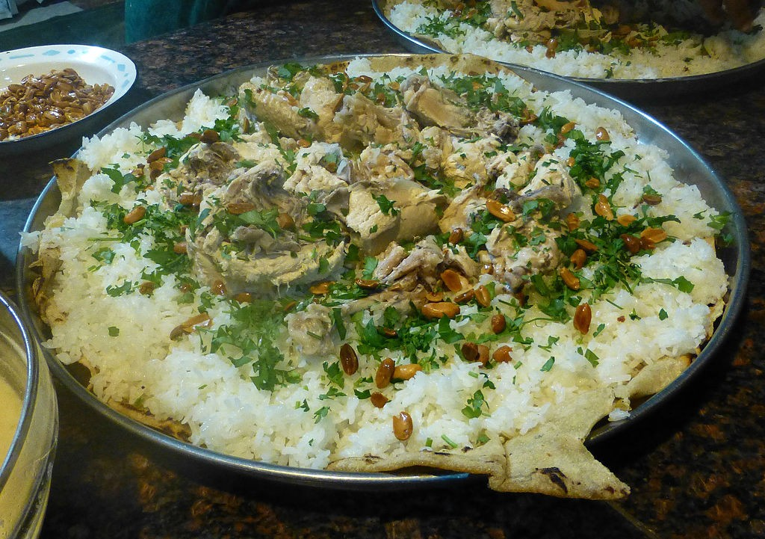
Search
What is Mansaf?
Mansaf
Mansaf is a traditional Jordanian dish, its found in the middle east , it’s served with Arabic rice, lamb, and flavorful broth of dried sour milk .
Mansaf is the national pride of Jordan which is often symbolizes a joyful occasion.

Slide 8
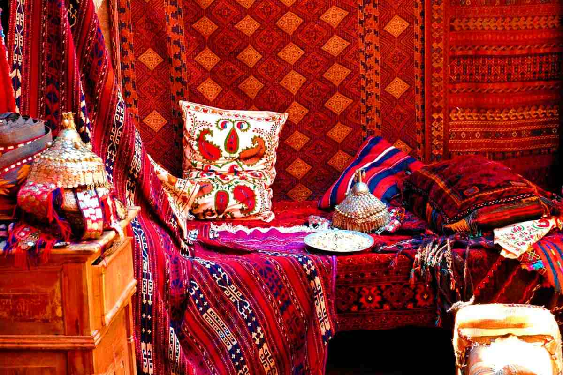
Thank You

