Slide 1
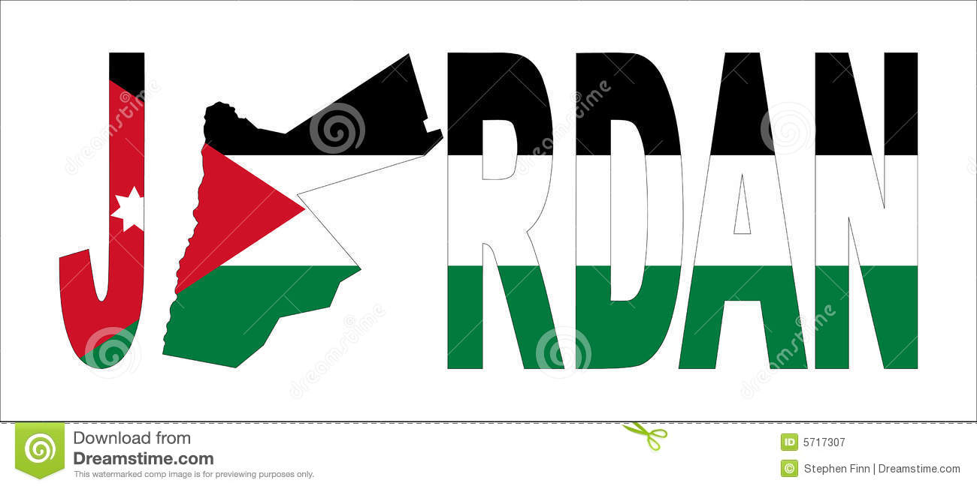
Interesting Jordanian traditions
By Teresa, Adam.S ,Rayan ,Khalil and Saif.g

Slide 2
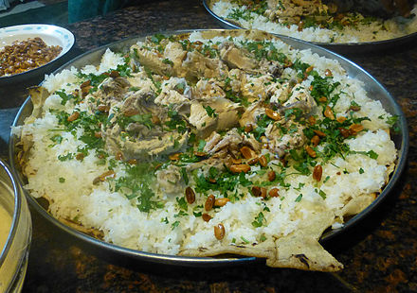
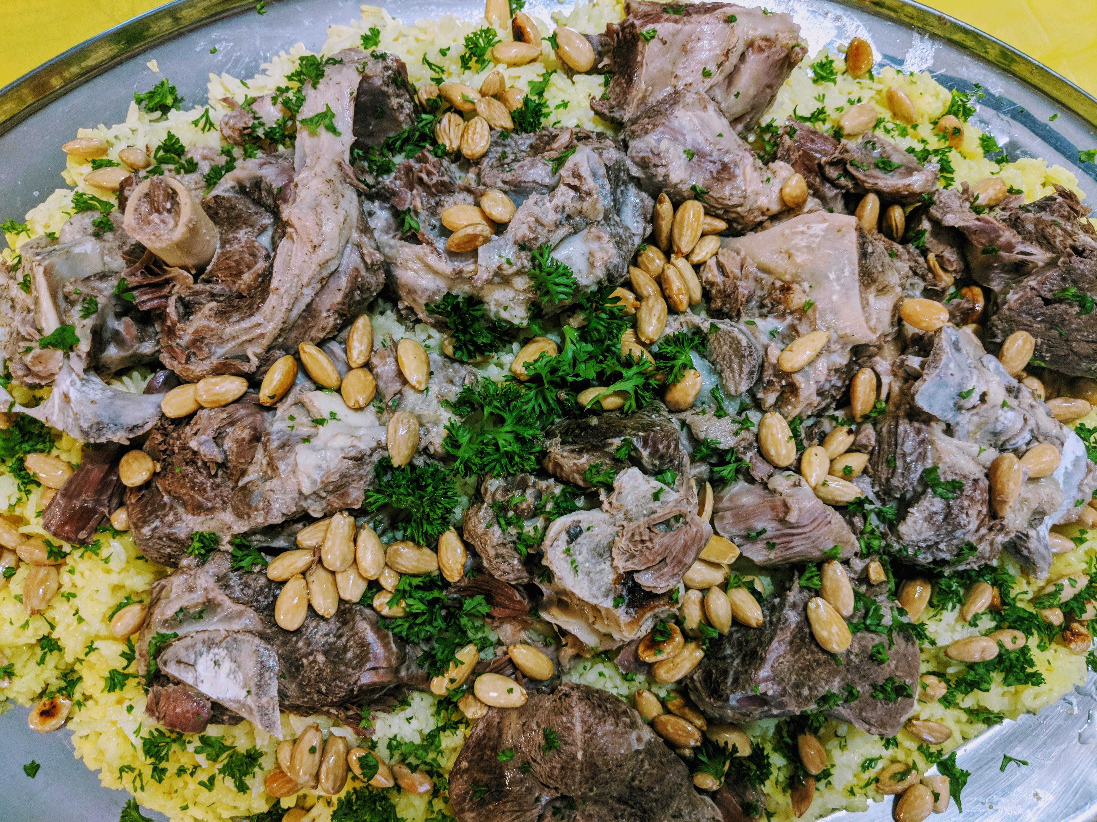
Mansaf

Slide 3
Mansaf
Mansaf is a traditional Jordanian dish, it consists of lamb cooked in a sauce of fermented dried yogurt and served with rice. It is a popular dish eaten through the Levant.
Mansaf is served in special occasions such as (wedding, graduations, parties and at condolences.)

Slide 4
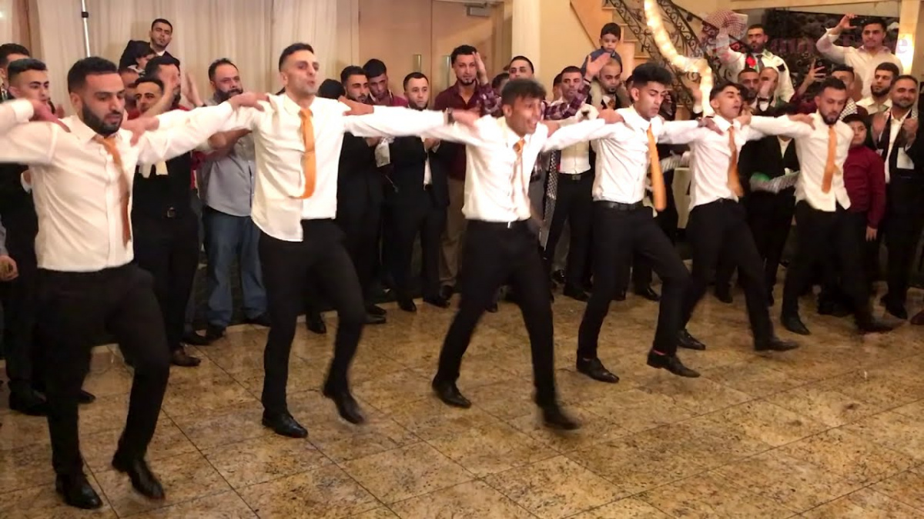
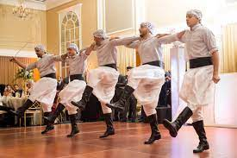
Dabke

Slide 5
Dabke
Dabke is a Levantine Arab folk dance. Dabke combines circle dance and line dancing.
It is described as a dance where everyone stands in a line or circle holding hands facings outward or to the audience it is an Arabic dance.
It is practiced at wedding, Arabic parties and graduations.
Dabke consists of groups of people mostly Jordanian.
It is practiced to share historical narratives and vibrate folk dance.

Slide 6
thank you for seeing this presentation about the traditions

