Slide 1
Two National Traditions In Jordan
Made by GEORGE barjeel/Issa dihmes/joud alshalabi/selena alkali and lamya

Slide 2
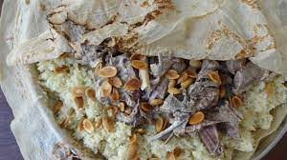
MANSAF
Mansaf is eaten by Jordanians, they serve Mansaf in weddings funerals, main holydays and to honor guests. Jordanians practices this TD. This tradition is practiced because it symbolizes a joyous occasions.
NOTE:
The Mansaf is a perfect meal for Jordan.

Slide 3
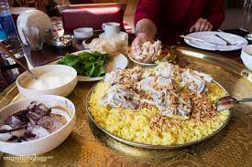
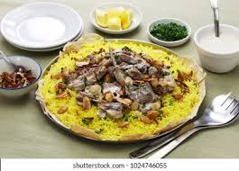
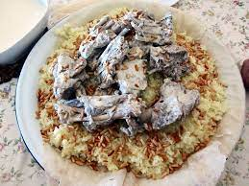
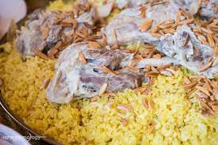
Video:
https://youtu.be/T7OOg6wcdj4

Slide 4
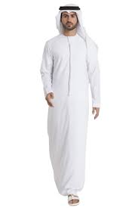
DISHDASHEH
They wear dishdasheh in Saudi Arabia, Jordan and more. They practice this TD in formal occasions, such as weddings.
People practice this TD in Saudi Arabia, Jordan and more. They practice it because it helps keep body cool it the heat of the region.
NOTE:
The dishdasheh helps in many things.

Slide 5
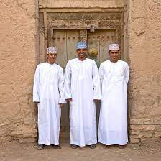
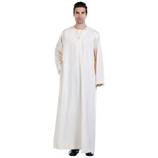
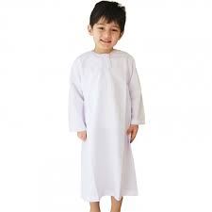
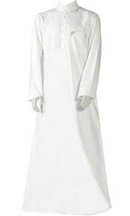
Video:
https://youtu.be/SqanwKjcAwo

