Slide 1
Jordan TD
By: Naya, Kareem, Mohamad, Noor, Sanad, Taimour

Slide 2
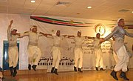
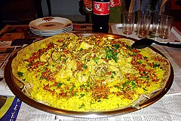
Why WE Picked These TD
There are a lot of TD around the world but we picked these because they are well-known ,Fun and and part of our culture

Slide 3
Book questions answers
Dabke
Dabke combines circle dancing and line dancing .
Dabke is preformed at weddings and happy other joyful occasions.
Dabke is usually preformed in the middle eastern countries.
It is practiced to show happiness and fun to enjoy there time.

Slide 4
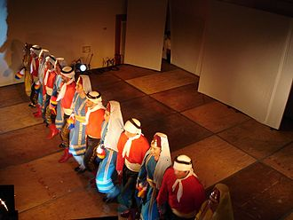
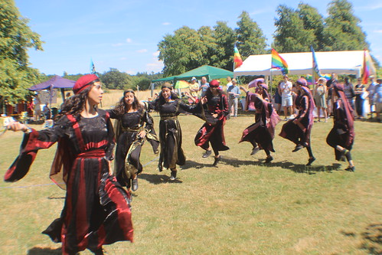
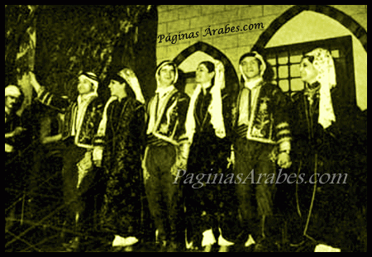
Here is a fun video you can watch
https://www.youtube.com/watch?v=HApM4WeiXI4

Slide 5
Mansaf is a Jordanian dish made of lamb cooked with sauce and dried yoghurt. Its is eaten at graduations, parties, lunches and sometimes funerals. Mansaf is usually practiced to serve guests and eat. Arabs usually practice mansaf for special occasions
Mansaf

