Slide 1

Jordanian Traditions
Made by:
Tia Nazha
Noor Nasar
Raad Atiyat
Saif Yaghmour
Dina Haddad

Slide 2
Introduction
Jordan offers a variety of wonders, from vast desert, to the Dead Sea, to the ancient city of Petra. Jordanians typically respect those who are kind, friendly, and hospitable. They are generally socially conservative; family values and honor are fiercely protected.

Slide 3
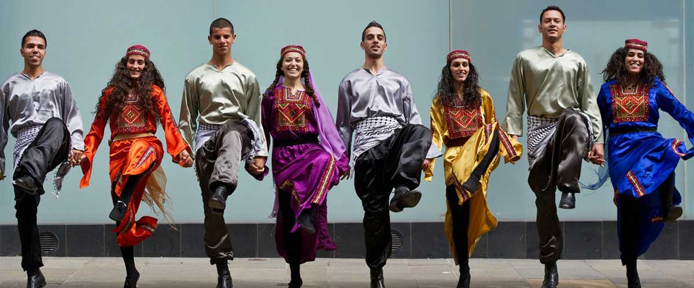
Dabke

Slide 4
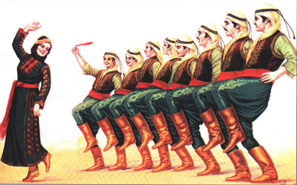
What is Dabke?
https://u.osu.edu/sellman.13/2021/05/01/dabke-dance-a-shared-tradition-of-the-levant/#:~:text=Dabke%20(also%20spelled%20as%20Dabka,Lebanon%2C%20Jordan%2C%20and%20Syria
Dabke is a joyful form of traditional line and circle dancing with origins in Middle Eastern Culture and Bedouin tribes.

Slide 5
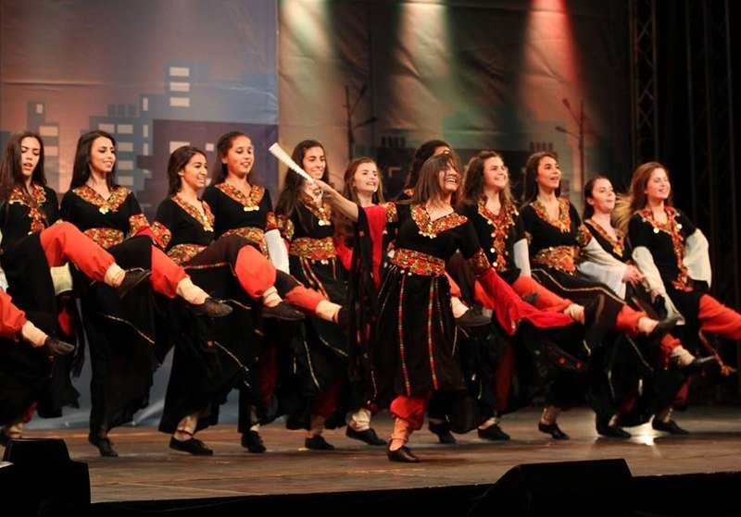
Where is Dabke practiced?
https://u.osu.edu/sellman.13/2021/05/01/dabke-dance-a-shared-tradition-of-the-levant/#:~:text=Dabke%20(also%20spelled%20as%20Dabka,Lebanon%2C%20Jordan%2C%20and%20Syria.
Dabke is an Arabic folk dance which originated in the mountains of the Levantine region. This region in the Middle East includes countries of Palestine, Lebanon, Jordan, and Syria.

Slide 6
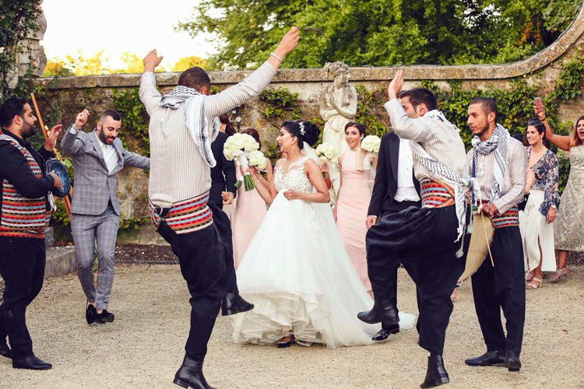
When is Dabke practiced?
https://www.wikihow.com/Dabke
Dabke is usually practiced at weddings or other joyous occasions.

Slide 7
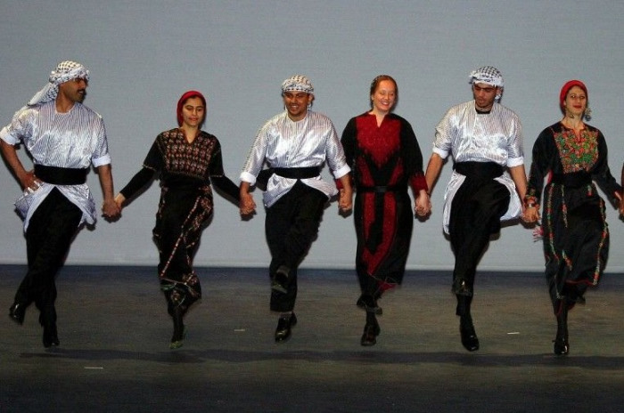
Who practices Dabke?
https://www.eatpitapita.com/all-about-dabke/
Dabke is usually practiced by a large group of people mainly from
Syria, Lebanon, Jordan, Palestine, Iraq and Turkey.

Slide 8
Why is Dabke practiced?
Dabke is practiced to signify hope, struggles, and history of the Palestinian people. Making it one of the most important cultural form of art in their culture.
https://u.osu.edu/sellman.13/2021/05/01/dabke-dance-a-shared-tradition-of-the-levant/

Slide 9
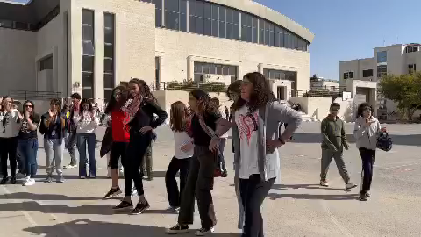
Dabke at NOS

Slide 10
Reflection
I have seen traditions from different perspectives.

Slide 11
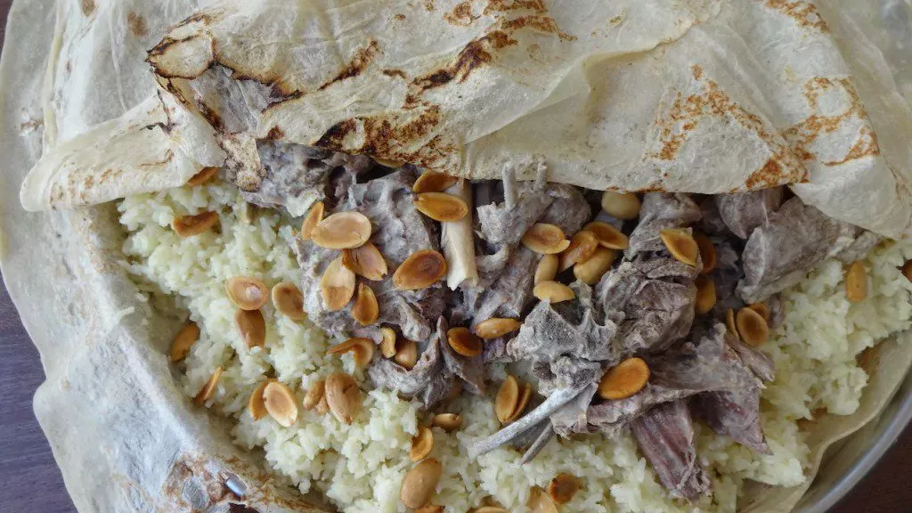
Mansaf

Slide 12
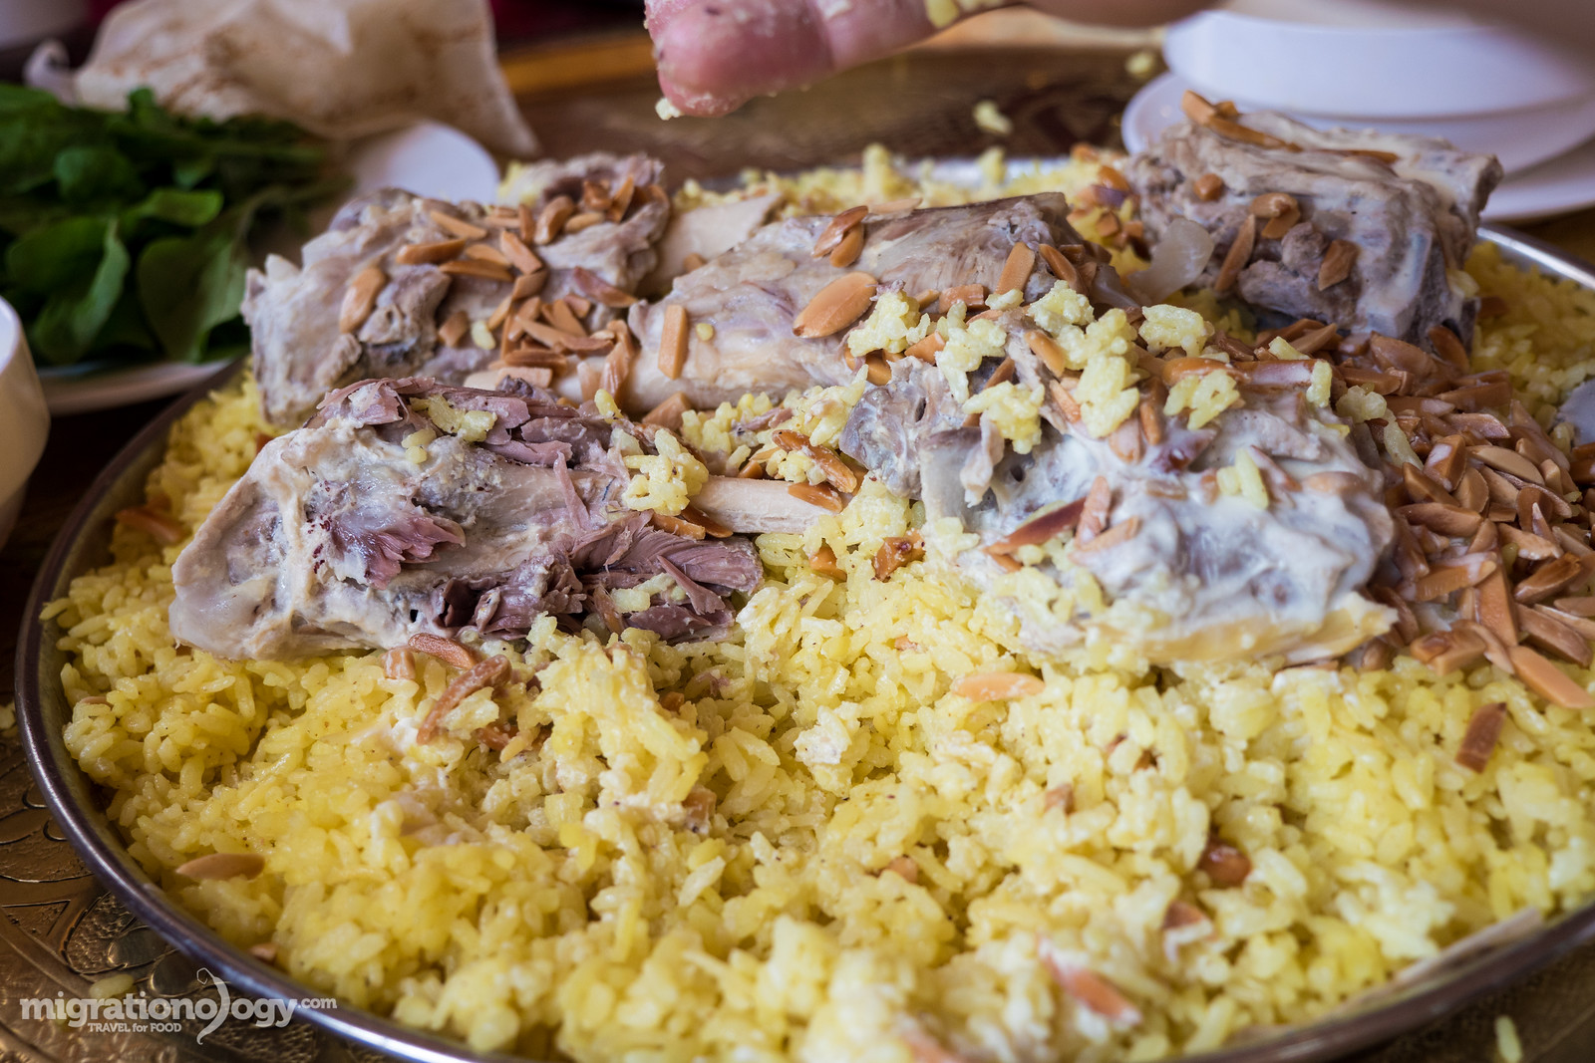
What is Mansaf?
https://en.wikipedia.org/wiki/Mansaf
Mansaf is a Jordanian traditional dish. Mansaf is made of lamb, rice, jameed and dried or fermented yoghurt.

Slide 13
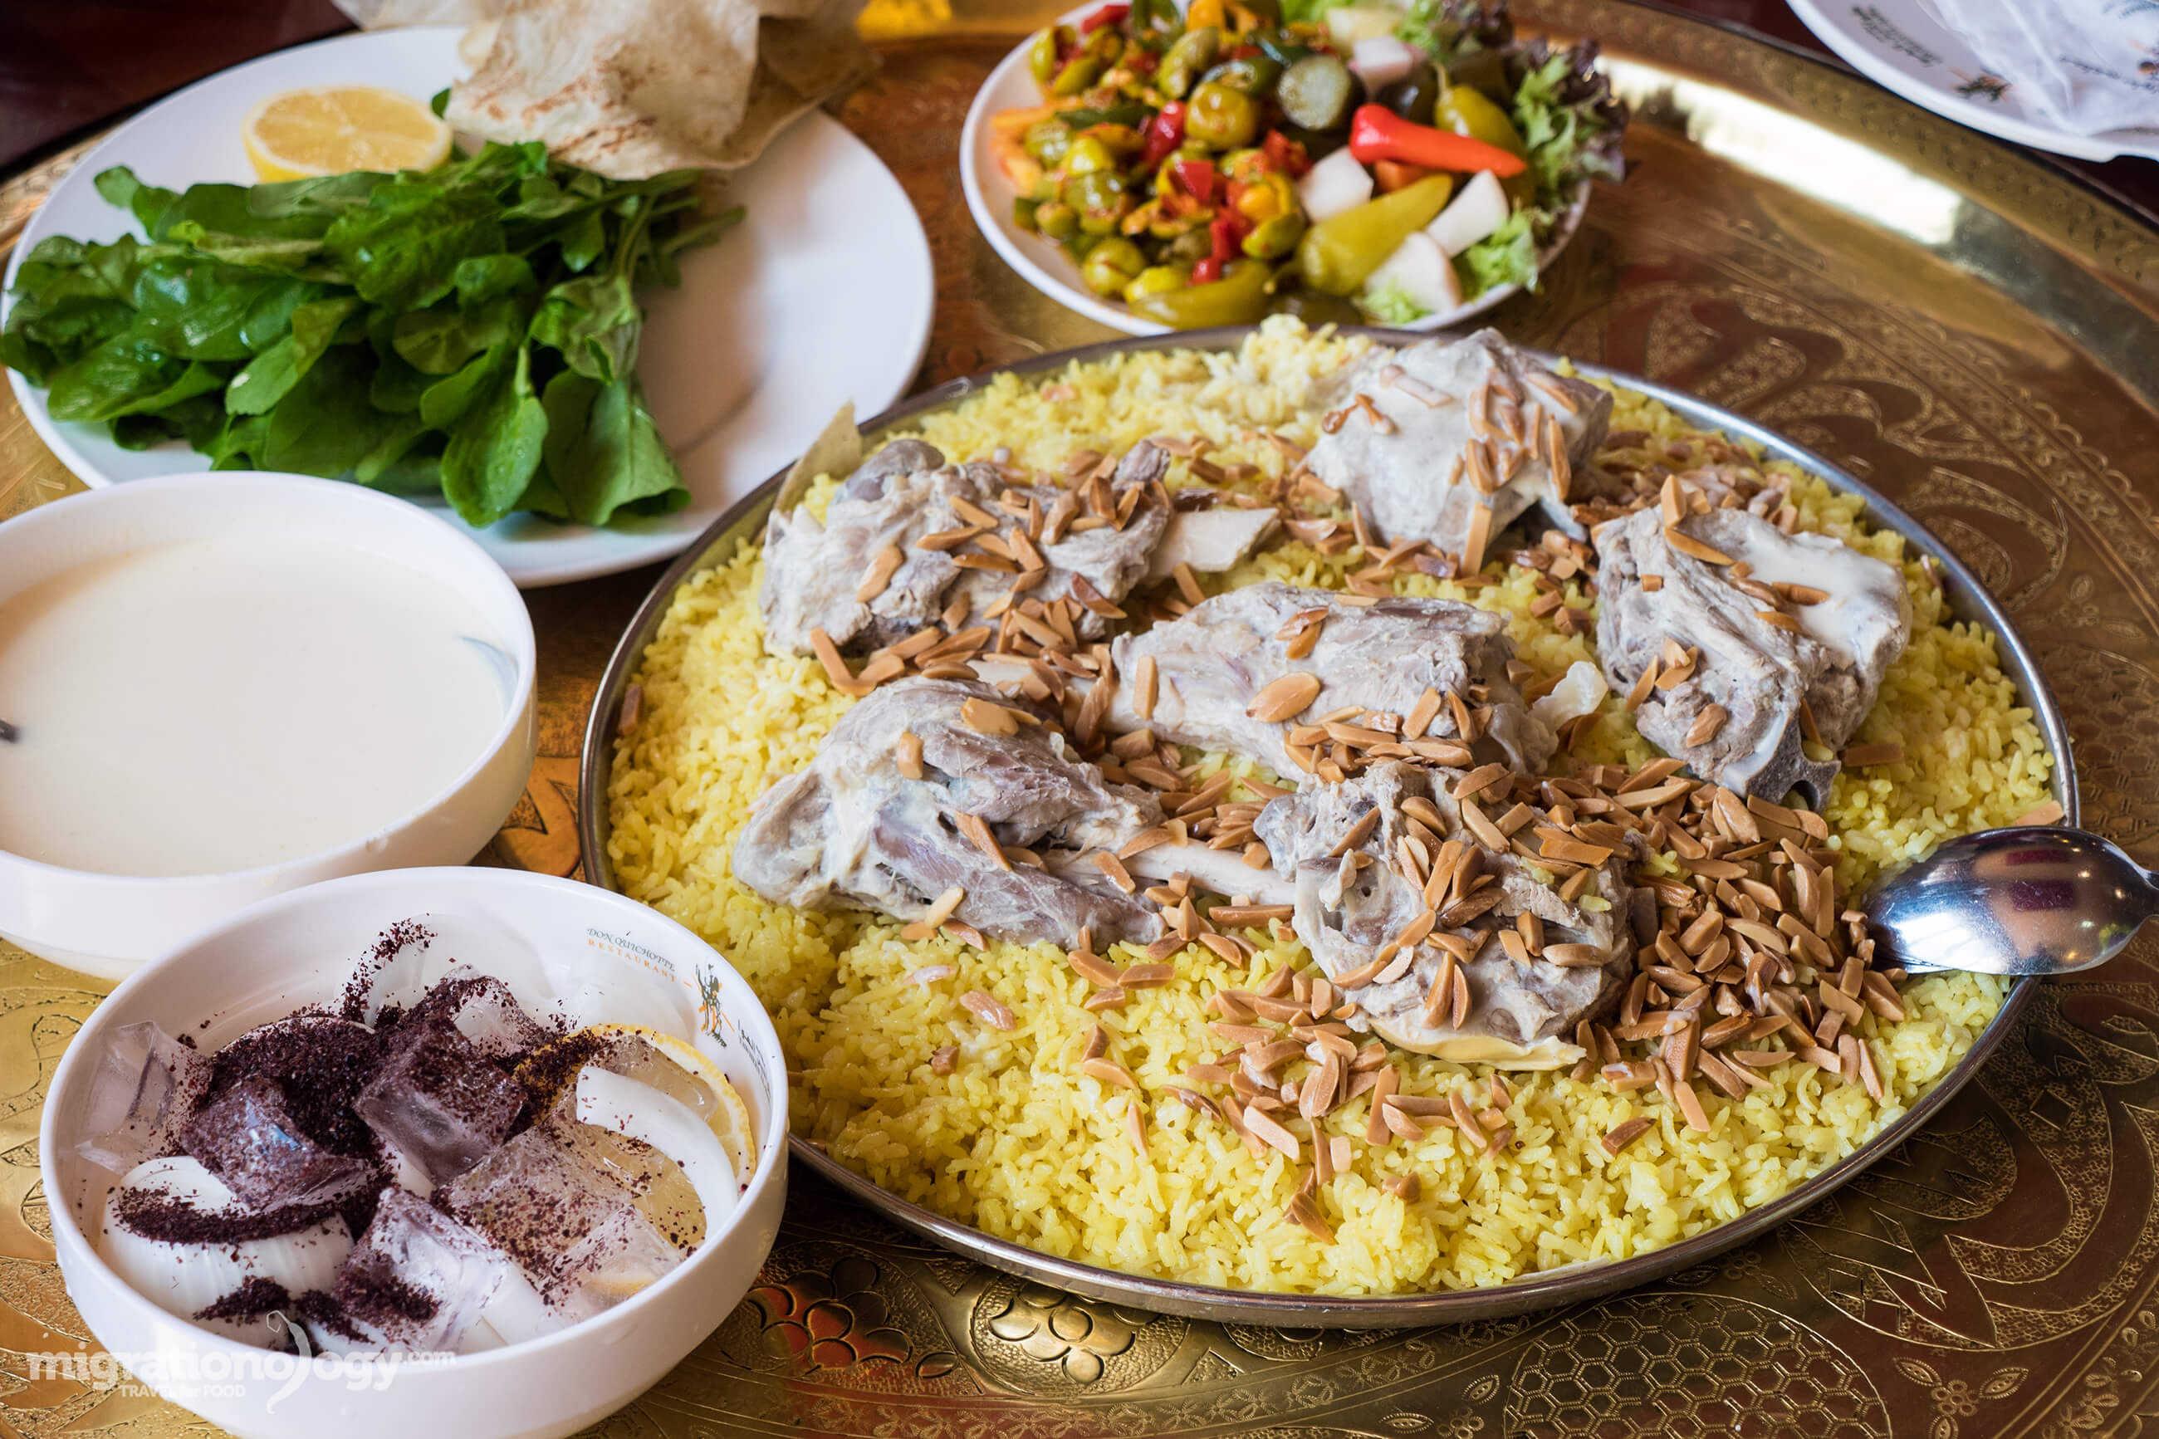
When do you eat Mansaf?
https://www.edseed.me/2020/10/09/the-most-famous-dish-in-jordan-186/#:~:text=Mansaf%20is%20the%20most%20distinctive,Independence%20Day%20on%20May%2015.
Mansaf is usually eaten at weddings, funerals, graduations or birth of a baby. It is also severed on holidays such as: Eid al-Fitr, Eid al-Adha, and national holidays such as the Jordanian Independence Day on May 25th.

Slide 14
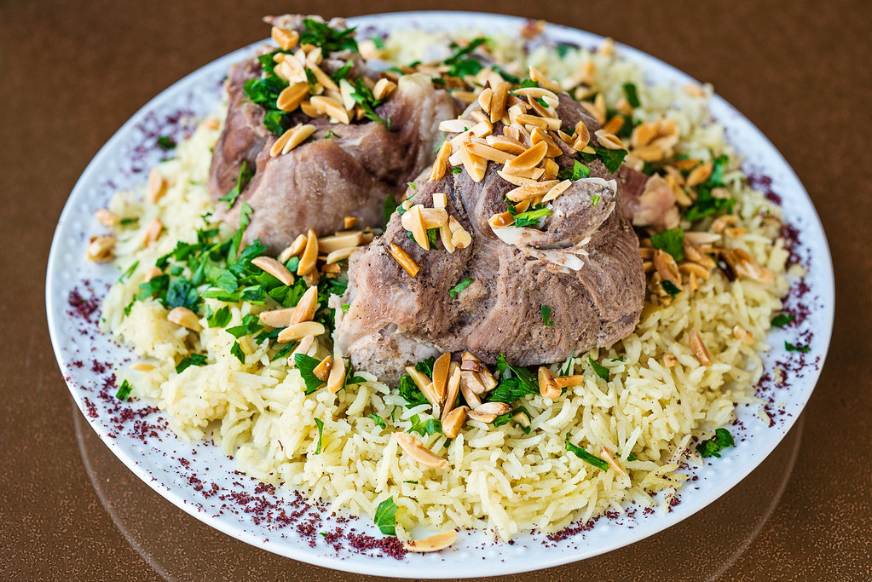
Where do you eat Mansaf?
https://en.wikipedia.org/wiki/Mansaf
Mansaf can be eaten in Jordan, Kuwait, Saudi Arabia and Syria.

Slide 15
Why do we eat Mansaf?
https://migrationology.com/mansaf-jordan/
It has been known to resolve conflicts and restore peace among tribes.

Slide 16
Reflection
I know that I have completed my idea about Mansaf. It’s a way to gather people together!

