Slide 1
dabke
Made by rakan qsous grade 6b

Slide 2
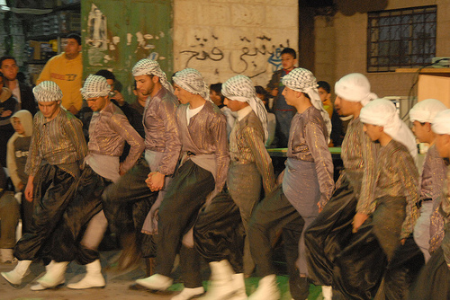
What’s a dabke?
a dabke is a joyful form of traditional line and circle dancing with origin in middle eastern culture

Slide 3
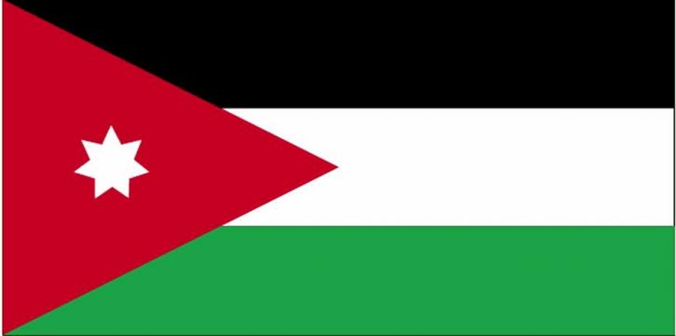
Where is the dabke done?
a dabke is preformed or practiced in the mountains of the levantine region this region in the middle east includes Jordan Palestine Lebanon and syria

Slide 4
When is the dabke preformed?
it’s usually preformed in weddings , special occasions , and family gatherings

Slide 5
Who preforms a dabke?
A dabke is practiced by the levantine countries and is preformed by a large group of people interlocking arms , taping and stomping with their feet and sing or chant

Slide 6
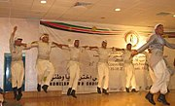
Why is a dabke preformed?
The dabke is preformed to share historical narratives and vibrant folk legacies

Slide 7
Mansaf

Slide 8
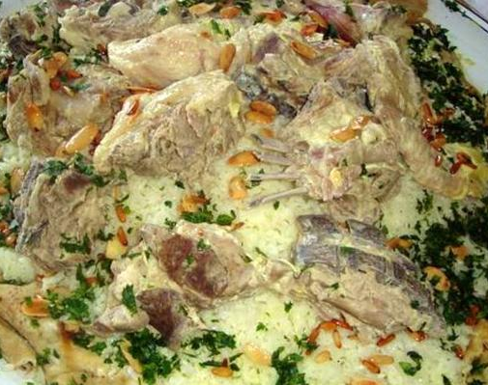
What’s mansaf?
Mansaf is a traditional Jordanian dish made of lamp cooked in a sauce of fermented dried yogurt and served with rice or bulgur

Slide 9

The end

