Slide 1
Jordan and it's traditions

Slide 2
Mansaf
You fly to Jordan right?
you think hm... I'm hungry.
You ask a Jordanian what should I eat I am very hungry
He say's eat our traditional dish Mansaf.

Slide 3
What is Mansaf?
Mansaf is a dish of rice, lamb, and a dry yoghurt made into a sauce called jameed.
It’s the most beloved Jordanian foods and it's also the tradional dish of Jordan.
Got this information from
https://migrationology.com/mansaf-jordan/

Slide 4
When or where is mansaf practiced?
It's practiced in homes and maybe partys
Got this information from https://migrationology.com/mansaf-jordan/

Slide 5
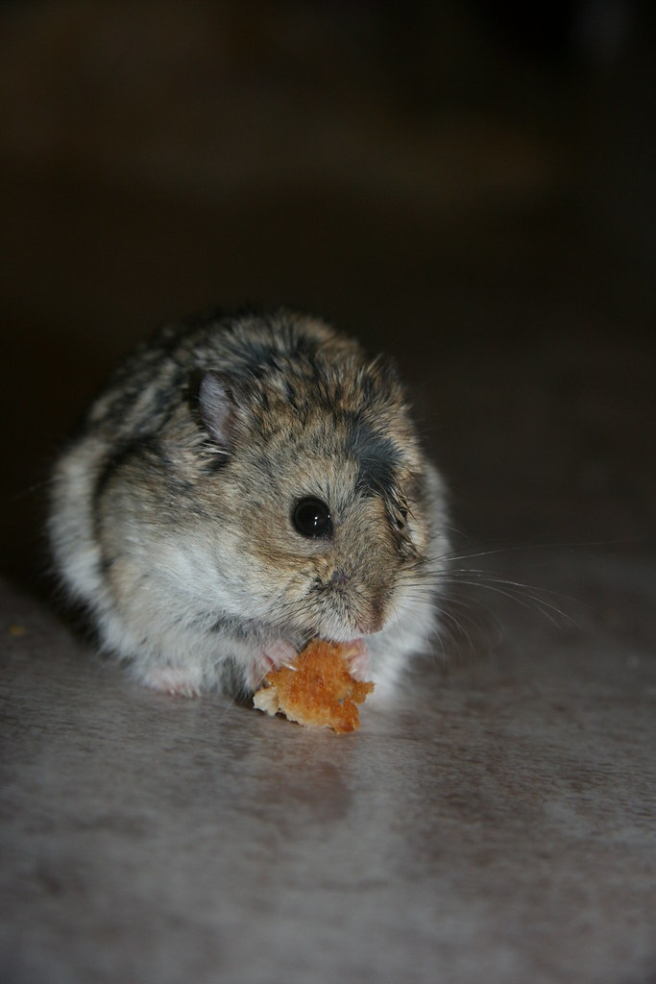
Who or why is this tradition practiced?
Jordanians practice this traditions of course!
Got this information from https://migrationology.com/mansaf-jordan/
Why do they practice it to make the dish as tasty as possible!!!

Slide 6
The second tradition is Dabkeh!!!!
You got a party invitation from you good old friend right? so you go there and you see a couple of people dancing hmm... what is that?
That looks surprisingly fun you go there and you start dancing and you ask what is that dance's name???
The person replies its Dabkeh!! Wohoooo!!!

Slide 7
What is Dabkeh
Dabkeh is a traditional Jordanian dance that is for party's and for fun
Got this information from https://u.osu.edu/sellman.13/2021/05/01/dabke-dance-a-shared-tradition-of-the-levant/

Slide 8
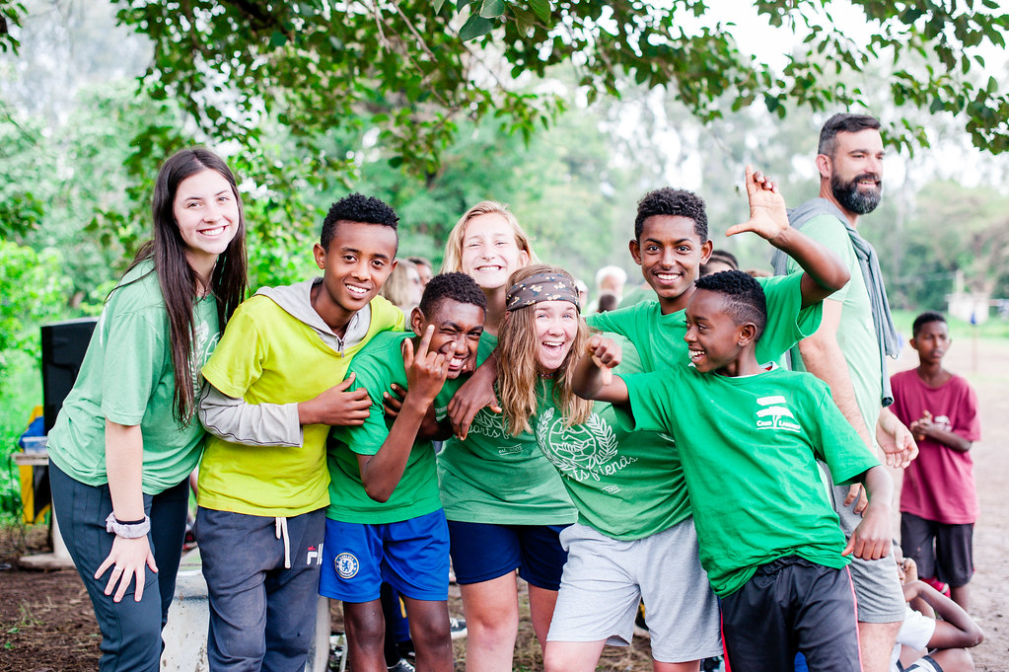
Where or when is this tradition practiced
Its practiced in normal friend inviting to their homes or you to invite friends.
Got this info from https://u.osu.edu/sellman.13/2021/05/01/dabke-dance-a-shared-tradition-of-the-levant/

Slide 9
Who/ why practices this tradition
The Jordanian people practice this dance and why you ask?
Because when they dance it they will be good at it or even better than most of the people!!
Got this information from https://u.osu.edu/sellman.13/2021/05/01/dabke-dance-a-shared-tradition-of-the-levant/

Slide 10
Thank you for all of your attention!!
Hope you liked it.

