Slide 1
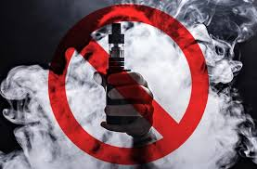
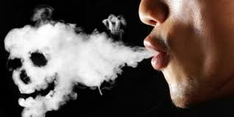
Vaping
By: Omar Goussous, Carla Hijazin, Hala Abu Baida, Yaseem Al Yousef, Sanad Al Halasa

Slide 2
Vaping
How can we stop the phenomenon of Vaping?
Is vaping less harmful or safer than smoking?
Are electronic cigarettes just as addictive as traditional ones?
How does vaping affect our lungs and other organs?
What is the effect of vaping on the environment?
Our campaign, is trying to focus on the risks of vaping by raising awareness and informing the individuals about how it can affect our lungs, heart and every organ in our body, on the other hand it can affect and poison our environment by releasing toxic chemicals, that eventually will have a bad impact on our health in the future.

Slide 3
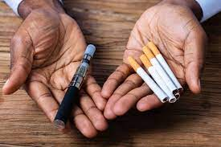
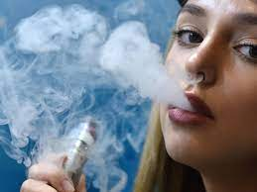
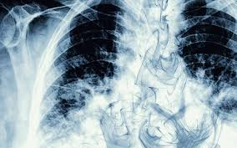
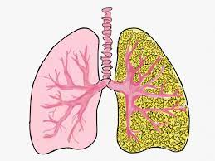

Slide 4
Who’s our audience
In our campaign we would like to focus mainly on our high school students, hence our survey has covered all the expected ages, although the results were exclusively among teenagers.

Slide 5
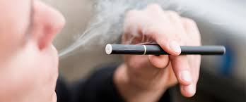
Vaping
Although vaping might be less harmful than smoking, but it is still not safe, as the electronic cigarettes heat nicotine (that is extracted from tobacco) mixed with flavors and other chemicals that you inhale.

Slide 6
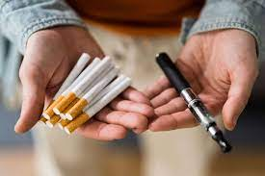
Vaping
In order to provide our campaign with rich information, as a result to help raise awareness, therefore we want to dig more into gathering facts and share them with our audience.
To begin with, we all have to know that electronic and regular cigarettes both contain nicotine that may be as addictive as heroin and cocaine, in addition users may get even more nicotine when buying extra strength cartridges which have higher concentration of nicotine.
Furthermore, a recent study found that most people who intended to use electronic cigarettes to quit smoking, ended up using both traditional and electronic cigarettes.

Slide 7
Our Big Problem is:
A New generation of youth is getting hooked on nicotine, according to the 2021 National Youth Tobacco Survey, as more than 2 million U.S. middle and high school students were reported using electronic cigarettes.
On the same manner, and according to the results of our survey, we discovered that the main group of vapers are among teenagers.
There are three reasons why teenagers prefer the electronic cigarettes:
1. They believe vaping is less harmful than smoking.
2. Electronic cigarettes cost cheaper than traditional ones.
3. Vaping has no bad smell, on the contrary, it has nice and a variety of flavors and above all, it reduces some of the stigma of smoking.

Slide 9
How does vaping affect our lungs and health?
There are many diseases caused by the habit of vaping, as a result of inhaling toxic chemicals that coat the lungs leading to several lung diseases, such as Bronchiolitis Obliterans (BO), which is also known as “Popcorn Lung” it might be a rare condition that damages the lungs and may also lead to permanent scarring in the smallest branches of the airways — popcorn lung — which makes breathing difficult. It has no lasting treatment. But, however, treatments manage the symptoms, such as:
Coughing
Wheezing
Chest pain
Shortness of breath

Slide 10
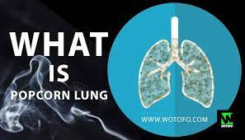
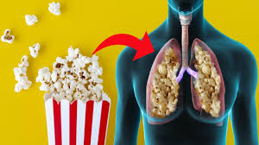
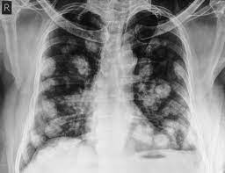
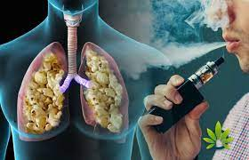

Slide 11
How does vaping affect our lungs and health?
Other diseases caused by the habit of vaping, is Lipoid Pneumonia that comes as a result of inhaling oily substances found in e-liquid cigarettes which spark an inflammatory response in the lungs. Symptoms of Lipoid Pneumonia include:
Chronic cough
Shortness of breath
Coughing up blood or blood-tinged mucus
However, there is no treatment for Lipoid Pneumonia, other than supportive care, or to leave the lungs heal on their own when identifying the cause and eliminate it.

Slide 12
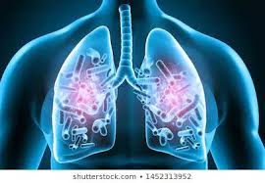
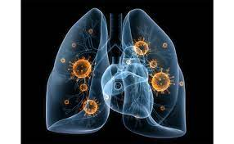
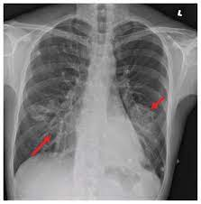
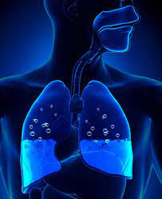

Slide 13
How does vaping affect our lungs and health?
Other than nicotine, vaping liquid may include other harmful substances including:
Cancer-causing chemicals
Heavy metals such as nickel, tin and lead
Flavorings such as diacetyl, a chemical linked to lung disease
Volatile organic compounds
Ultra-fine particles that can be inhaled deep into the lungs
Moreover, this can lead to lung cancer, which can lead to death.

Slide 14
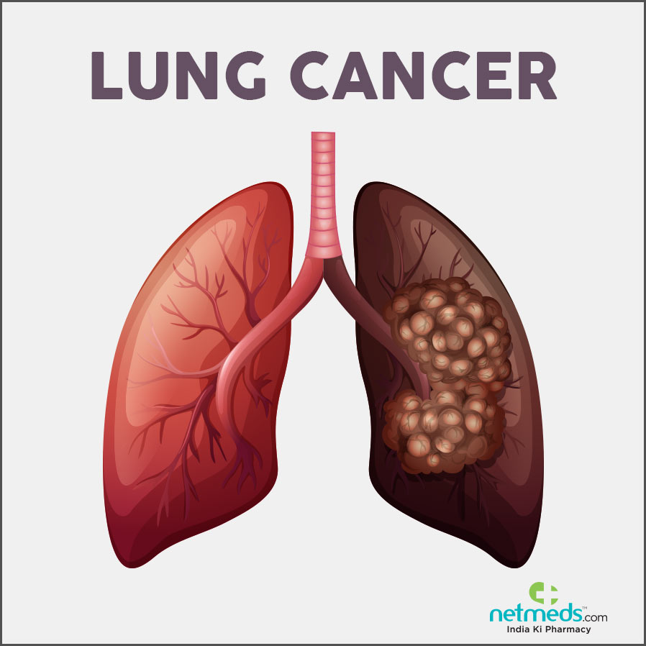
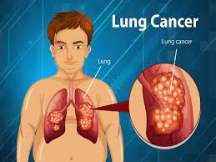
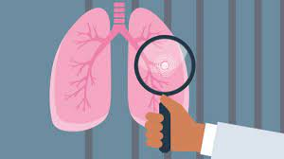
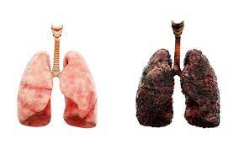

Slide 15
How does vaping affect our lungs and health?
According to 2018 National Youth Tobacco Survey (NYTS) data, 3.6 million children in middle school and high school use e-cigarettes.
While according to our survey, 53.3% of males within the years of 10 – 15 years old were considered vapers as a percent of 66.7%, followed by the fact that 42.1% were vaping for 1 – 12 months.
Hence, using e-cigarettes are not limited among adults, but teenagers as well.

Slide 16
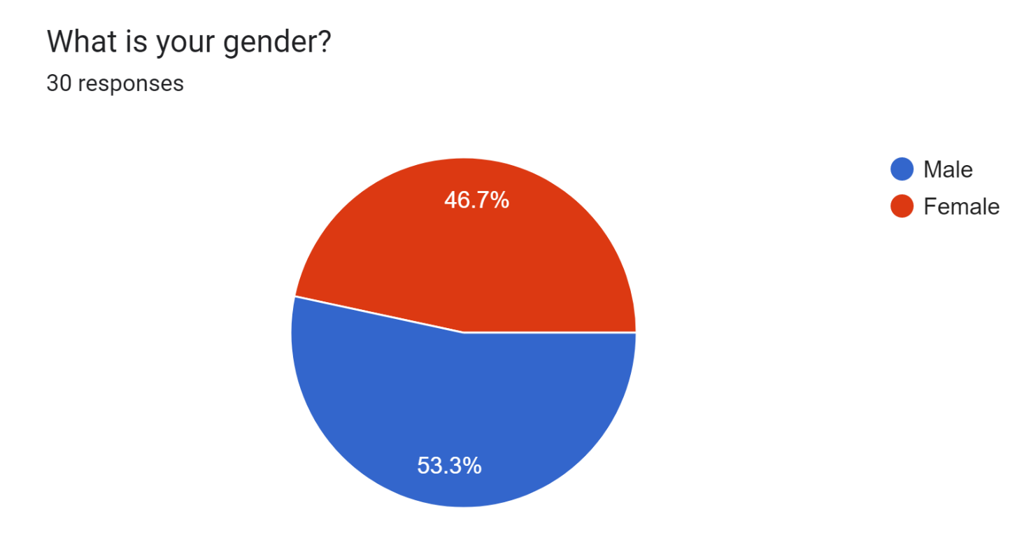
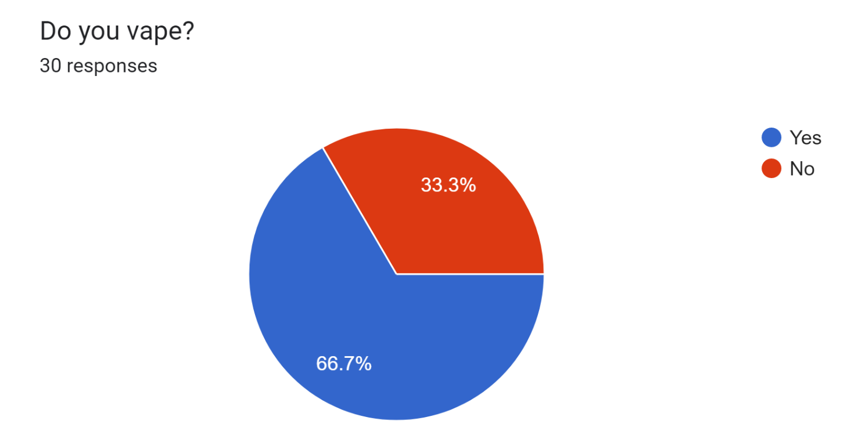
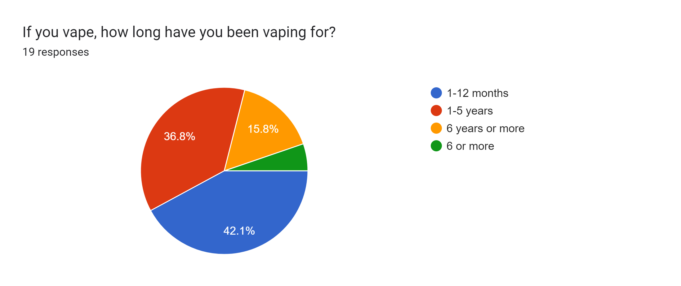

Slide 17
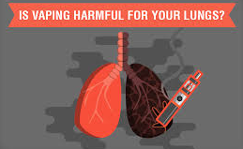
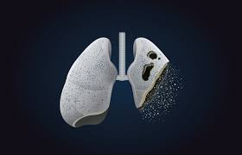
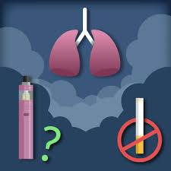
How does vaping affect our lungs and health?
Following the rise of e-cigarette used among middle school and high school students, where this bad habit might lead to many diseases other than the ones mentioned before, such as:
Lung disease (Pneumoconiosis)
Rapid Heart rate (Tachycardia)
Chest pain (Angina pectoris)

Slide 18
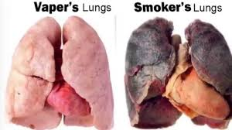
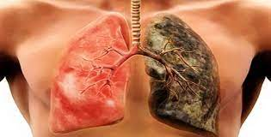
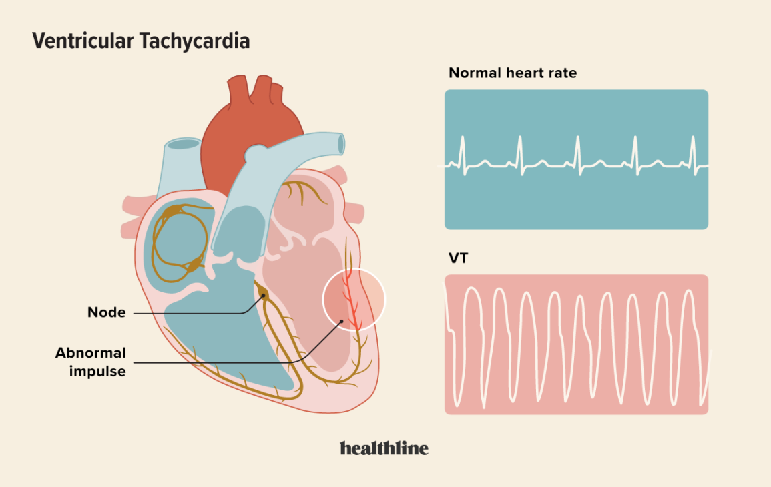
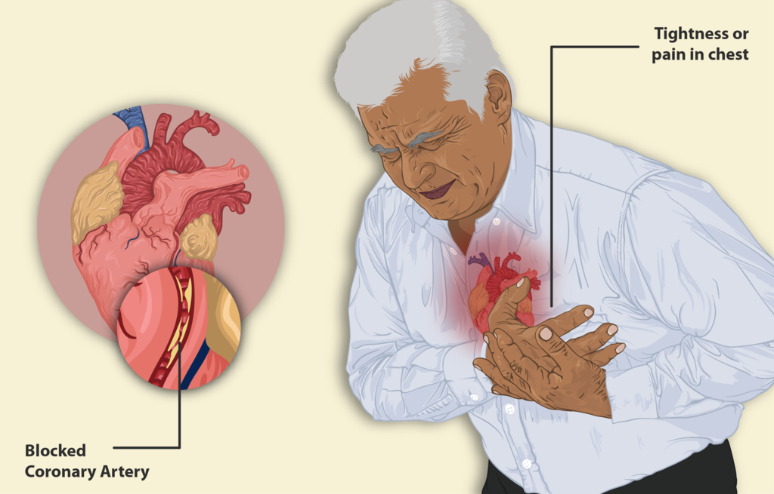

Slide 19
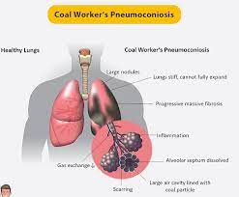
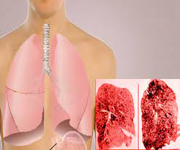
How does vaping affect our lungs and health?
Lung disease (Pneumoconiosis)
Breathing in the dangerous compounds from vaping devices can result in Pneumoconiosis, yet in some cases can lead to death. Certain chemicals found in vaping products have also been linked to the development of cancer and cardiovascular diseases.

Slide 20
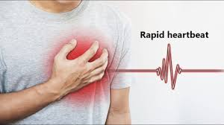
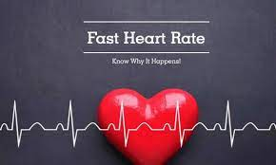
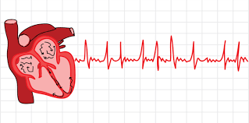
How does vaping affect our lungs and health?
Rapid Heart rate (Tachycardia)
Occurs when the heart beats more than 100 times per minute, whereas the range of normal heart beat is between 60 – 80 times per minute. The sensation that your heart is beating or fluttering faster than usual is a sign that you have a rapid heartbeat.

Slide 21
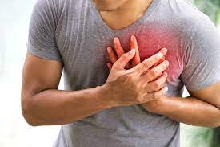
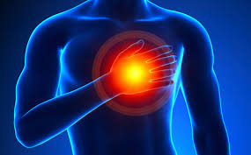
How does vaping affect our lungs and health?
Chest Pain (Angina pectoris)
Feels like anything from a dull ache to a sharp stabbing.
Chest pain can occasionally feel crushing or burning. Sometimes the pain starts in the jaw and moves down the neck before spreading to the back or down one or both arms.

Slide 22
How does vaping affect the environment?
Vapes harm our environment in many ways, such as:
The improper way of getting rid of disposable vaping pen batteries may be contributing to contamination (toxic waste from batteries), since there is no legal way to recycle these products.
E-cigarettes can release nicotine in the environment which pollutes the air we breathe.
Besides the nicotine, e-cigarettes can leak heavy metals, volatile organic compounds and ultrafine articles that can be inhaled deeply into the lungs leading to many diseases.

Slide 23
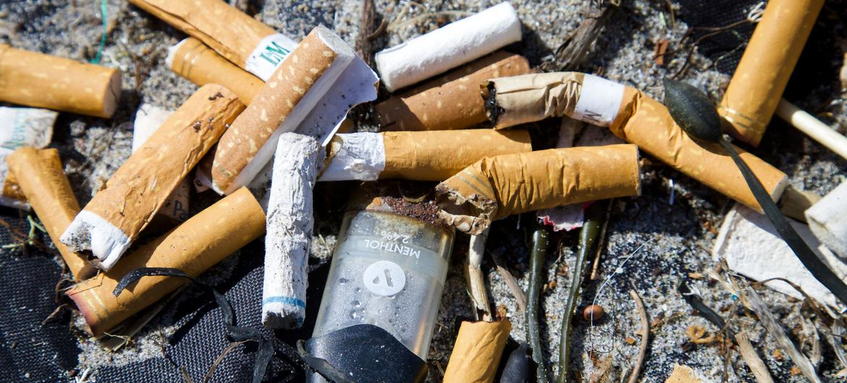

Slide 24
How can we help stop the youth from vaping?
Regarding all the information listed above, we tried to raise awareness among young teens to stop this bad habit, we would like to add some tips to help quit vaping, taking into consideration that many people fail to quit this bad habit from the first time, but most of all, remember to be very patient.
By surrounding yourself with supportive people, like friends and family, it might make it easier to quit vaping, because being surrounded by people you like might boost your mood and distract you from thinking about vaping.
You have to keep in mind that nicotine affects the development of your brain other than the addiction that it causes.

Slide 25
How can we help stop the youth from vaping?
Vaping is dangerous, as it exposes users to dangerous particles, chemicals and to nicotine.
Whereas nicotine is highly addictive and can be a “gateway” to other addictive drugs. In addition to the severe cases of lung illnesses and heart diseases that are linked to vaping.
Encourage yourself to have a plan and keep all your time busy with sports or other activities to distract yourself.
Finally, you may also ASK FOR HELP from a health care provider who can suggest some programs to help teenagers get rid of the habit.

Slide 26
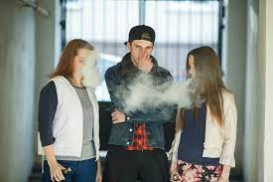

Slide 27
Survey
https://docs.google.com/forms/d/11LT7REm-gFLBvWogYy1H3ImQBmzJfF7eJ4cD2fBqnH8

Slide 28
Resources
https://www.hopkinsmedicine.org/health/wellness-and-prevention/5-truths-you-need-to-know-about-vaping
https://www.hopkinsmedicine.org/health/wellness-and-prevention/what-does-vaping-do-to-your-lungs
https://www.webmd.com/connect-to-care/vaping/what-is-vaping
https://medlineplus.gov/lungdiseases.html#:~:text=The%20term%20lung%20disease%20refers,can%20lead%20to%20respiratory%20failure.
https://www.mayoclinic.org/diseases-conditions/tachycardia/symptoms-causes/syc-20355127#:~:text=Tachycardia%20(tak%2Dih%2DKAHR,as%20a%20response%20to%20stress.
https://www.mayoclinic.org/diseases-conditions/chest-pain/symptoms-causes/syc-20370838
https://www.undo.org/environmental-impact/vape-waste-is-toxic-waste
https://healthy.ucdavis.edu/smoke-tobacco-free/vaping-campaign/environmental
https://utswmed.org/cancer/community-outreach/join-a-conversation/beating-nicotine-together/how-to-quit-vaping-teen/

Slide 29
Thanks For Listening!

