Slide 1
Drinking alcohol and smoking
By: Sanad Kakish, Saif jumaian, Odeh Dababneh, Raad Azar

Slide 2
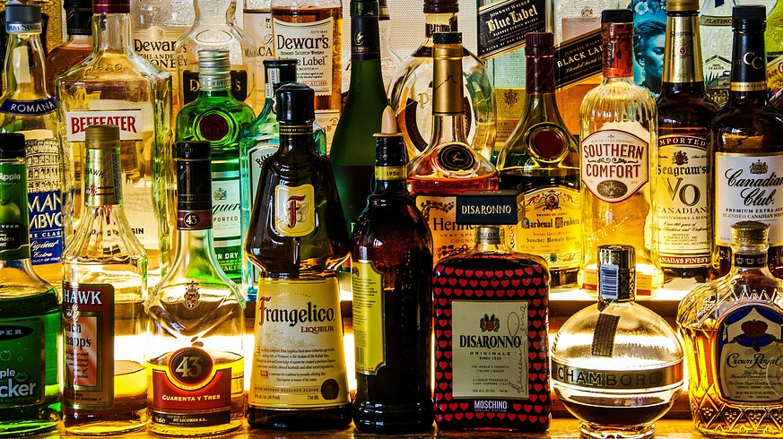
What is (AUD)?
Alcohol use disorder (AUD) is a condition characterized by an impaired ability to stop or control alcohol use despite adverse social, occupational, or health consequences. It is a spectrum disorder and can be mild, moderate, or severe and encompasses the conditions that some people refer to as alcohol abuse, alcohol dependence, or the colloquial term, alcoholism.

Slide 3
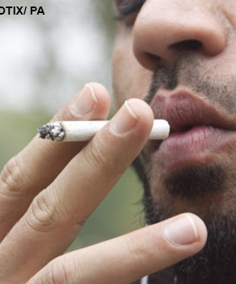
What is smoking?
Smoking is the act of inhaling harmful stuff into the lungs and exhaling it and some of the things are tar nicotine and tobacco and other toxic chemicals. smoking also harms everybody at any age whether you start when you are young or old and it causes diseases in the heart and almost evert organ in the body.

Slide 4
What are the effects of alcohol?
Unstable moods: people that drink can not control their moods if they are sad or happy.
Weak memory: drinking can damage your brain and can cause to Alzheimer.
Slurred speech: having trouble speaking or pronouncing words properly.
Liver cancer: cancer tissues can build up your liver.

Slide 5
What are the effect of smoking?
Lung cancer: cancer tissues can build up your lungs.
heart disease: damages your heart and blood.
Stroke: smoking can block blood vessels in the brain.
Bronchitis: infection of the main airways of the lungs (bronchi).
Diabetes: Your body breaks down most of the food you eat into sugar (glucose) and releases it into your bloodstream.

Slide 6
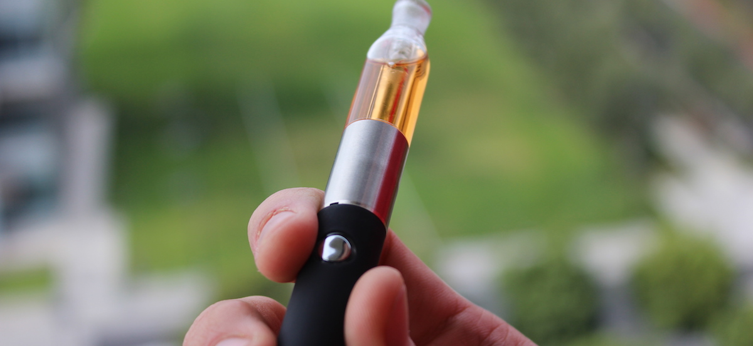
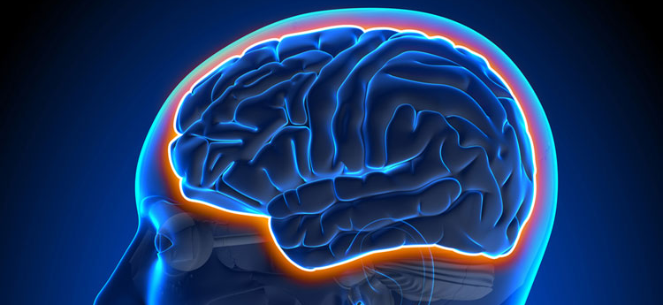
What make alcohol and smoking addictive?
Nicotine is a highly addictive chemical found in cigarettes, chewing tobacco and vaping products.
Alcohol and other drugs flood our brain with reward chemicals like dopamine. Long after our last drink, our brains and memories still associate drinking with this flood of reward.

Slide 7
How can the country help quitting smoking and alcohol?
There are national centers in the middle east to help addiction such as drinking, the cure is helpful but expensive for some people.
King Hussain cancer center gives the doctors a 5-day course for them to cure smokers.

Slide 8
THANK YOU FOR LISTENING

Slide 9
Cross checking:
https://www.niaaa.nih.gov/publications/cycle-alcohol-addiction.
https://www.britannica.com/topic/smoking-tobacco.
https://www.cdc.gov/tobacco/basic_information/health_effects/index.htm#:~:text=Smoking%20causes%20cancer%2C%20heart%20disease,immune%20system%2C%20including%20rheumatoid%20arthritis.
https://www.hss.gov.nt.ca/en/services/health-effects-tobacco/nicotine-it%E2%80%99s-why-smoking-so-addictive#:~:text=Nicotine%20is%20a%20highly%20addictive,so%20hard%20to%20quit%20smoking.
https://www.mayoclinic.org/diseases-conditions/alcohol-use-disorder/symptoms-causes/syc-20369243
https://www.health.gov.au/health-topics/smoking-and-tobacco/about-smoking-and-tobacco/what-is-smoking-and-tobacco
https://www.health.gov.au/health-topics/smoking-and-tobacco/about-smoking-and-tobacco/what-are-the-effects-of-smoking-and-tobacco
https://adf.org.au/drug-facts/nicotine/

